Slide 1

What is a war memorial?

Slide 2
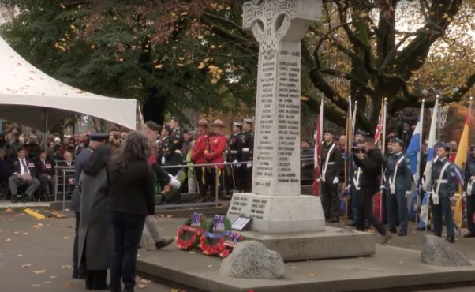
What is happening?
Who is being remembered?
How do you know?
Remembrance Day Ceremony 2024 | Richmond, British Columbia
Image: City of Richmond

Slide 3
What is a war memorial?
A war memorial is anything created to honour and remember people who died as a result of their military service.
A war monument is a statue, building, or structure that honours people who served or marks an important battle or event.
Sometimes a tribute can be both
  The Vimy Memorial honours all Canadians who served in the First World War, marks a battle site, and lists names of those who died in France with no known grave.
  The Afghanistan Monument honours all Canadians who served in Afghanistan and lists the names of those who died.

Slide 4
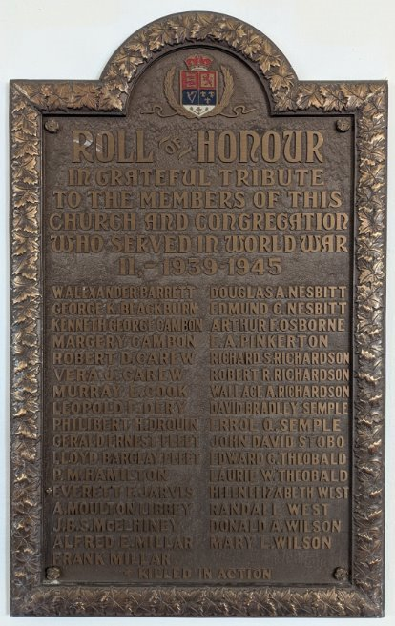
What do they look like?
More than 6,000 Canadian war memorials have been documented in Canada – and many more exist here and around the world!​​
They could be local, national or international.
They come in many shapes, sizes and forms and are often unique pieces of art.
Some are statues or monuments while others might be schools, streets, paintings or books.
Although many were created after the First and Second World Wars, Canadians continue to dedicate new memorials today.
Second World War Plaque in a Baptist Church | Quebec City, QC​
Photograph by: Sara Battle

Slide 5
Every memorial tells a story
They lend a voice to the fallen. All of them were someone’s son, daughter, husband, wife, family or friend.
They remind us of our shared past. Victories and losses that changed the course of history and the lives of those who served.
Today, we will learn their stories by seeing the story they tell visually and researching their history.

Slide 6
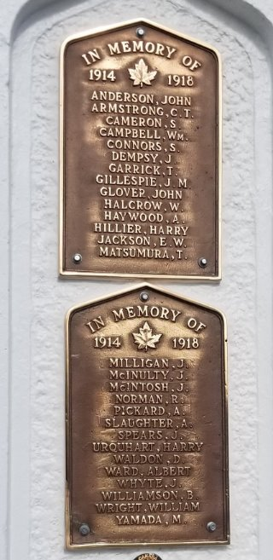
Examine
Study the assigned photos.​
What do you notice about how a memorial was made, its text or other details? ​
What do you wonder about the memorial?
Memorial Arch, Royal Canadian Legion Branch 28 | Cumberland, BC
Image: Cumberland Museum & Archives

Slide 7
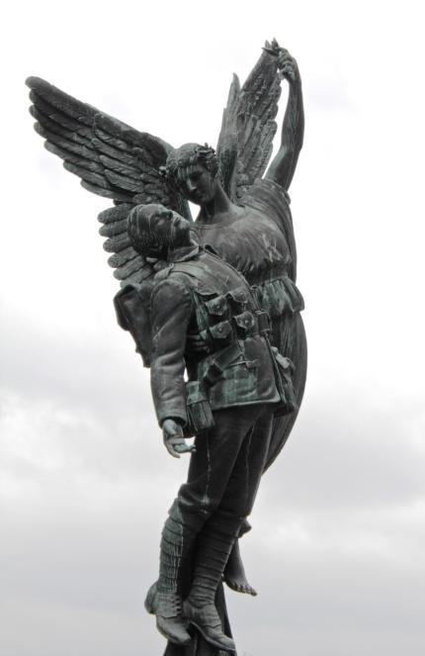
Identify
What does each element symbolize?​​
What materials were used to build it?
Where is the memorial located and why?
Canadian Pacific Railway Station ​Memorial | Vancouver, BC
Image: City of Vancouver

Slide 8
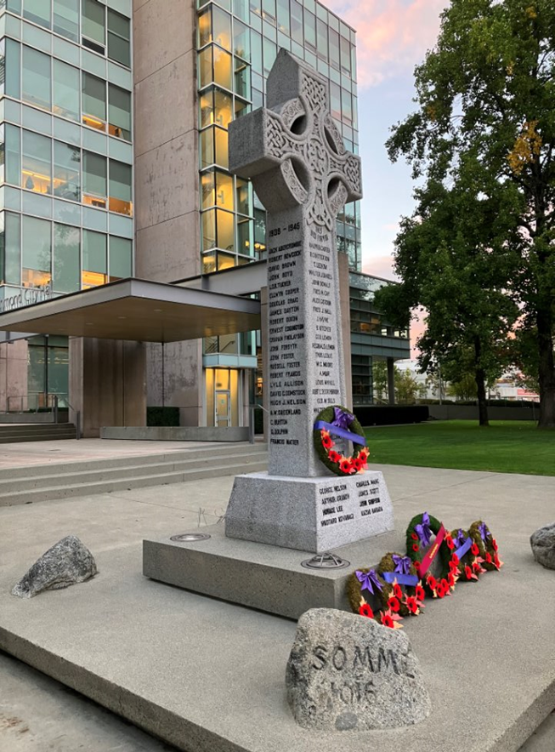
Analyze
What kinds of war memorials exist in Canada?
When and why were they created?
Who built them?
How have war memorials changed over time?
Richmond Cenotaph | Richmond, BC
Photograph by Debbie Jiang

Slide 9
Think like a historian…
Select one of the memorials in this presentation or choose another by searching our memorials database.

Slide 10
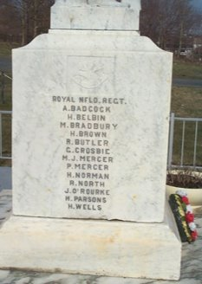
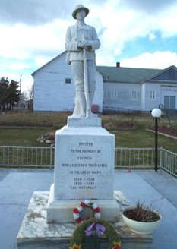
Bay Roberts Cenotaph
Bay Roberts, Newfoundland
Honours local men who died in service during the First and Second World Wars.​​
ERECTED IN THE MEMORY OF THE MEN WHO LAID DOWN THEIR LIVES IN THE GREAT WARS
1914-1918
1939-1945​
"LEST WE FORGET"​​
Image: Bay Roberts Cenotaph (Veterans Affairs Canada
More information:
Bay Roberts Cenotaph (Veterans Affairs Canada)

Slide 11
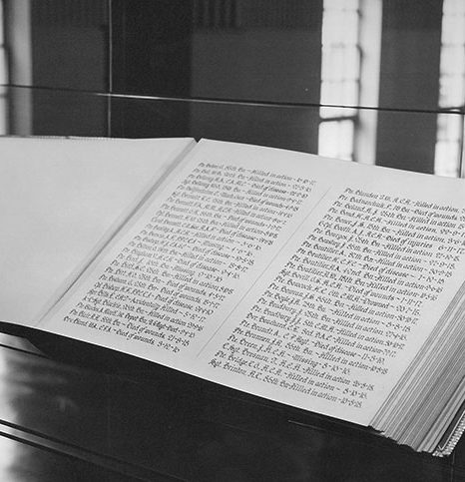
Great War Book of Remembrance
Halifax, Nova Scotia
Honours men and women from Halifax County who died in service during the First World War.
Lists the names, date and cause of death for each person.
Lettering was created by Nova Scotian book illuminator, Henry Perley Bernasconi.
Two other books honour locals who died:
  during the Second World War and Korean War
  since 1953
More information and photos:
Great War Book of Remembrance (Veterans Affairs Canada)
Image: City of Halifax

Slide 12
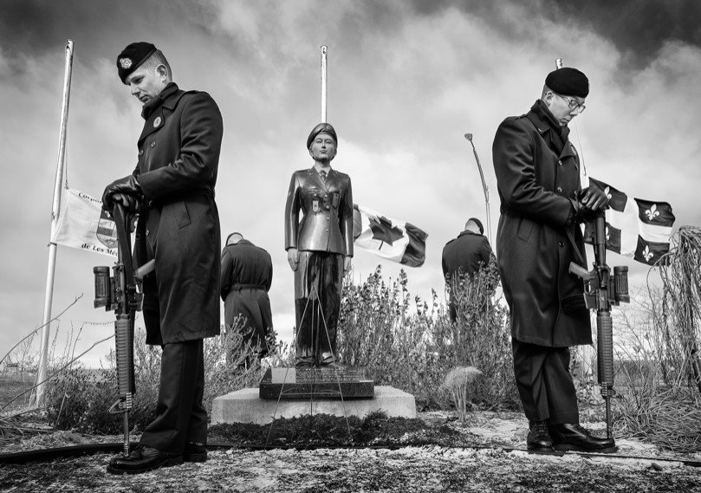
Karine Blais Memorial
Les Méchins, Quebec
Honours Corporal Karine Blais who lost her life in Afghanistan in 2009.
Karine joined the military at 18. She was 21 when she was killed by a roadside bomb near Kandahar, Afghanistan.
Her community, with support from her regiment, created a statue, flags, benches, and a memorial plaque along the St. Lawrence River to honour her memory.
Corporal Karine Blais Memorial
More information:
Corporal Karine Marie Nathasha Blais (CVWM - Veterans Affairs Canada)
Corporal Karine Blais Monument (Veterans Affairs Canada)

Slide 13
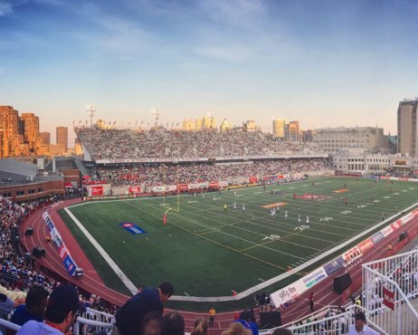
Percival Molson Memorial Stadium
Montreal, Quebec
The stadium at McGill University was named in honour of Captain Percival Molson. ​
Percy was a top athlete and graduate of the school. ​He was also a member of the wealthy Molson family.
He died on July 5, 1917 during fighting on the outskirts of Vimy Ridge.
Left $75,000 to McGill in his will to pay for most of the stadium’s construction.
More information:
Percival Molson Stadium (Veterans Affairs Canada)
Captain Percival Molson (Canadian Virtual War Memorial)
Image: McGill University Archives
Notes:
Image: McGill University

Slide 14
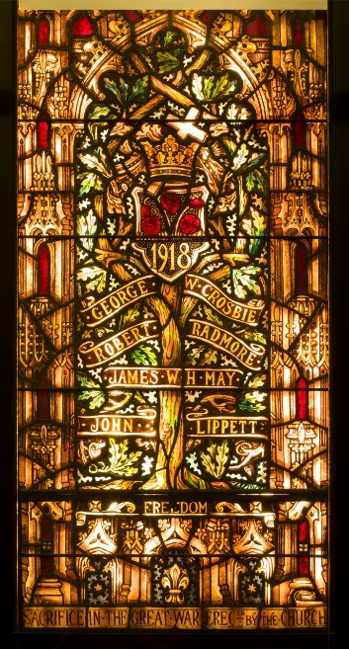
Welcome Zion stained glass window
Ottawa, Ontario
Honours four fallen congregation members from the Welcome Zion Congregational Church in Ottawa.
After the First World War, many communities created stained‑glass memorial windows for churches and public buildings. ​
This one remembers:
  George W. Crosbie
  Robert Radmore
  James W. H. May
  John Lippett
The window was moved to the Canadian War Museum after the church closed in 1941.
More information and photos:
Welcome Zion Church Memorial Window (Veterans Affairs Canada)
Stained Glass Window (Canadian War Museum)
Image: Canadian War Museum

Slide 15
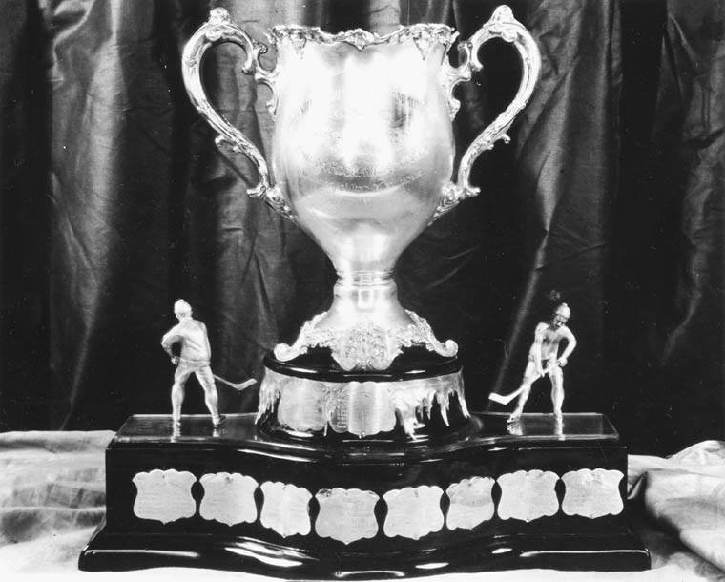
Memorial Cup Trophy
Honours hockey players who served and died in the First World War, especially those from the Ontario Hockey Association.
Many players enlisted and more than 30 Canadian hockey players were killed in the war.
The cup was first awarded in 1919.
Still awarded today to the champion
of the Canadian Hockey League.
More information and photos:
Memorial Cup (The Canadian Encyclopedia)
Image: Canadian Hockey League

Slide 16
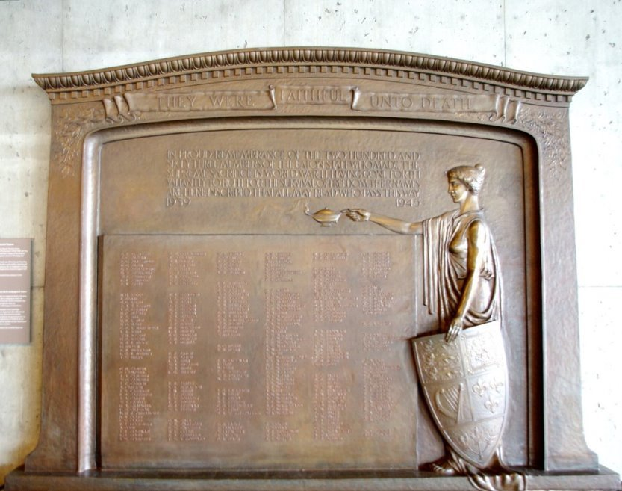
T. Eaton Company Memorial Plaques
Toronto, Ontario
Honours Eatons employees who died in the Second World War.
Unveiled on November 11, 1948 and originally displayed inside Eaton’s department store.
Later donated by the Eaton Family to the Canadian War Museum
“They were faithful unto death. In proud remembrance of the two hundred and sixty-three members of the Eaton staff who made the supreme sacrifice in World War II, having gone forth valiantly to fight for the survival of freedom. Their names are here inscribed so that all may read who pass this way.” ​
More information and photos:
T. Eaton Company Memorial Plaques (Veterans Affairs Canada)
Memorial plaque their name liveth forevermore (Canadian War Museum)
Image: Canadian War Museum

Slide 17
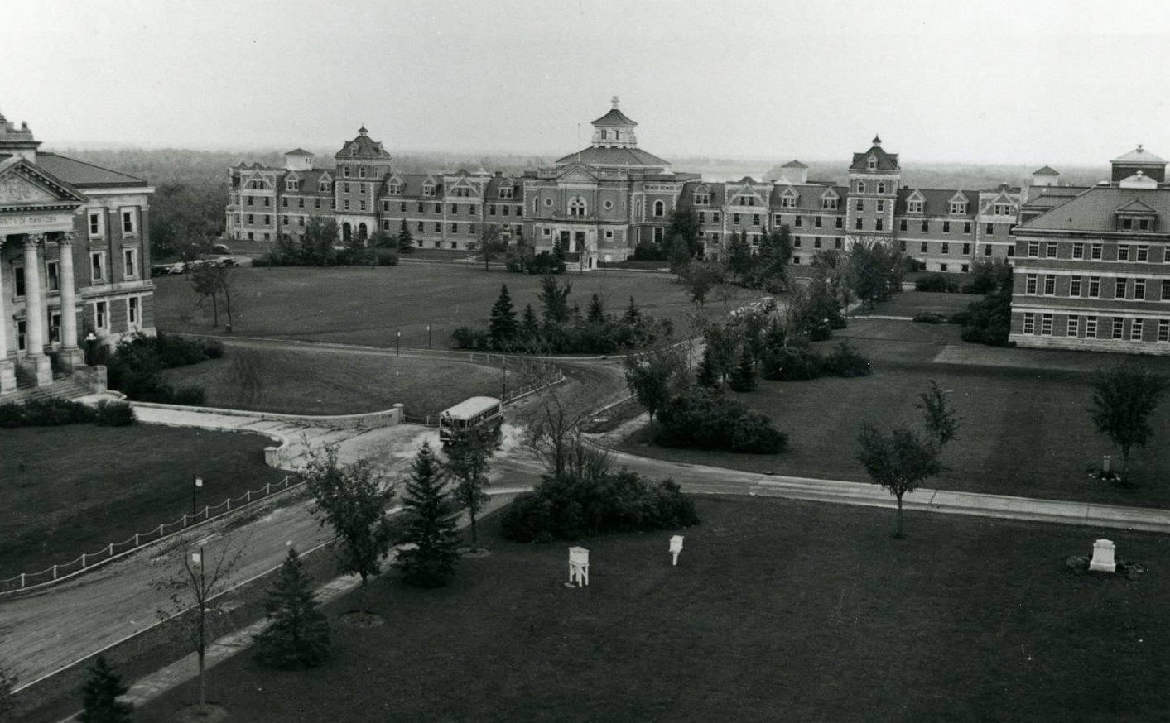
Avenue of Elms
Winnipeg, Manitoba
Honours students from the Manitoba Agricultural College who died in the First World War.
On November 11, 1923, the college unveiled a granite memorial at the end of a mile-long avenue of elm trees.​
The University of Manitoba continues to actively maintain the trees and memorial.
About 55% of the elms have been replaced over the years.
Image: Avenue of Elms
More information and photos:
Avenue of Elms (Veterans Affairs Canada)

Slide 18
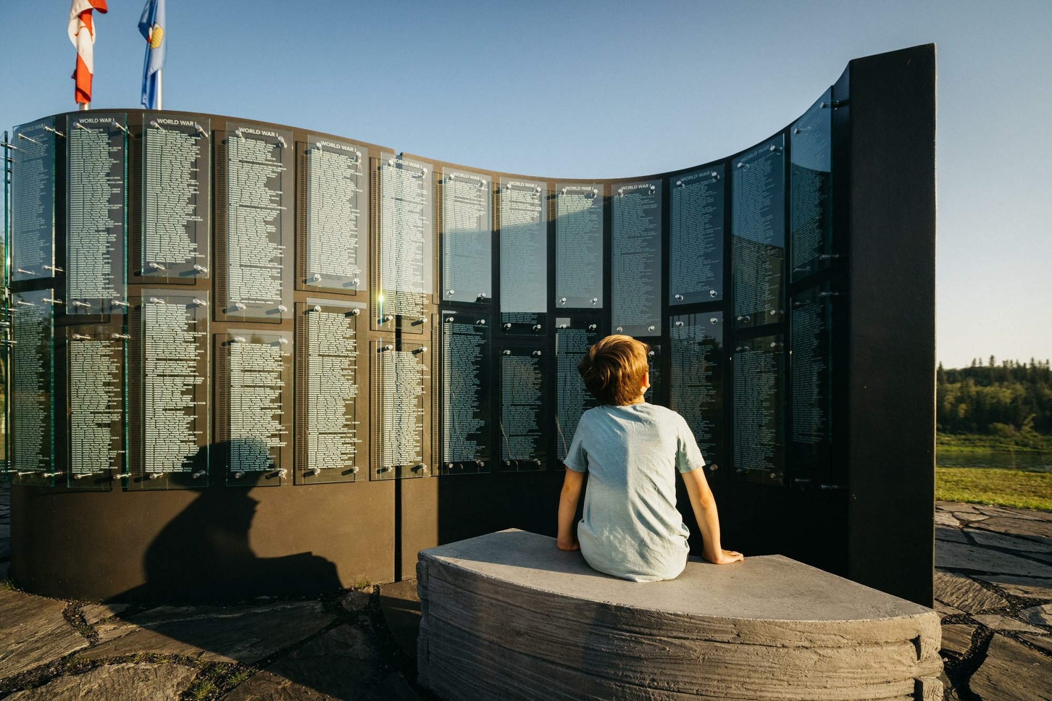
Métis Crossing Veteran’s Monument
Smoky Lake, Alberta
Honours the service and sacrifice of Métis peoples across their military history.
The monument’s shape is modeled on a traditional Métis sash.
Includes panels about Métis military history starting with the Battle of Seven Oaks in 1816 through to modern missions.
Glass panels listing the fallen can be recycled when they are updated in the future.
Unveiled on August 21, 2021.
Image: Cooper and O’Hara
More information and photos:
Métis Crossing Veteran’s Monument (Veterans Affairs Canada)

Slide 19
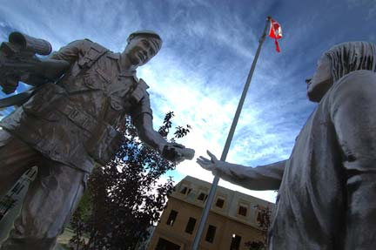
Peacekeepers Park
Calgary, Alberta
Honours Canadian peacekeepers and peace support personnel who have served in international missions worldwide since 1947.
Features a Wall of Honour, a bronze statue of a peacekeeper and child, and a Missions Wall.
Thirteen nearby streets are named for Canadian peacekeepers.
National Peacekeepers’ Day ceremonies are held each year on August 9.
Image: Peacekeepers Park (Veterans Affairs Canada)
More information and photos:
Peacekeepers Park (Veterans Affairs Canada)

Slide 20
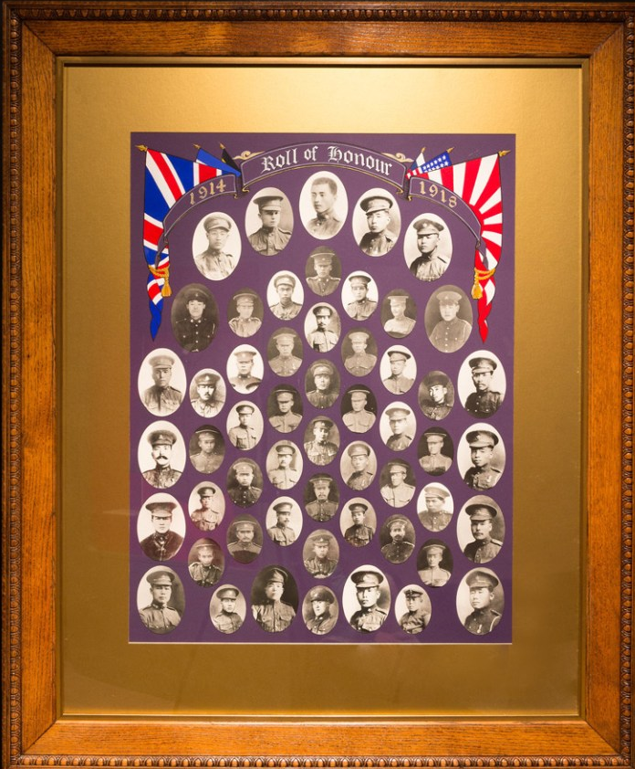
Japanese Canadian Roll of Honour
Vancouver, British Columbia
Honours 54 Japanese-Canadian soldiers from British Columbia who died in France and Belgium during the First World War.
Created by the Japanese-Canadian community in Vancouver around 1920.
Corporal Sainosuke Kubota kept it safe when Japanese-Canadians were forced into internment camps in 1942.
In 1977, he returned the Roll of Honour to Vancouver, where it now hangs in the Japanese Language School Hall.
It was restored in 1985 by the Japanese Canadian War Memorial Committee
More information and photos:
First World War Roll of Honour (Veterans Affairs Canada)
Image: Veterans Affairs Canada

Slide 21
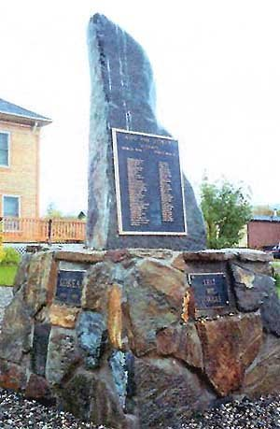
Mayo Memorial
Mayo, Yukon
Honours local Veterans of the First and Second World Wars, Korean War, and United Nations peacekeeping missions. ​​
The stone slab has been cut in the shape of the Yukon Territory. ​​
The rock used was donated by a local gold mine. ​​
Volunteers constructed the monument. Funding was provided by the village of Mayo, Mt. Haldane Lions Club, and the Mayo Historical Society.
Dedicated and unveiled on October 26, 1995.
More information and photos:
Mayo Memorial (Veterans Affairs Canada)
Image: Mayo Historical Society

