Slide 1

Tombs of unknown soldiers

Slide 2

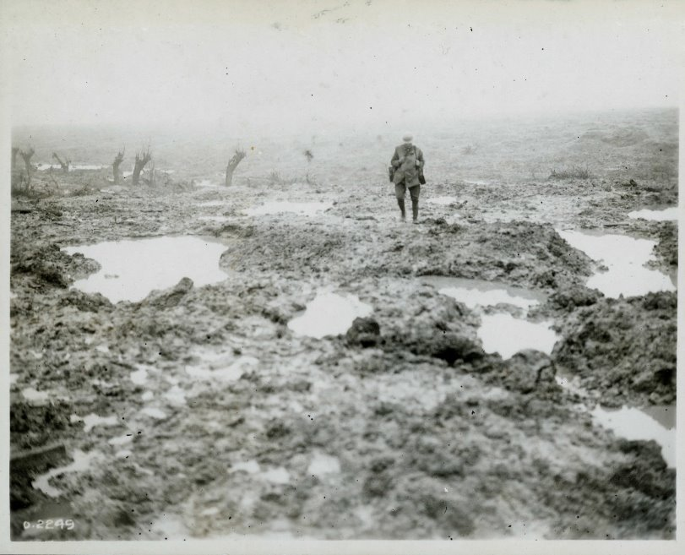
Missing and presumed dead
During the First World War, some service members might have been recorded as missing with no known grave for several reasons:
  Their remains were never found.
  They were lost at sea or in aircraft accidents.
  Their identification disks were destroyed or separated from their bodies.
  Their original marked graves were later destroyed by continued fighting.
Recovering bodies from devastated battlefields (like Passchendaele, shown here in 1917) was often extremely difficult.
Notes:
Image source: Library and Archives Canada

Slide 3
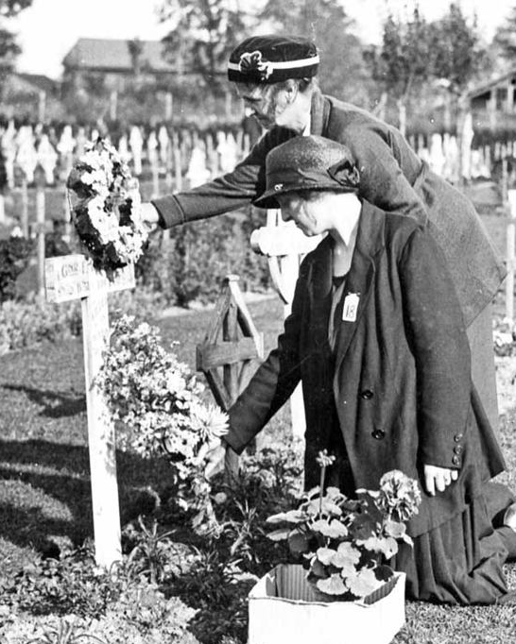
Remembering the fallen
Honouring those who died was an important part of grieving.
Allied countries created many ways to remember those who served and died:
  Individual headstones in military cemeteries
  National war memorials
  Local cenotaphs in home communities
The names of those lost with no known grave were engraved on large memorials to the missing, such as the Vimy Memorial and the Menin Gate.
Notes:
Image: Commonwealth War Graves Commission

Slide 4
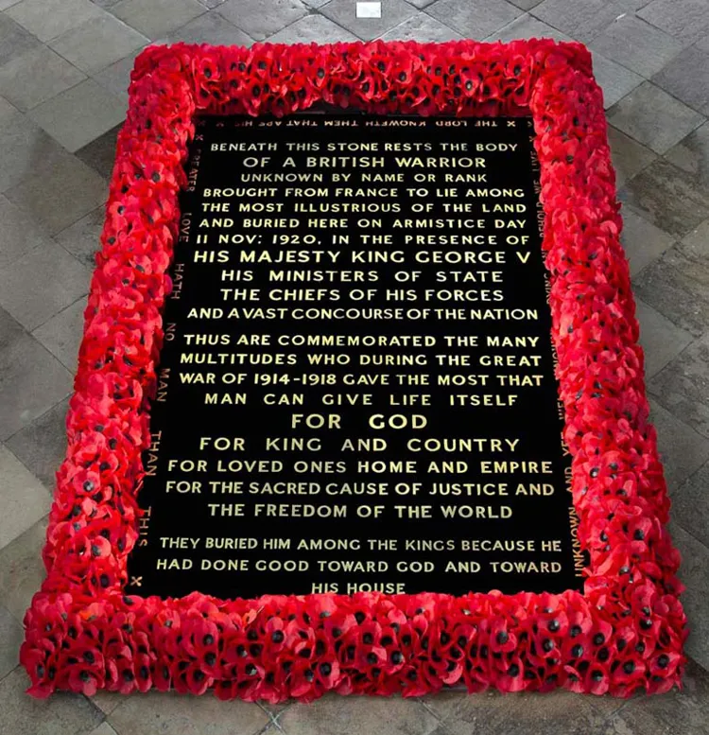
The Unknown Warrior
On November 11, 1920, a special memorial in London, England was dedicated to all British Commonwealth service members with no known grave.
The unknown warrior’s identity and unit are unknown.
He could have served in the Army, Navy, or Air Force, and could have come from across the British Isles, Dominions, or Colonies.
His burial at Westminster Abbey gave families a place to grieve for their missing loved ones.
*See notes for transcript of image text.
Notes:
BENEATH THIS STONE RESTS THE BODY
OF A BRITISH WARRIOR
UNKNOWN BY NAME OR RANK
BROUGHT FROM FRANCE TO LIE AMONG
THE MOST ILLUSTRIOUS OF THE LAND
AND BURIED HERE ON ARMISTICE DAY
11 NOV: 1920, IN THE PRESENCE OF
HIS MAJESTY KING GEORGE V
HIS MINISTERS OF STATE
THE CHIEFS OF HIS FORCES
AND A VAST CONCOURSE OF THE NATION
THUS ARE COMMEMORATED THE MANY
MULTITUDES WHO DURING THE GREAT
WAR OF 1914-1918 GAVE THE MOST THAT
MAN CAN GIVE LIFE ITSELF
FOR GOD
FOR KING AND COUNTRY
FOR LOVED ONES HOME AND EMPIRE
FOR THE SACRED CAUSE OF JUSTICE AND
THE FREEDOM OF THE WORLD
THEY BURIED HIM AMONG THE KINGS BECAUSE HE
HAD DONE GOOD TOWARD GOD AND TOWARD
HIS HOUSE
Around the main inscription are four texts:
(top) THE LORD KNOWETH THEM THAT ARE HIS,
(sides) GREATER LOVE HATH NO MAN THAN THIS
UNKNOWN AND YET WELL KNOWN, DYING AND BEHOLD WE LIVE,
(base) IN CHRIST SHALL ALL BE MADE ALIVE.
Image: Westminster Abbey Collection

Slide 5
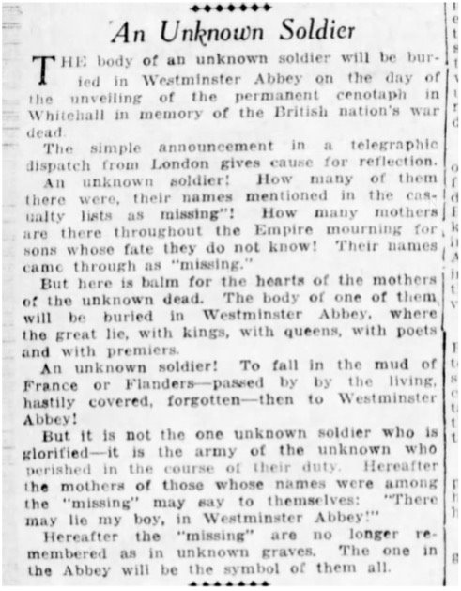
Worldwide attention
The burial of the Unknown Warrior was attended by the King, military leaders, and the public.
News of the event spread across the world. A Vancouver newspaper wrote:
“Hereafter the mothers of those whose names were among the missing may say to themselves:
‘There may lie my boy, in Westminster Abbey!’
Hereafter the missing are no longer remembered as in unknown graves. The one in the Abbey
will be the symbol of them all.”
*See notes for transcript of full article text.
Notes:
An unknown soldier
The body of an unknown soldier will be curried in Westminster Abbey on the day of the unveiling of the permanent cenotaph in Whitehall in memory of the British nation’s war dead.
The simple announcement in a telegraphic dispatch from London gives cause for reflection.
An unknown soldier: How many of them there were, their names mentioned in the casualty lists as “missing”! How many mothers are there throughout the Empire mourning for sons whose fate hey do not know! Their names came through as “missing.”
But here is balm for the hearts of the mothers of the unknown dead. The body of one of them will be buried in Westminster Abbey, where the great lie, with kings, with queens, with poets and with premiers.
An unknown soldier! To fall in the mud of France or Flanders—passed by by the living, hastily covered, forgotten—then to Westminster Abbey!
But it is not the one unknown soldier who is glorified – it is the army of the unknown who perished in the course of their duty. Hereafter the mothers of those whose names were among the ”missing” may say to themselves: ”There may lie my boy, in Westminster Abbey!”
Hereafter the ”missing” are no longer remembered as in unknown graves. The one in the Abbey will be the symbol of them all.
(Published in the Vancouver Daily World)

Slide 6
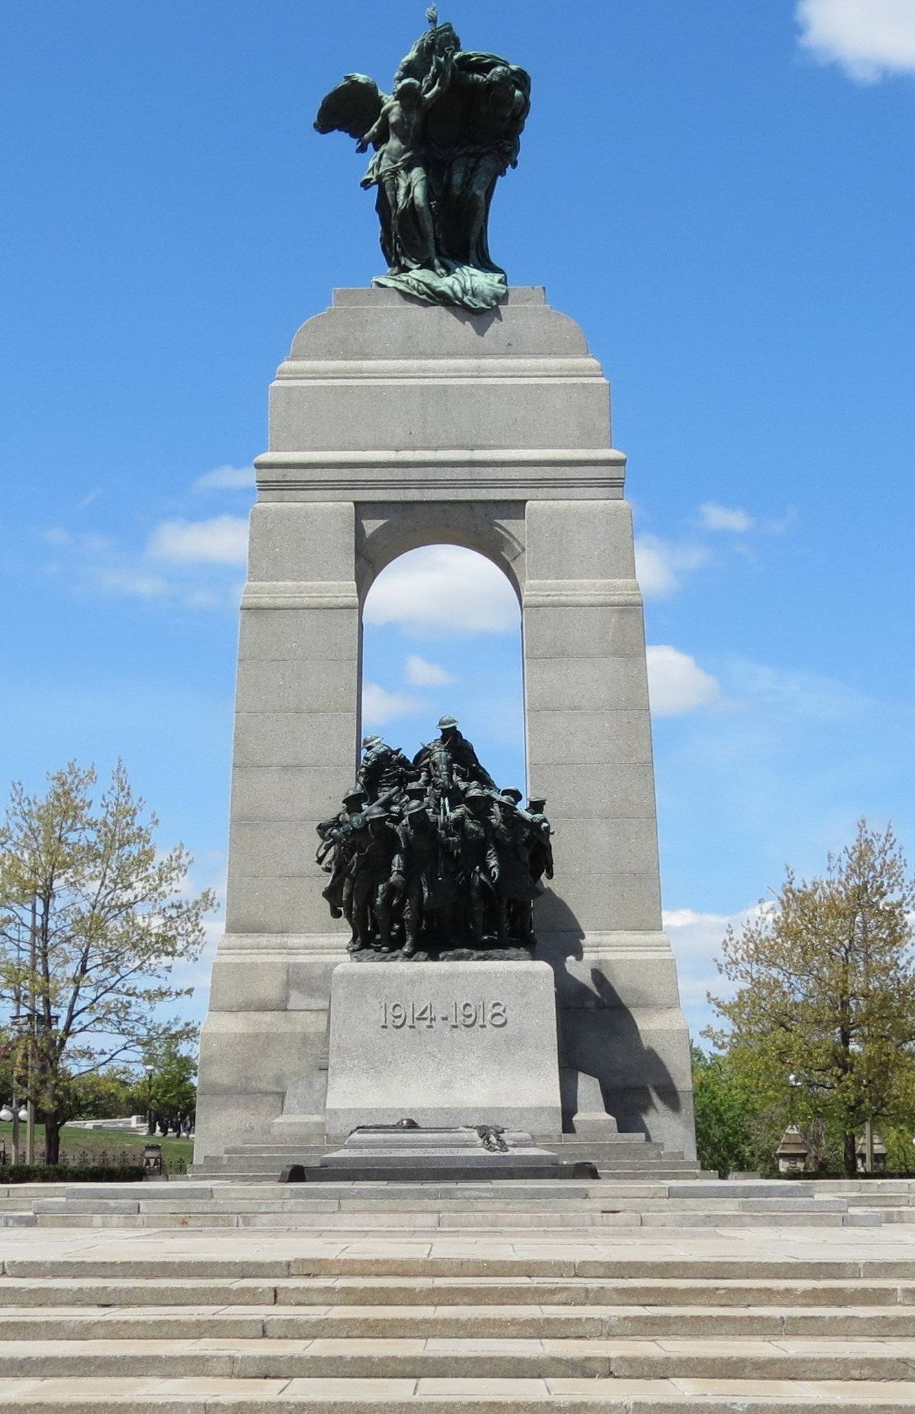
Canada’s Tomb of the Unknown Soldier
Inspired by the Unknown Warrior, Canada repatriated its own unknown soldier as a Millenium Project in the year 2000.
Although the soldier inside died during the First World War, Canada’s Tomb represents all Canadians who have — or will — give their lives in service to their country.
Notes:
Source: Wikimedia Commons

Slide 7
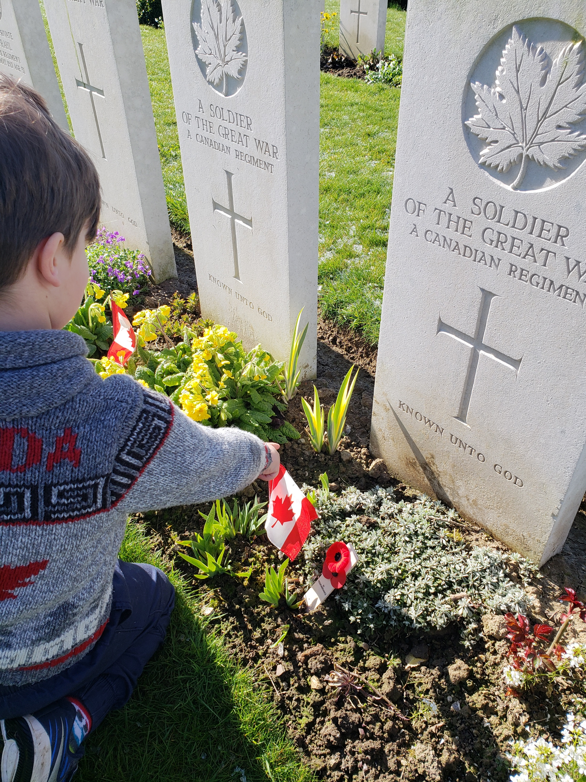
Known unto God
More than 18,000 Canadians who died in the First World War had no known grave.
Their headstones were marked with a maple leaf and often read:
A Soldier of the Great War
A Canadian Regiment
Known unto God
Notes:
Image: Veterans Affairs Canada

Slide 8
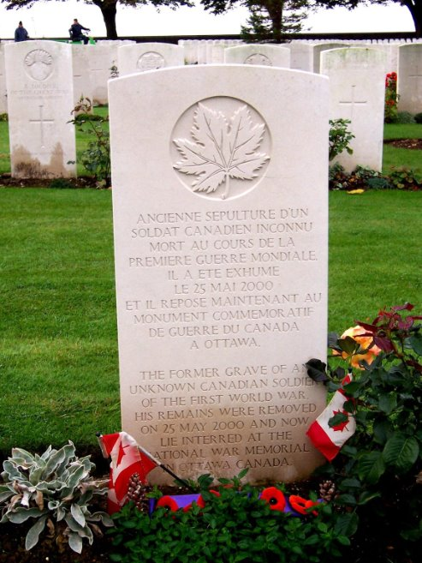
Choosing the unknown soldier
Canada’s unknown soldier was exhumed from Cabaret Rouge Cemetery near Vimy Ridge.
His original headstone was replaced with one reading:
The former grave of an
unknown soldier of the
First World War.
His remains were removed
on 25 May 2000 and now
lie interred at the
National War Memorial
in Ottawa, Canada
Notes:
Image: Commonwealth War Graves Commission

Slide 9
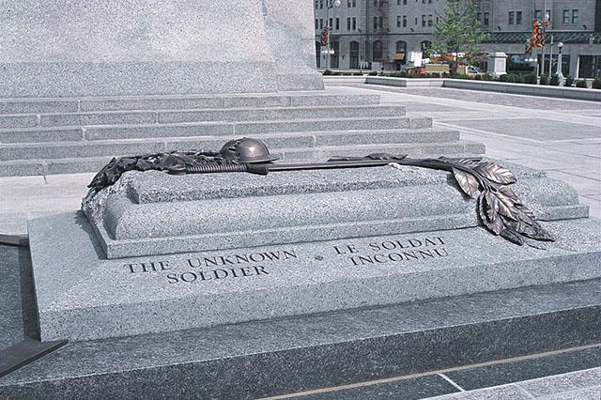
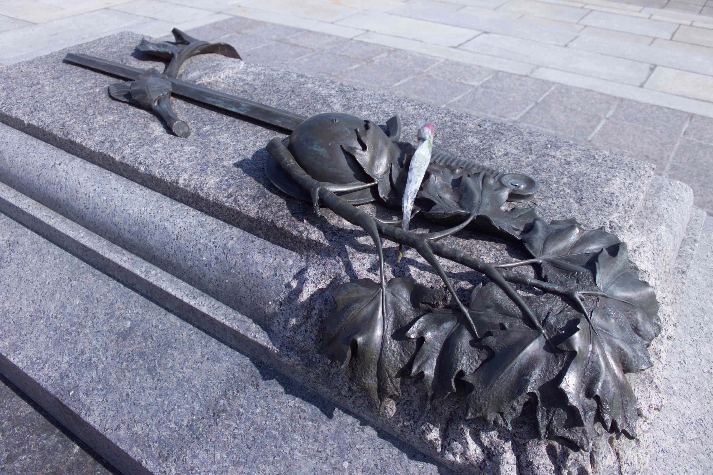
Creating a special resting place
A special sarcophagus was created at the National War Memorial in Ottawa.
The bronze elements were designed by sculptor Mary-Ann Liu (Mission, BC).
Made of granite from the Beauce region of Quebec.
The sword, helmet, maple leaves and laurel leaves symbolize national pride and sacrifice.
Notes:
Images: Veterans Affairs Canada

Slide 10
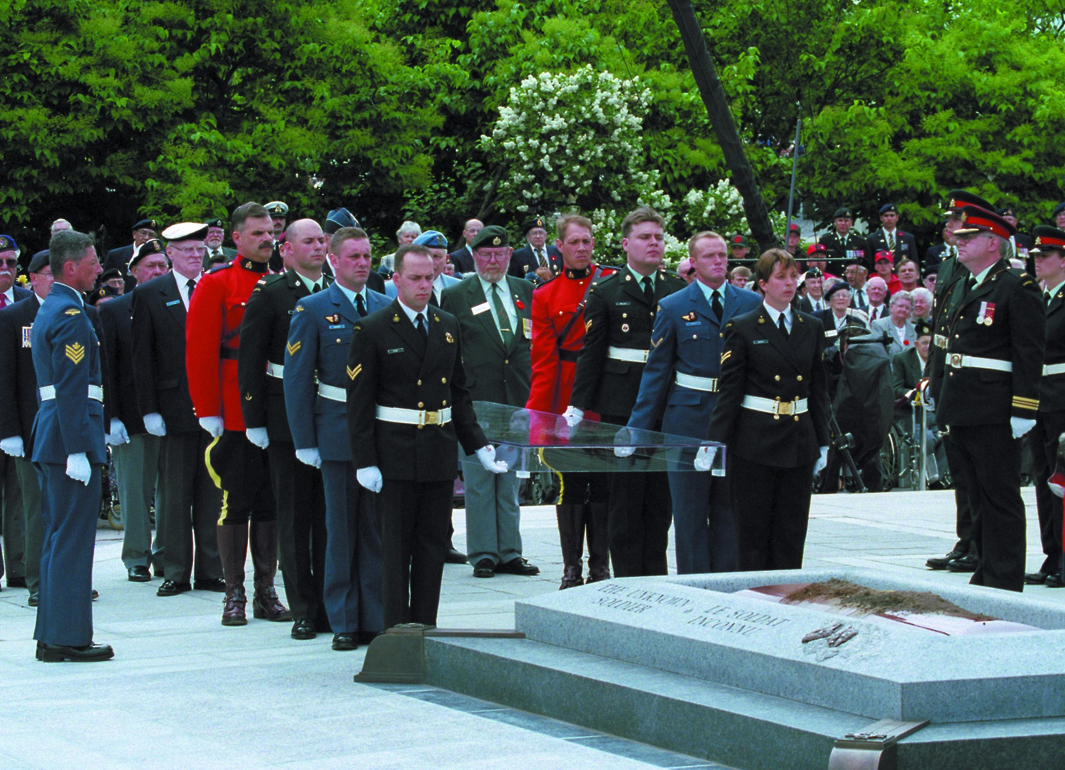
A national ceremony of remembrance
Before the burial, the remains lay in state for three days in the Hall of Honour on Parliament Hill.
The tomb was dedicated at a national ceremony on May 28, 2000.
The ceremony was attended by Canada’s Governor General, Prime Minister, Veterans, Canadian Armed Forces members, and youth.
Thousands attended in person. Millions watched on television.
Notes:
Image: The Royal Canadian Legion

Slide 11
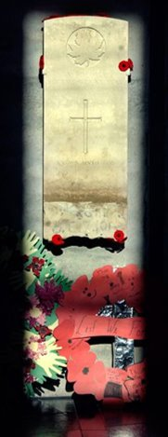
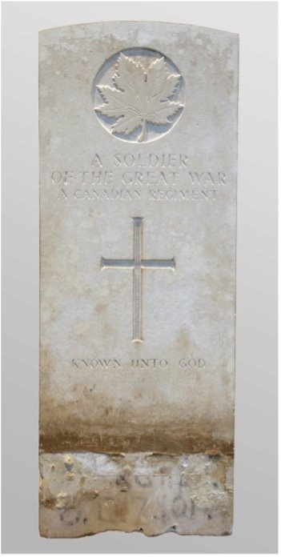
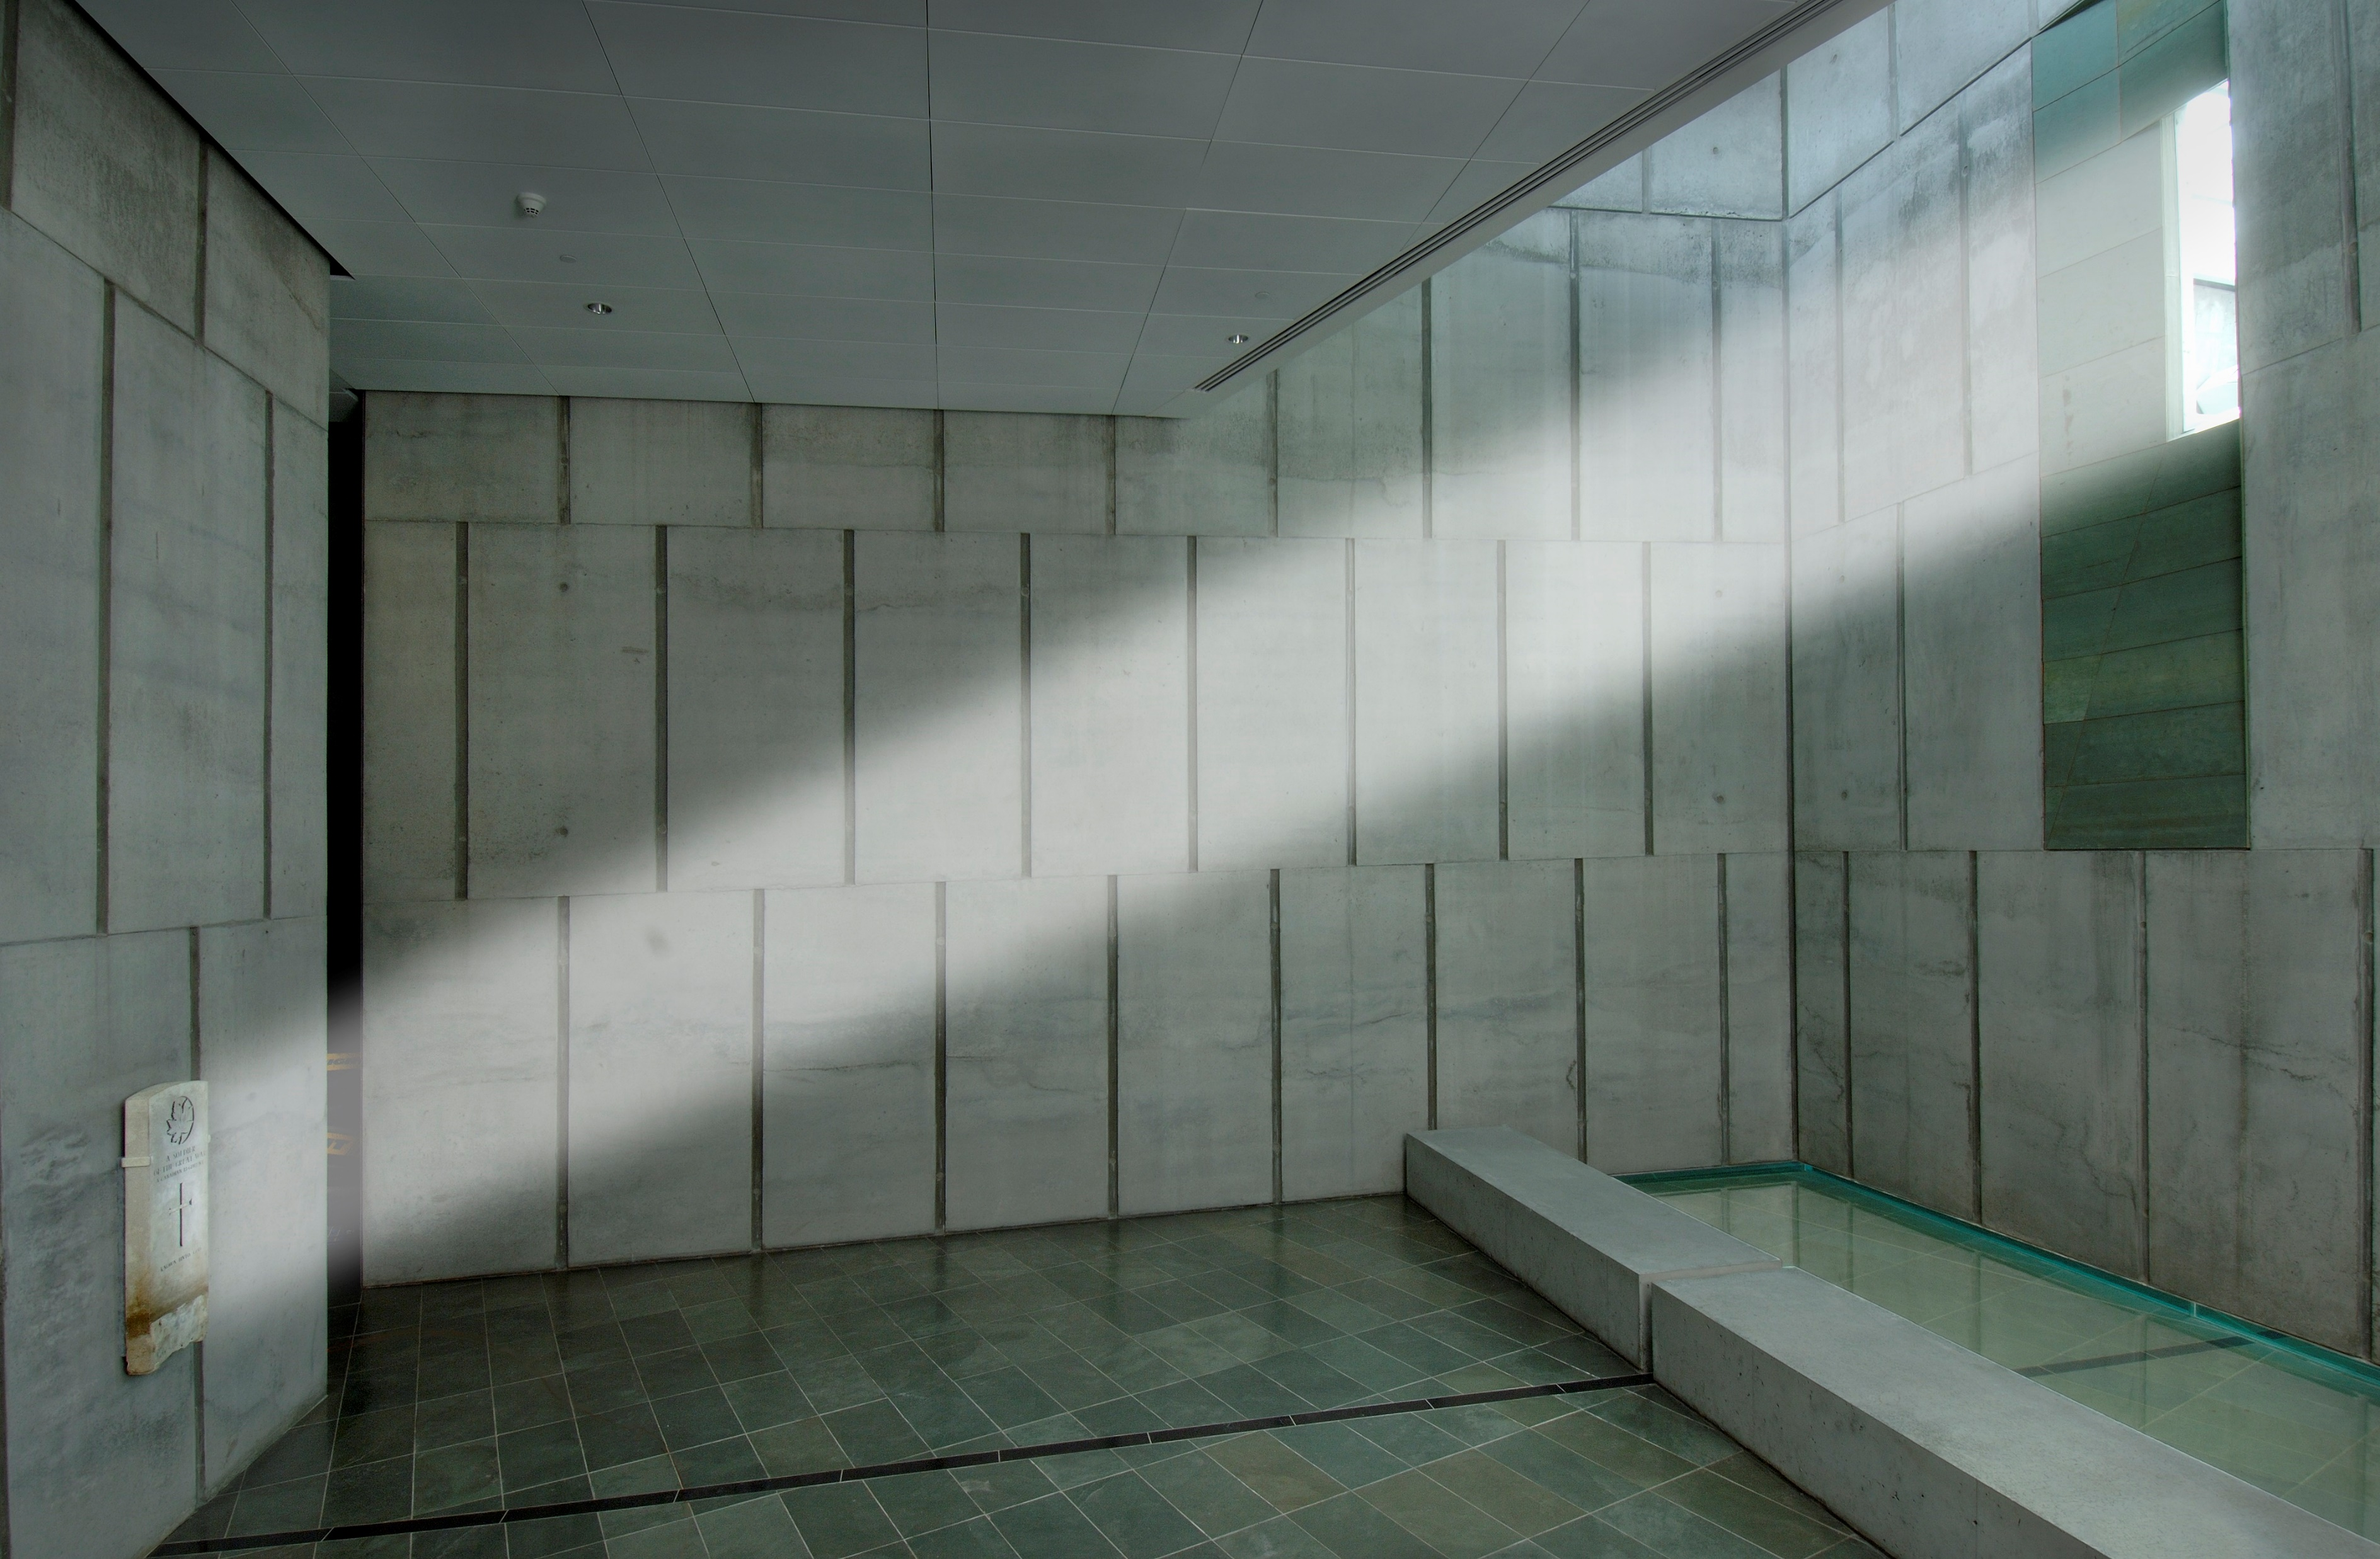
A moment of light
The original grave marker of Canada’s unknown soldier is displayed in Memorial Hall at the Canadian War Museum.
On Remembrance Day, at precisely 11 a.m., sunlight shines through a single window to frame the headstone.
This dramatic moment happens only once a year at the eleventh hour, of the eleventh day, of the eleventh month.
Notes:
Images: Canadian War Museum

Slide 12
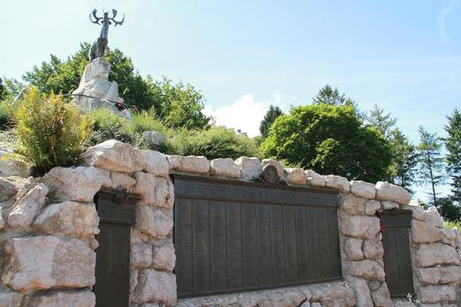
An unknown soldier for Newfoundland
Newfoundland and Labrador did not join Canada until 1949. The Dominion of Newfoundland served during the First World War as part of British forces.
Because of this, the tomb in Ottawa represents Canadian war dead but does not represent Newfoundland’s missing.
Newfoundland and Labrador created its own Tomb of an Unknown Newfoundland First World War Soldier in 2024 to mark the 100th anniversary of Newfoundland’s National War Memorial.

Slide 13
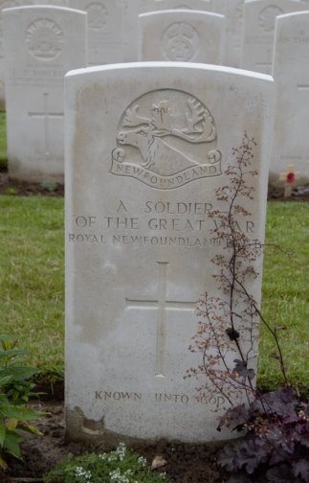
Remembering the fallen
More than 800 men from Newfoundland and Labrador died with no known grave during the First World War.
They served with The Royal Newfoundland Regiment, The Newfoundland Royal Naval Reserve, and The Newfoundland Mercantile Marine.
Their names appear on the Beaumont-Hamel Newfoundland Memorial in France.
Unknown Newfoundland soldiers’ headstones featured a caribou — the regiment’s emblem — and the inscription:
A Soldier of the Great War
Known unto God
Notes:
Source: Commonwealth War Graves Commission

Slide 14
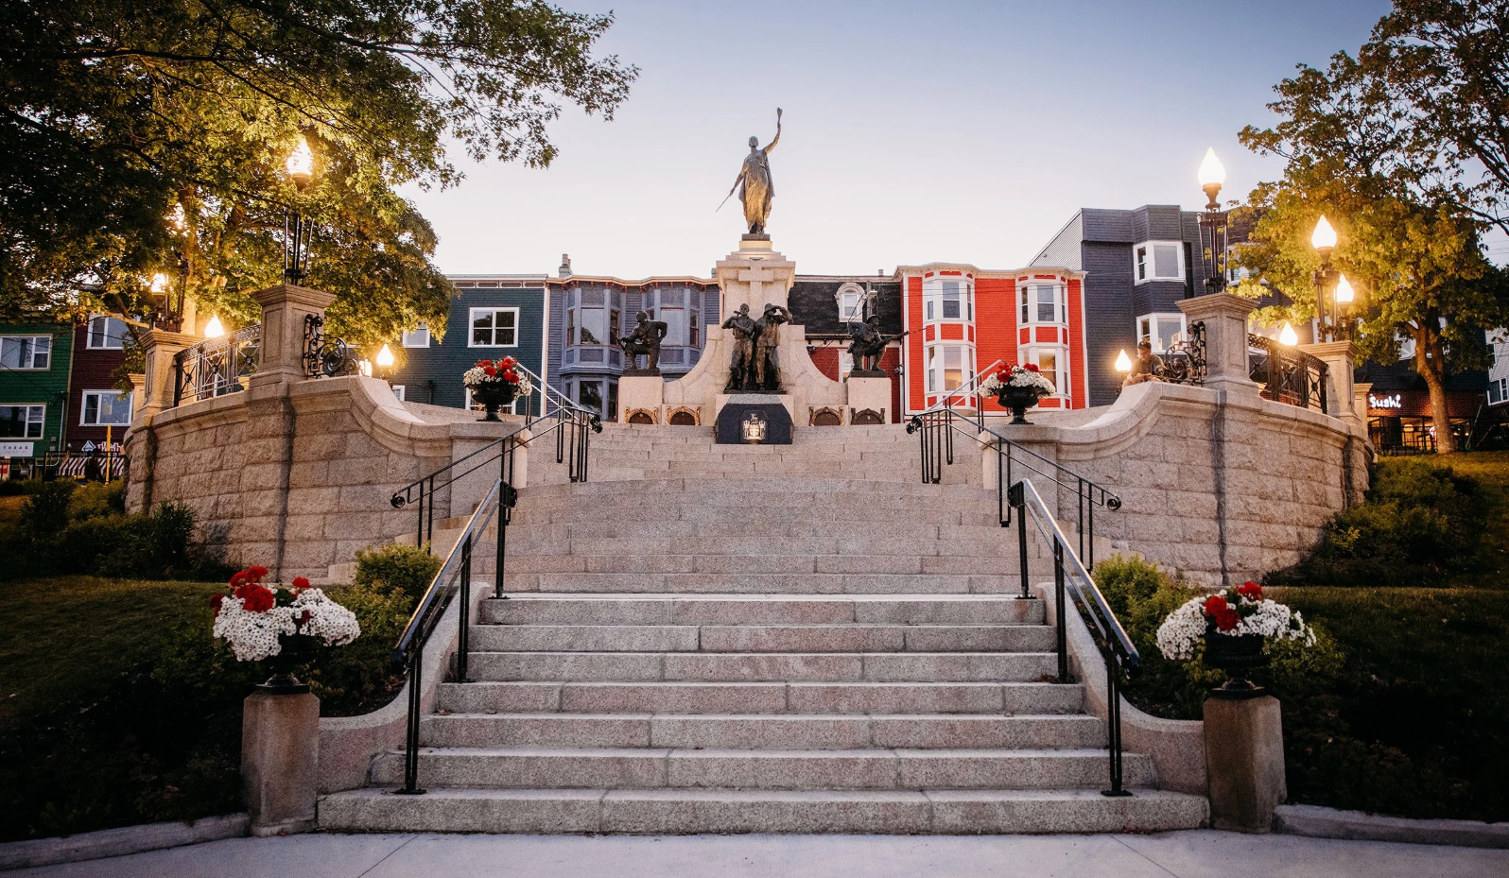
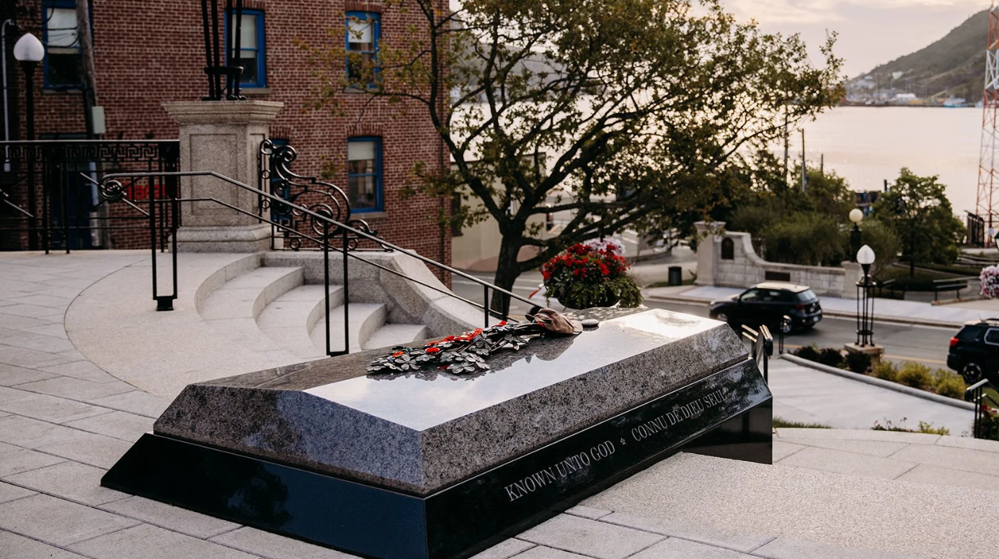
Designing Newfoundland’s tomb
The tomb was installed in front of the Newfoundland National War Memorial.
It was designed by a Newfoundland and Labrador landscape architecture firm.
The bottom (vault) of the tomb was carved from black granite stone mined from a Quebec quarry. It is inscribed with the words “Known Unto God” in both English and French.
The tomb cover was carved in stone from Labrador called “Blue Eyes” granite.
The tomb is adorned with a bronze bouquet of forget-me-not flowers – a symbol of remembrance for the Newfoundland Regiment. The blue flower is worn by Newfoundland and Labradorians each year on July 1st.
The province’s coat-of-arms is carved into the front of the tomb.
Notes:
Images: Mills & Wright Landscaping (Photographs by Chelsey Lawrence Photography)
Tomb of Unknown Newfoundland First World War Soldier

Slide 15
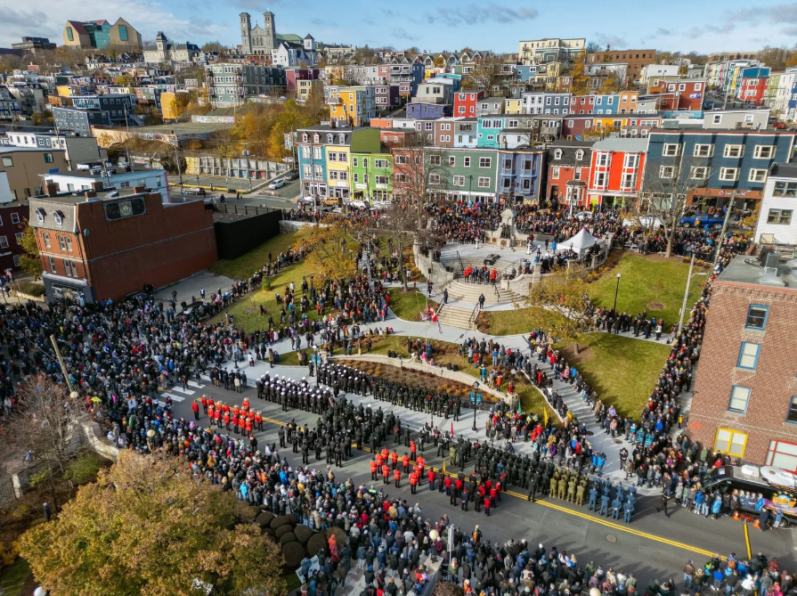
A moving ceremony
The remains of the unknown soldier lay in state for three days in St. John’s.
The tomb was dedicated at a commemorative ceremony on
July 1, 2024.
July 1 is Memorial Day in Newfoundland and Labrador. This date was chosen for its connection to the Newfoundland Regiment’s heavy losses on July 1, 1916.
Notes:
Images: Mills & Wright Landscaping (Photographs by Chelsey Lawrence Photography)

Slide 16
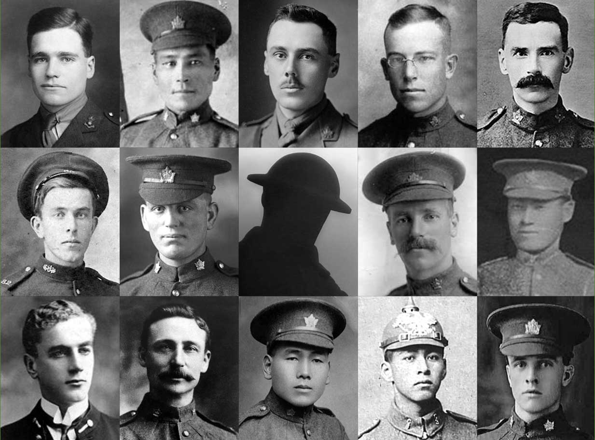
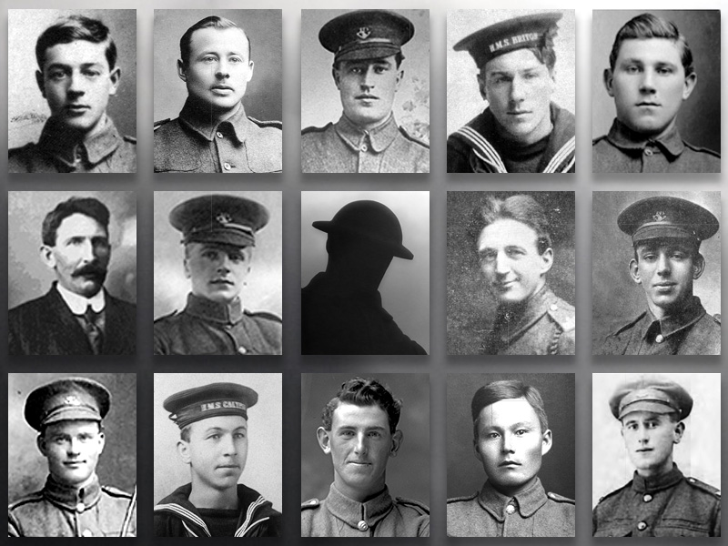
Who was the unknown soldier? We can only imagine…
Canadians missing with no known grave
Newfoundlanders missing with no known grave
Could he have been Franklin Rankin from Woodstock, NB or Frederick Lee from Kamloops, BC?
Was he Frederick Hobson from Toronto, ON or John Shiwak from Rigolet, NL?
Thousands were lost with no known grave. The Unknown Soldier represents them all.
Notes:
All of the Canadians seen here lost their lives during the First World War. None of them have a known grave.
First row (left to right):
Lieutenant Franklin Sharp Rankin was from Woodstock, New Brunswick. His mother’s name was Jennie and he served with the Royal Flying Corps. Franklin lost his life in October 1916 at the age of 23.
David Stranger was an Indigenous soldier born in Manitoba in 1874. The father of seven fought on the Western Front during the First World War. He was killed in action in France on March 29, 1917 at the age of 42.
Lieutenant Dudley Acheson was born in 1888 in Winnipeg. Upon his enlistment in Saskatoon in March 1916, he was immediately made an officer. He was killed in action on November 5, 1916 during the Battle of the Somme. His obituary described his death as “one of the saddest … of the war,” and said that he was “prominently spoken of” as an officer for the dedication he showed to his platoon.
Private Harold Adair died in France on August 8, 1918 during the Battle of Amiens.
Private Vivian Abbott’s nickname was “Bunny.” He lost his life at the age of 36 on August 21, 1917 during the Battle of Hill 70. Vivian was a member of the British Columbia Regiment and had also served in the South African War.
Second row (left to right):
Private Merrill Marshall of Prince Edward Island joined the Canadian Expeditionary Force in May 1915. He was killed on April 9, 1917 – the opening day of the Battle of Vimy Ridge.
Private Joseph Doughty was born in 1895 and served with the 38th Battalion during the First World War. He lost his life on November 18, 1916 during the Battle of the Somme at the age of 21.
Private Douglas Freeman Sr. was a British immigrant who served with the Canadian Expeditionary Force and died during the Battle of the Somme. Before the war, he worked for Eaton’s in Toronto. His eldest son, Douglas Jr., also served during the First World War. He was killed in action two years before his father.
Sergeant Fumio Tatsuoka was a highly respected Japanese Canadian soldier. He refused an offer to go to officer training school, saying, “I volunteered with 200 Japanese and I do not want to be an officer and be apart from them. It would not be right to be saluted by my comrades.” His death in August 1917 during the Battle of Hill 70 was mourned by his battalion.
Third row (left to right):
- Midshipman Malcolm Cann graduated from the Royal Naval College of Canada in 1914. He was selected to serve in the Royal Navy on board HMS Good Hope. On November 1, 1914 his ship was sunk off the coast of Chile. All hands were lost. Cann was one of four Canadian sailors to lose their lives that day – the first Canadian battle casualties of the First World War.
- Sergeant Frederick Hobson was 44 years old and a father of five. He earned the Victoria Cross at Hill 70 in August 1917. The 29th Battalion member dug out a gunner and sacrificed his life while a Lewis gun was being repaired. He said, "You get that gun online. I'm going to buy you as much time as I can.“
Private Katsukuma Katayama was born in Japan and came to Canada as a young man. Eager to serve his new country during the First World War, he enlisted in Calgary in 1916. He lost his life on May 7, 1917 while fighting on the Western Front with the 30th Battalion. He was 29 years old.
Private Peter Lavelley was an Indigenous soldier who served with the 3rd Battalion. He lost his life at the age of 20 on April 10, 1917 during the Battle of Vimy Ridge. He had come from a long line of warriors. His great-great-great-great grandfather was the Grand Chief of the Algonquins during the War of 1812.
Private Henry Ashton was born in 1886. He joined the Canadian Expeditionary Force during the First World War and served with the 31st Battalion. He was killed on September 15, 1916 during the Battle of the Somme. Henry was 30 years old.
(Canadian Virtual War Memorial – submitted photos)

