Slide 1

Menin Gate
Memorial

Slide 2
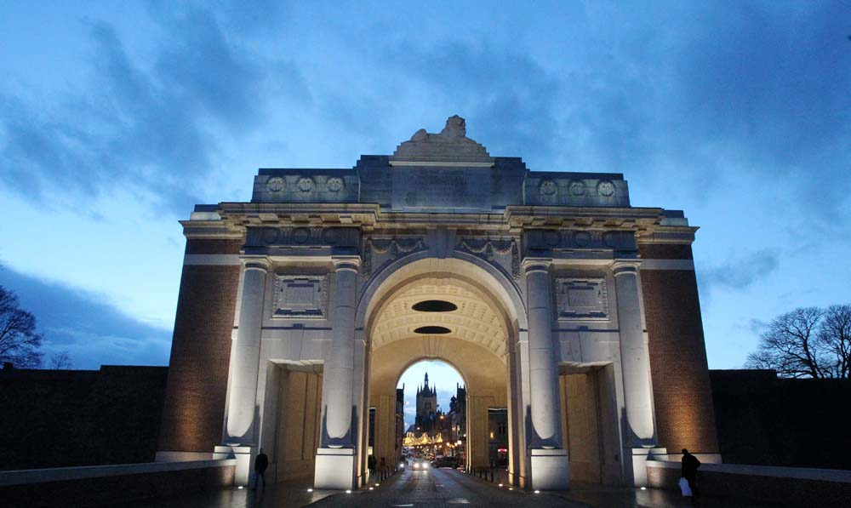
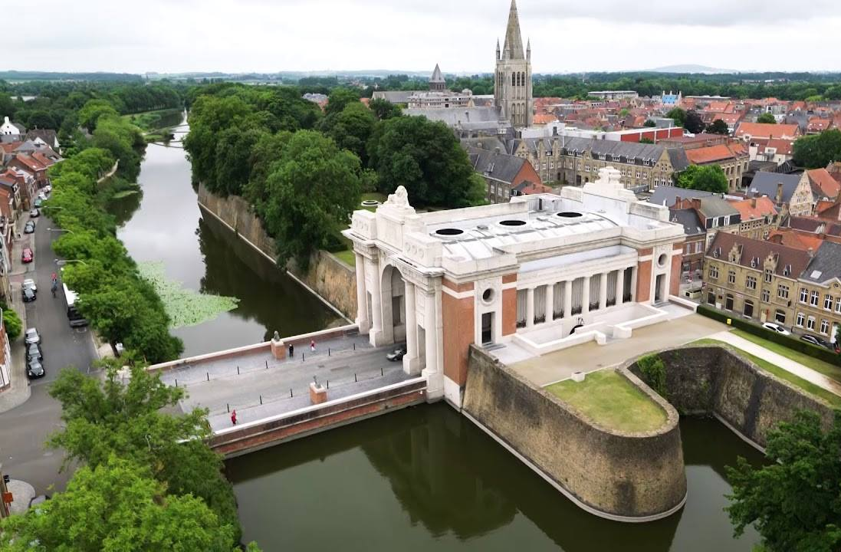
Where is it?
The Menin Gate Memorial is located at the eastern exit of Ypres (Ieper) in the Flanders region of Belgium.
This is the starting point of the main road leading allied soldiers from the town to the front line of the Ypres Salient.
The Ypres Salient region saw some of the war’s hardest fighting of the First World War, including the Battle of Passchendaele.
This location represents the journey of the soldiers who never came home.
Images: Commonwealth War Graves Commission and Last Post Association

Slide 3
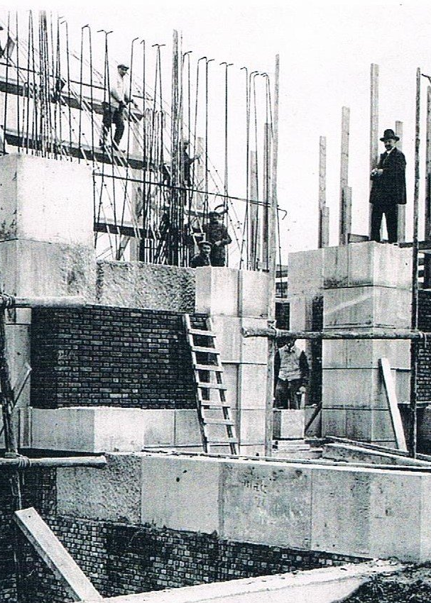
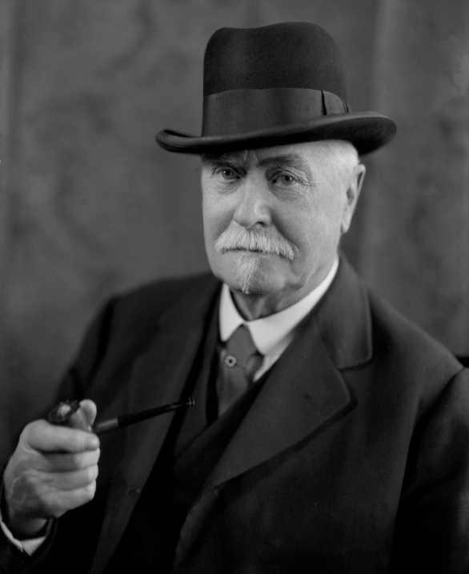
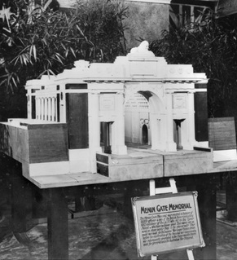
Who designed it?
Designed by British architect Sir Reginald Blomfield.
The design was commission by the Imperial War Graves Commission (now the Commonwealth War Graves Commission) in 1919.
Inspired by the Porte de la Citadelle built in the 1600s in Nancy, France.
Images:
National portrait Gallery, Australian War Memorial
and Commonwealth War Graves Commission

Slide 4
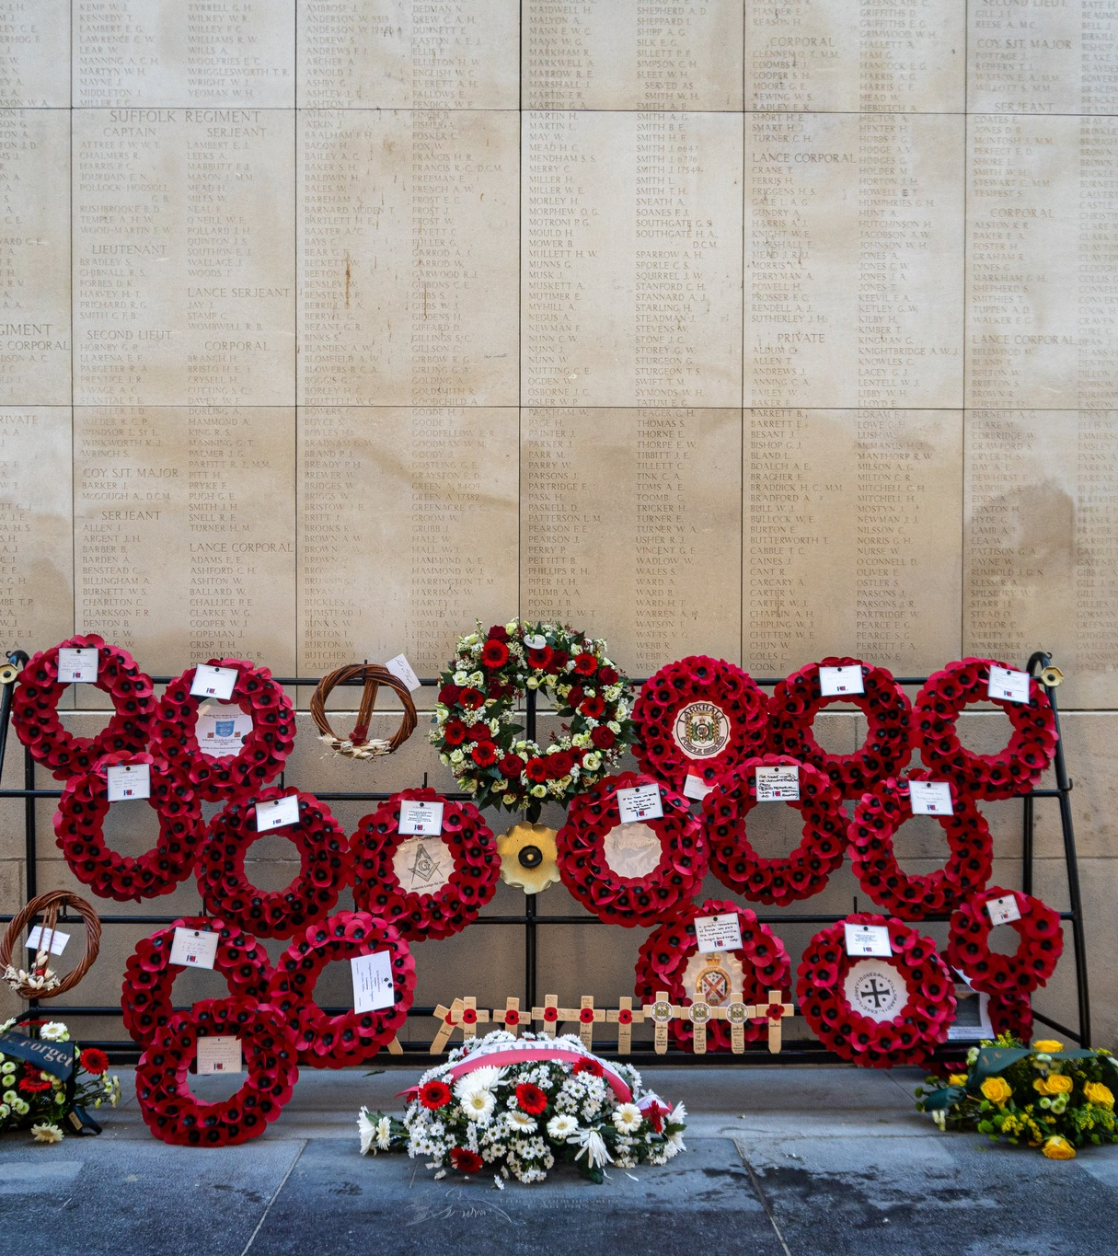
Who does it commemorate?
Almost 55,000 Commonwealth soldiers who died with no known grave in the Ypres Salient.
The Commonwealth is a voluntary group of countries linked through the former British Empire. Many fought alongside Britain in the war.
Names on the Menin Gate by country*:
  United Kingdom: 40,500
  Canada: 6,935
  Australia: 6,179
  South Africa: 561
  British India: 412
  British West Indies: 6
*Missing from Newfoundland and New Zealand are commemorated elsewhere.
Image: Commonwealth War Graves Commission

Slide 5
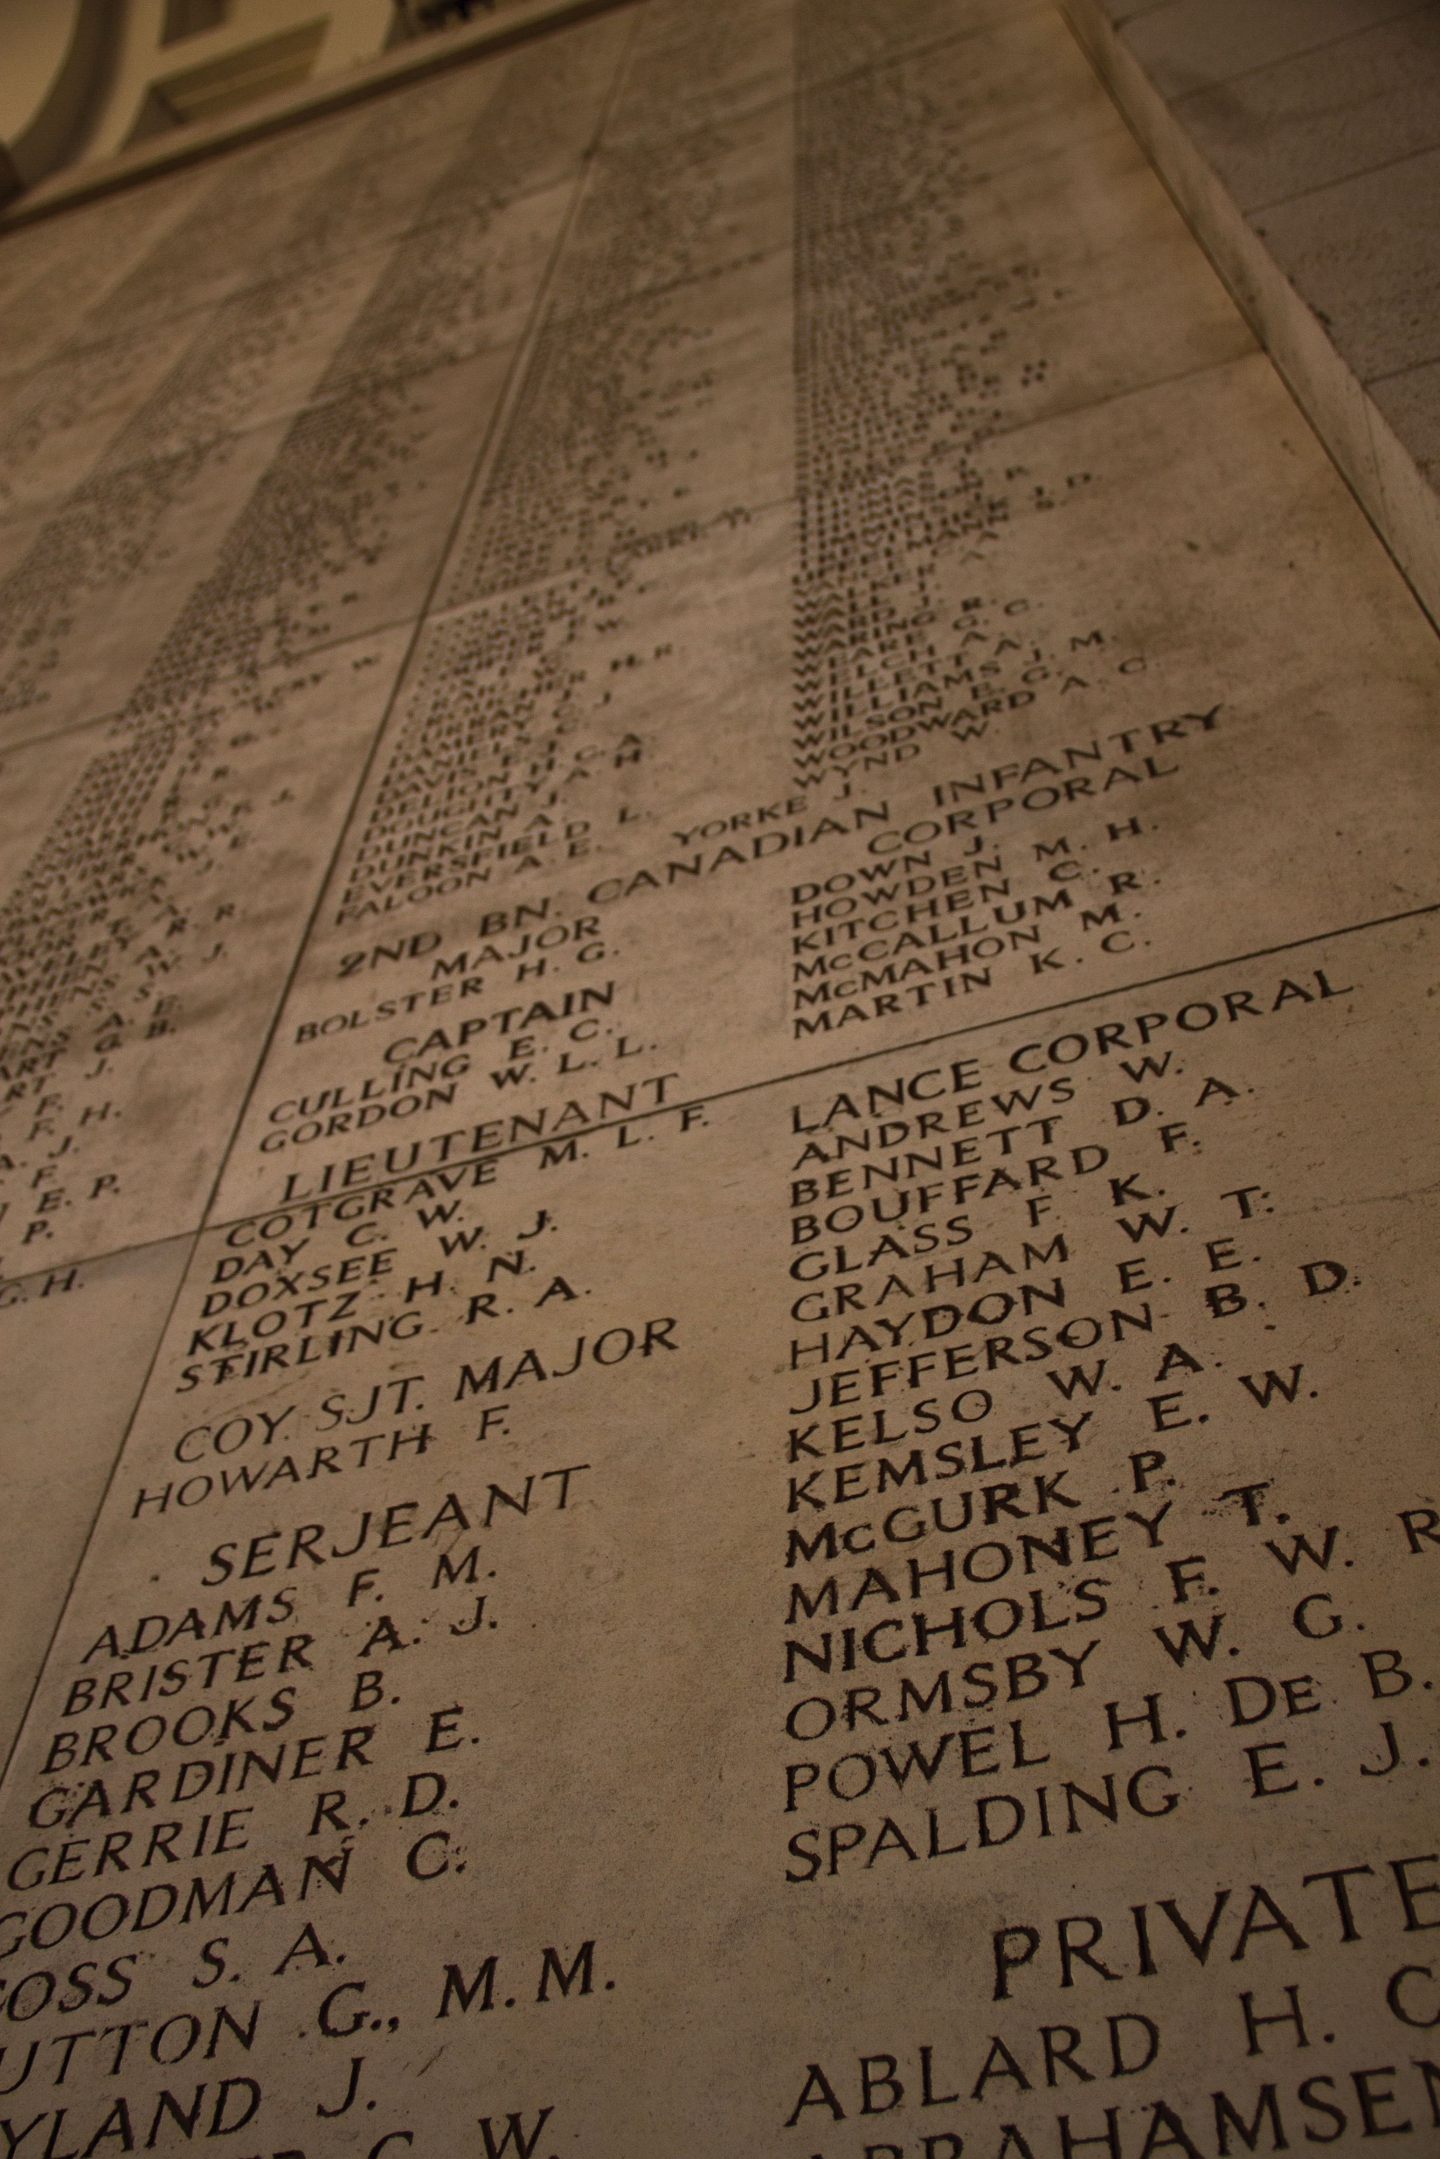
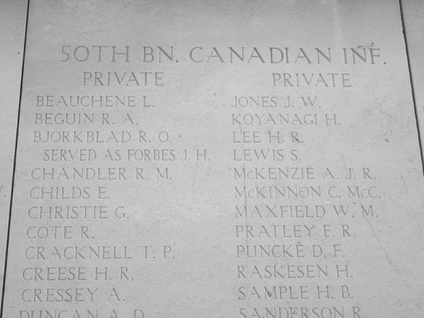
How are the missing remembered?
Image: Royal Canadian Legion
The names of the missing are engraved in panels made of white stone.
Most appear in the central hall. More are found along the stairways and in open galleries on both sides of the memorial.
Names are organized by regiment/unit, then by rank, and are finally listed alphabetically. Higher ranks appear at the top of the list.
Image: Veterans Affairs Canada

Slide 6
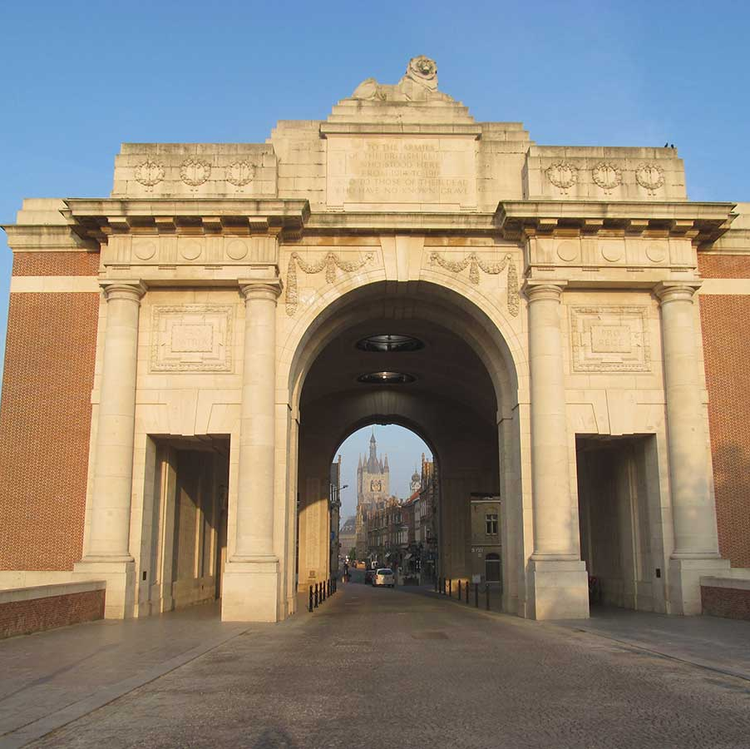
What symbols are used?
The memorial’s location is symbolic.
The central hall was built over the Menin Road exit from the city.
This site was chosen because of the hundreds of thousands of men who passed through this road on their way to the battlefields.
The Hall of Memory is 36.6 metres long and 20.1 metres wide.
Image: Commonwealth War Graves Commission

Slide 7
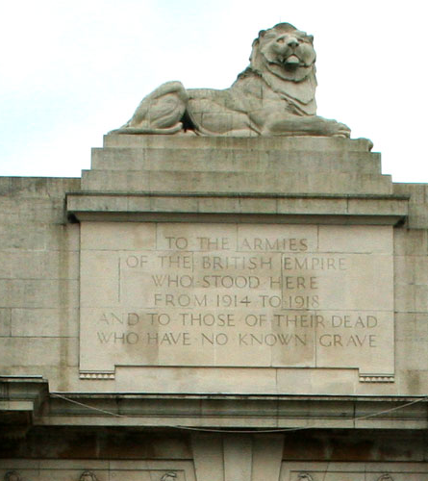
What symbols are used?
A large stone lion overlooks the former battlefields to the east.
The lion is a traditional symbol of England and also of Flanders. It highlights both British and local connections to the memorial.
A dedication plaque below the lion is engraved with the words:
TO THE ARMIES
OF THE BRITISH EMPIRE
WHO STOOD HERE
FROM 1914 TO 1918
AND TO THOSE OF THEIR DEAD
WHO HAVE NO KNOWN GRAVE
Image: Edward Nicholl

Slide 8
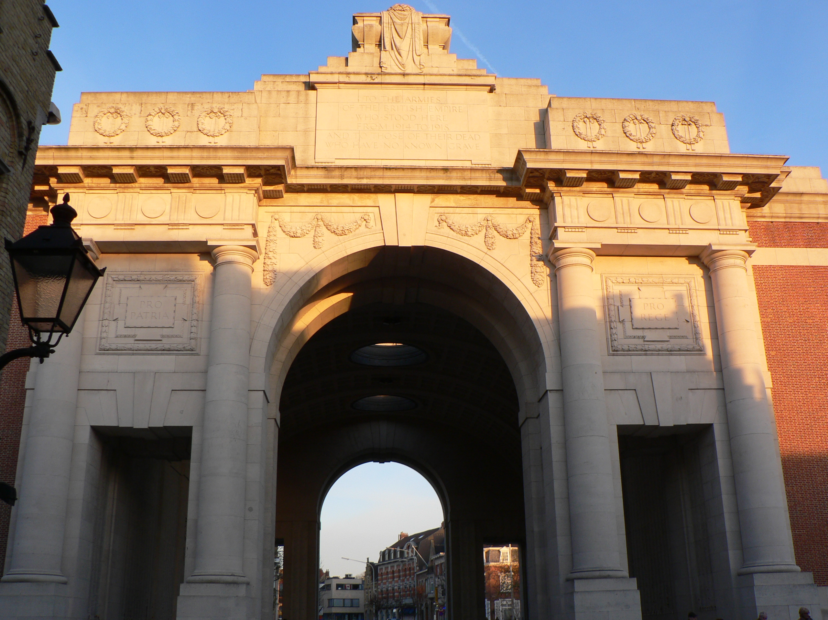
What symbols are used?
A sarcophagus topped by a flag and a wreath overlooks to town to the west.
A sarcophagus is a stone or metal container used to hold a coffin or a body after death.
The sarcophagus symbolizes the fallen soldiers who never received a known grave.
Engravings in latin on either side of arch read:
PRO PATRIA (for country)
PRO REGE (for king)
Image: Wikimedia Commons

Slide 9
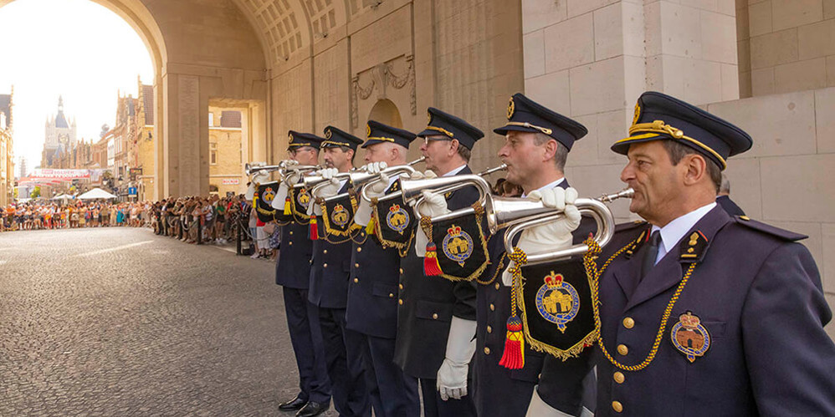
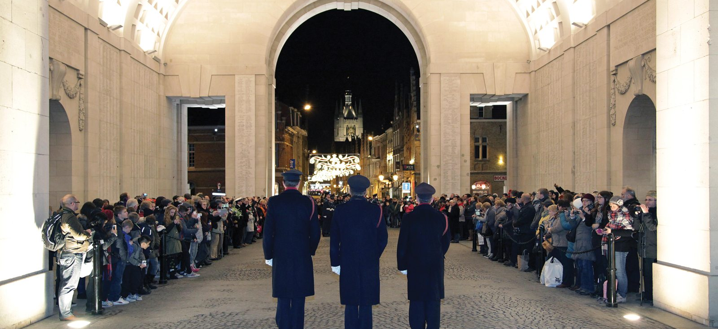
Are there any other features?
Each evening at 8 p.m., traffic stops and people line the Hall of Memory for The Last Post ceremony.
The Last Post was a bugle call traditionally played at the end of a soldier’s day. It now symbolizes a final farewell to those who died.
The ceremony also includes reading of the Act of Remembrance, and a minute of silence. Every Wednesday additionally includes wreath-layings.
Held since 1928 (except during wartime occupation).
The Menin Gate is maintained by the Commonwealth War Graves Commission.
Images: Commonwealth War Graves Commission

Slide 10
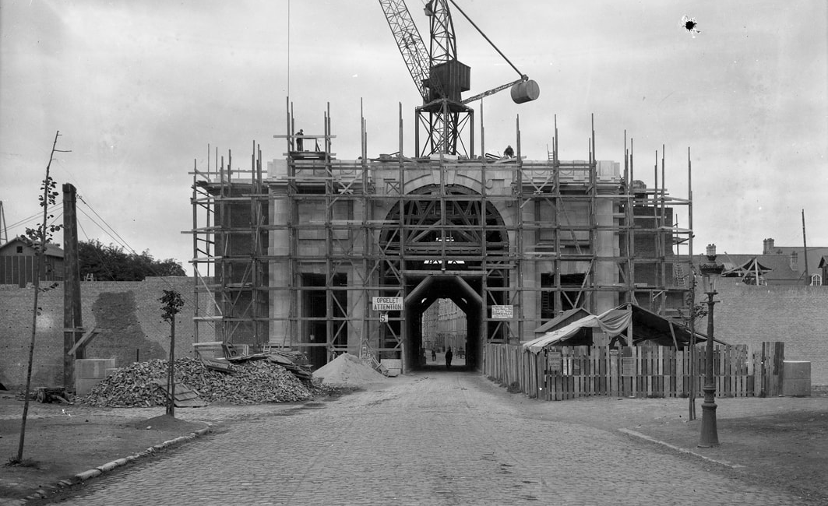
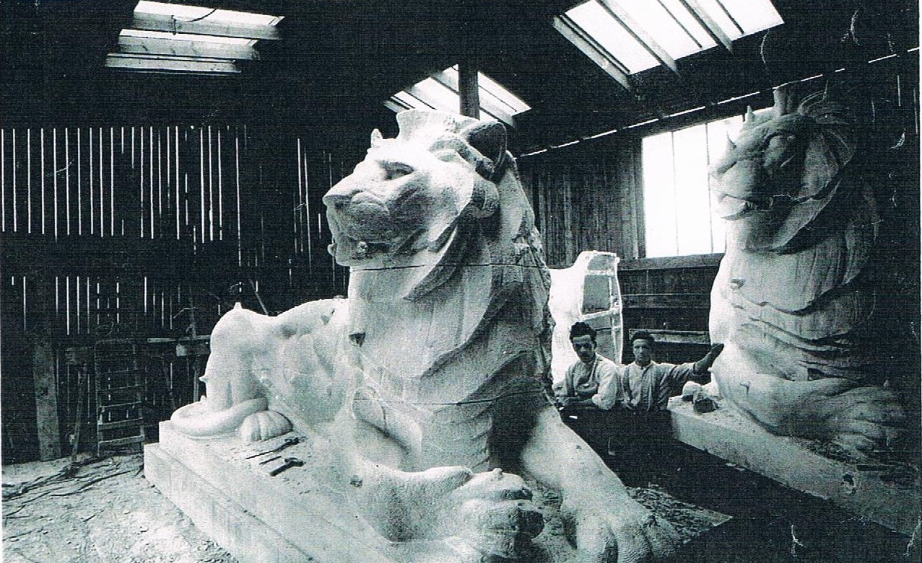
How was it built?
Construction took place between 1922 and 1927
Built of reinforced concrete covered with white stone and red brick.
The white Portland stone was shipped from England.
Seven lions were carved before the designers were satisfied with one. They were carved in place under a temporary shed.
Images: Commonwealth War Graves Commission

Slide 11
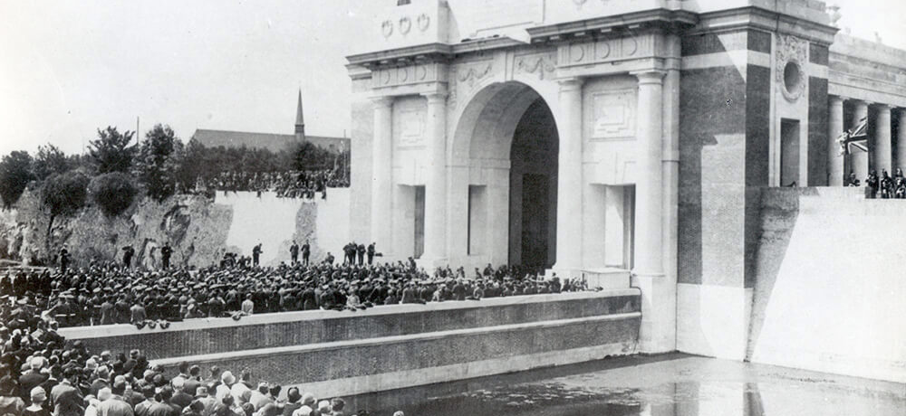
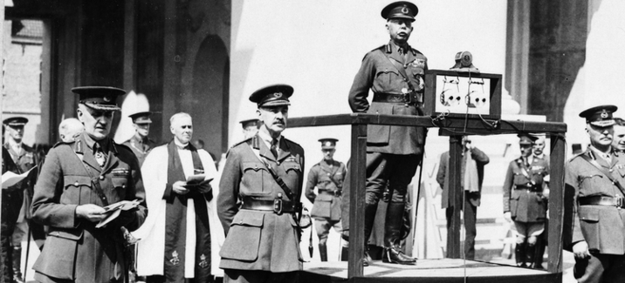
When was it dedicated?
Menin Gate was unveiled on July 24, 1927, by Field Marshal Lord Plumer, a senior British commander who served in the Ypres Salient.
Thousands gathered to inaugurate the new memorial.
In his speech, Plumer highlighted the purpose of the Menin Gate, saying of those it honours:
“He is not missing: he is here!”
Images: Commonwealth War Graves Commission

