Slide 1

Canadian National
Vimy Memorial

Slide 2
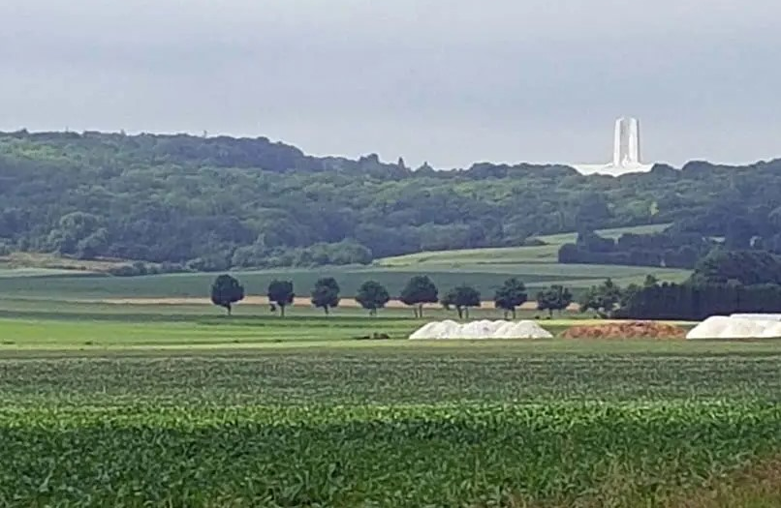
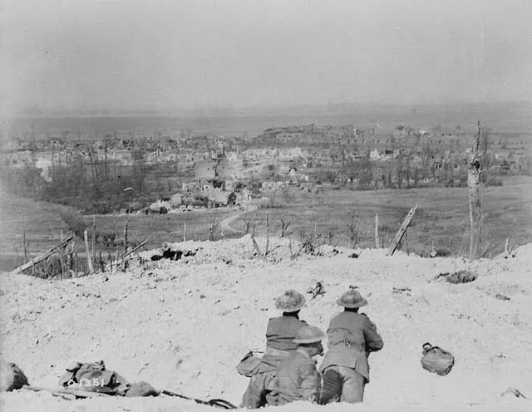
Where is it?
Located on the highest point of Vimy Ridge in northern France.
Built on the site of the Battle of Vimy Ridge (April 9–12, 1917), where all four divisions of the Canadian Corps fought together for the first time. The victory is often seen as a defining moment in Canadian nationhood.
The ridge was strategically important because of its view of the plains below.
In 1922, France granted Canada use of the land "freely and for all time" to build a memorial.
Images: Veterans Affairs Canada

Slide 3
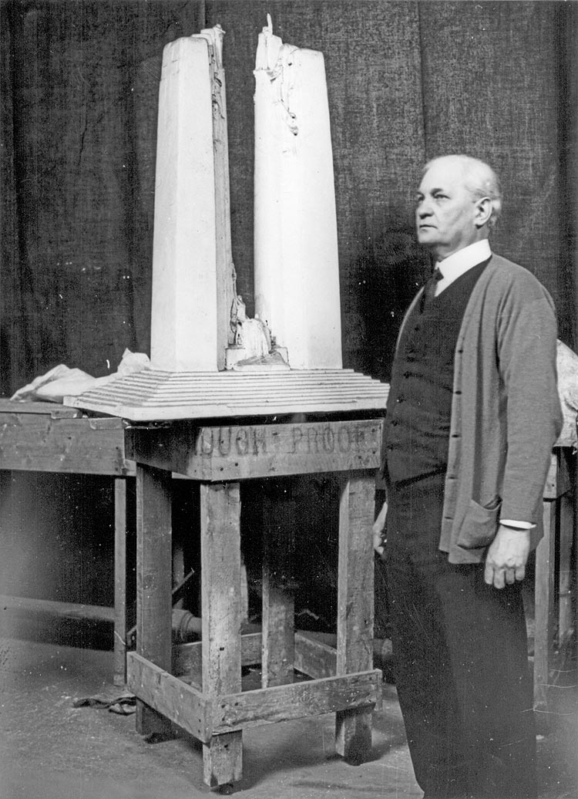
Who designed it?
Designed by Canadian architect and sculptor Walter Allward.
Chosen in 1921 from 160 entries entered in a national design competition.
The idea for the memorial’s design came to him in a dream. It emphasizes peace and sacrifice, rather than victory.
Allward was inspired by artists like Rodin and Michelangelo. His design was also influenced by the Christian symbolism.
Image: Veterans Affairs Canada

Slide 4
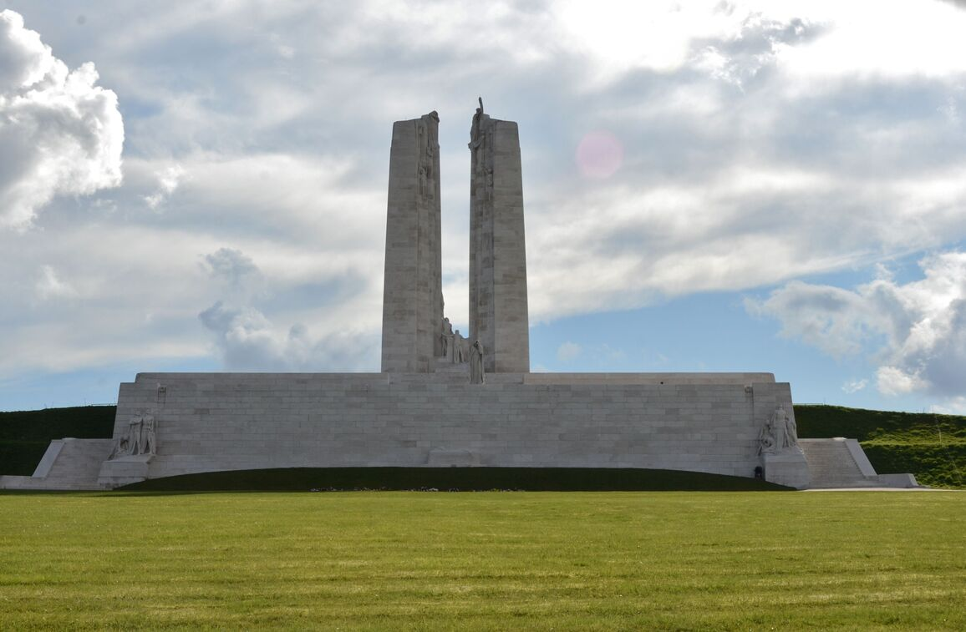
Who does it commemorate?
Honours all of the approximately 650,000 Canadians who served in the First World War, including 66,000+ who died.
As a memorial to the missing, it remembers 11,285 Canadians who died in France with no known grave.
Image: Veterans Affairs Canada

Slide 5
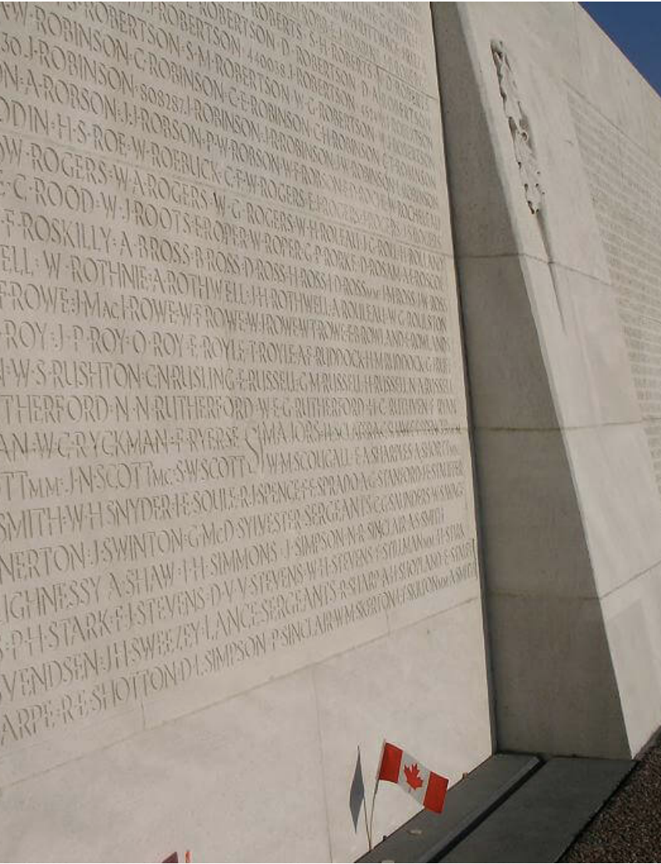
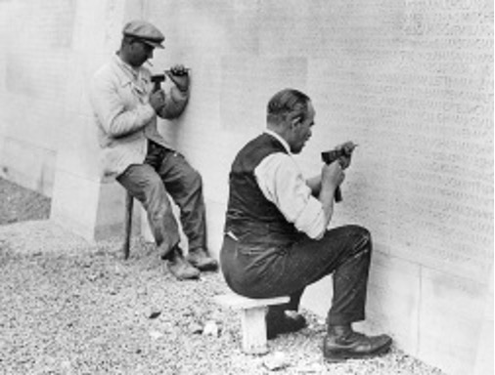
How are the missing remembered?
Stone carvers carefully sandblasted and meticulously etched the names of the missing into the white stone walls of the memorial.
Walter Allward created a special lettering style.
Names are listed alphabetically, not by military rank.
Images: Veterans Affairs Canada

Slide 6
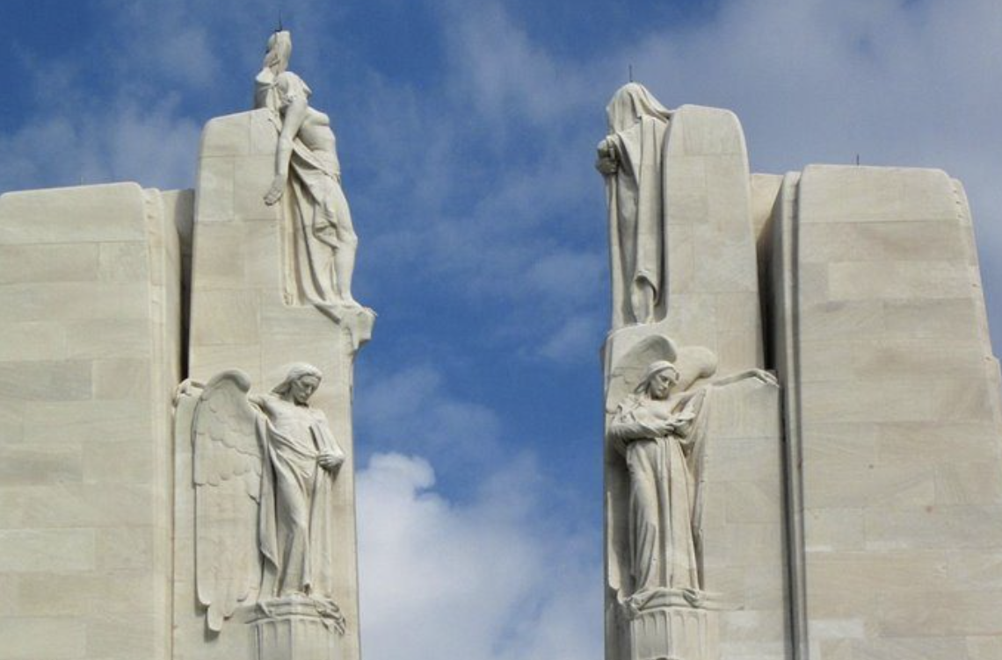
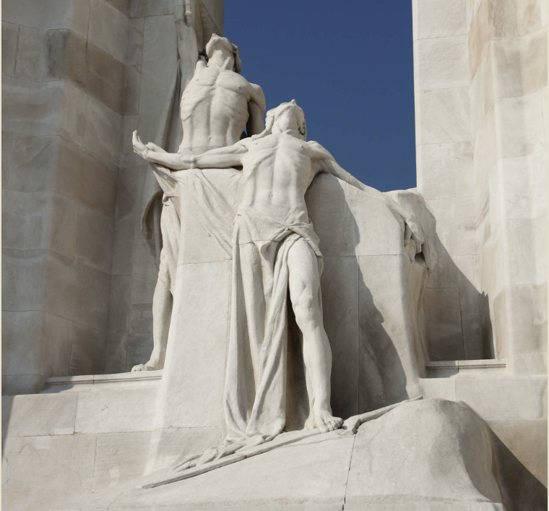
What symbols are used?
20 sculptures are carved from limestone. They are twice the size of an average person!
Two 30-metre pylons symbolize Canada and France.
  At the base: The Spirit of Sacrifice —a dying soldier passing the torch (linking to In Flanders Fields).
  At the top: The Chorus representing the values Canadians fought for: Peace, Justice, Honour, Hope, Charity, Faith, Truth and Knowledge.
Images: Veterans Affairs Canada

Slide 7
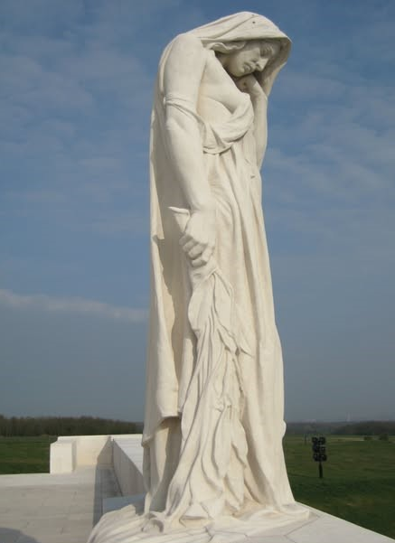
What symbols are used?
The most famous sculpture is Canada bereft (also known as Mother Canada).
This sad figure represents the young nation of Canada mourning its fallen. She gazes down at a symbolic tomb far below.
Image: Veterans Affairs Canada

Slide 8
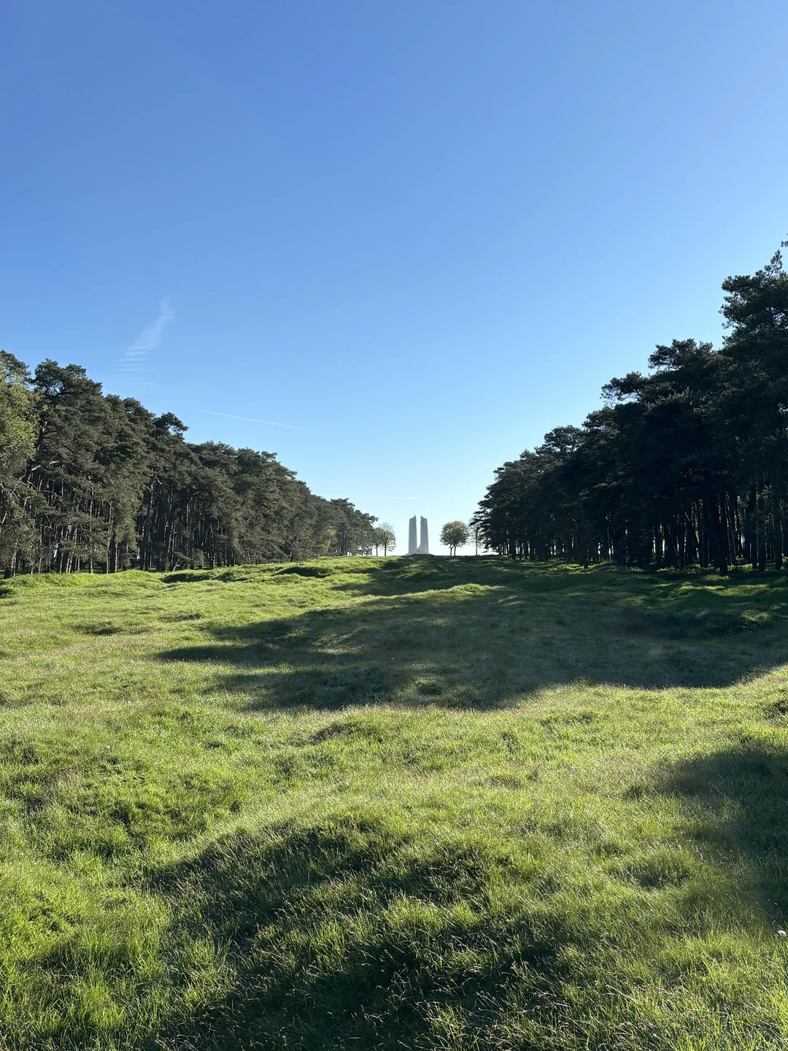
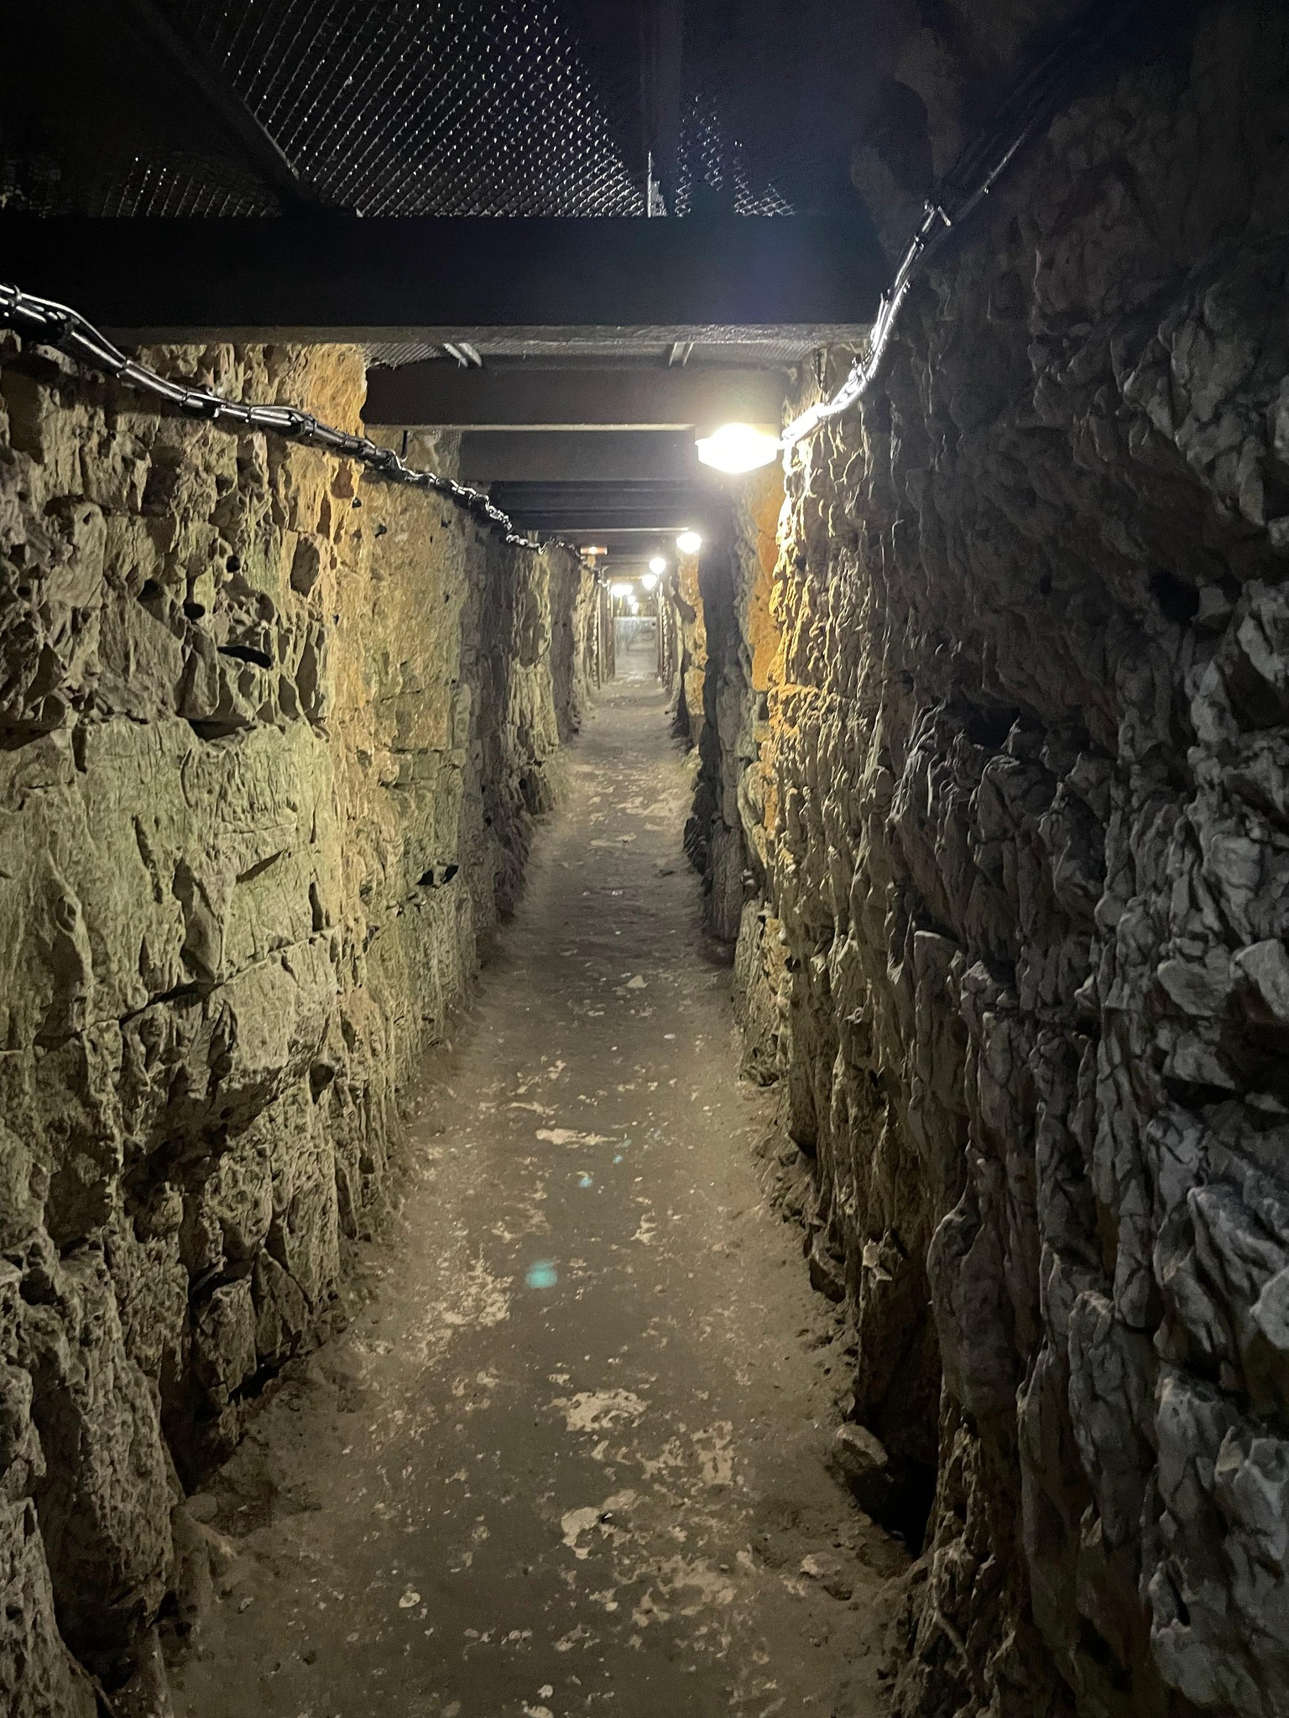
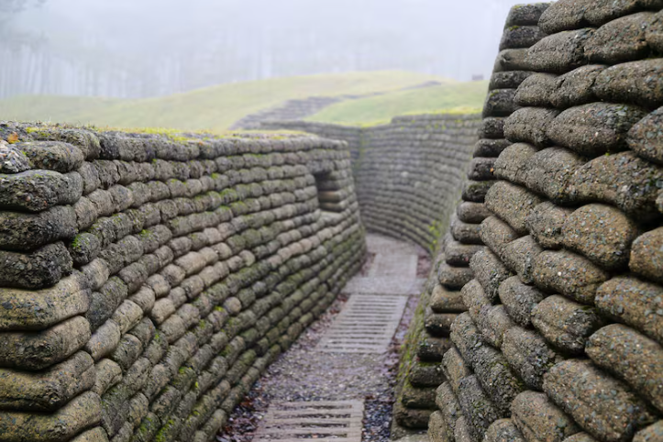
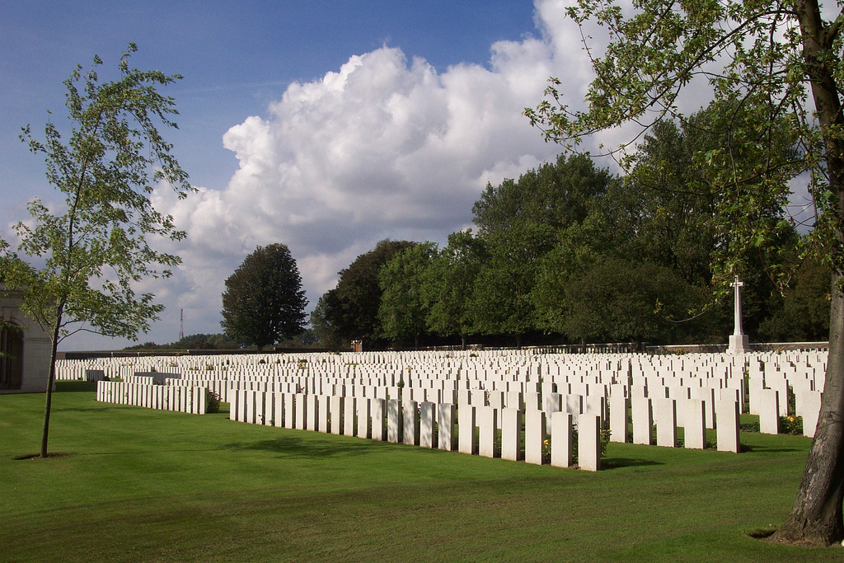
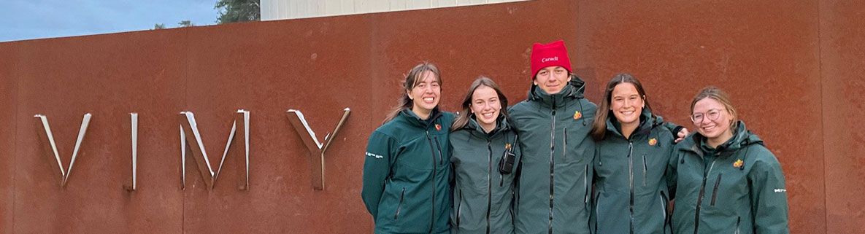
Are there any other features?
The Vimy Memorial is part of a larger battlefield park. It includes preserved battlefields, trenches, a tunnel used during the Battle of Vimy Ridge, and two cemeteries.
A visitor education centre shares Canada’s First World War story.
Student guides from Canadian universities lead tours.
Site is maintained by the Government of Canada.
Images: Veterans Affairs Canada

Slide 9
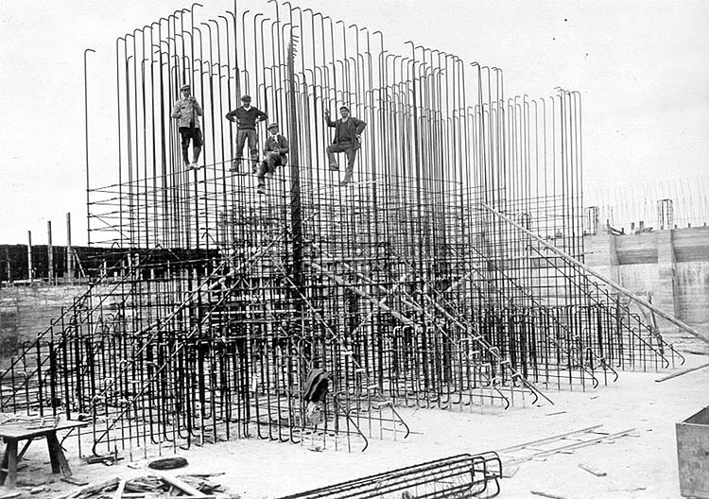
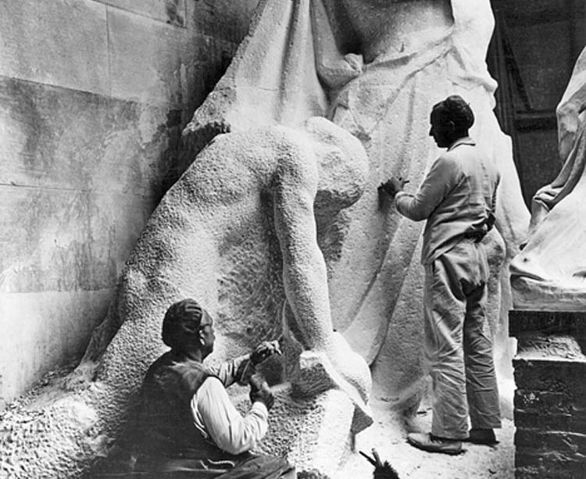
How was it built?
It took 11 years to build the Vimy Memorial (1925-1936).
A large foundation made of concrete with steel reinforcement was needed to support the memorial’s large size and weight.
The pillars and base are covered with almost 6,000 tons of limestone brought to the site from Croatia. It was chosen for durability and visual appeal.
The twenty sculptures were carved where they stand, from huge blocks of limestone.
Images: Veterans Affairs Canada

Slide 10
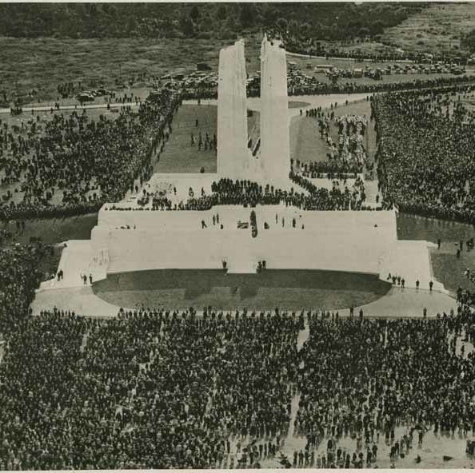
When was it dedicated?
The memorial was dedicated by King Edward VIII on July 26, 1936.
6,000+ Canadian Veterans and their families travelled by ship from Canada.
More than 50,000 French Veterans and civilians attended.
In 1997, Vimy became one of only two National Historic Sites of Canada located outside Canada (the other is the Beaumont-Hamel Newfoundland Memorial).
Image: Veterans Affairs Canada

