Slide 1

Beaumont-Hamel
Newfoundland Memorial

Slide 2

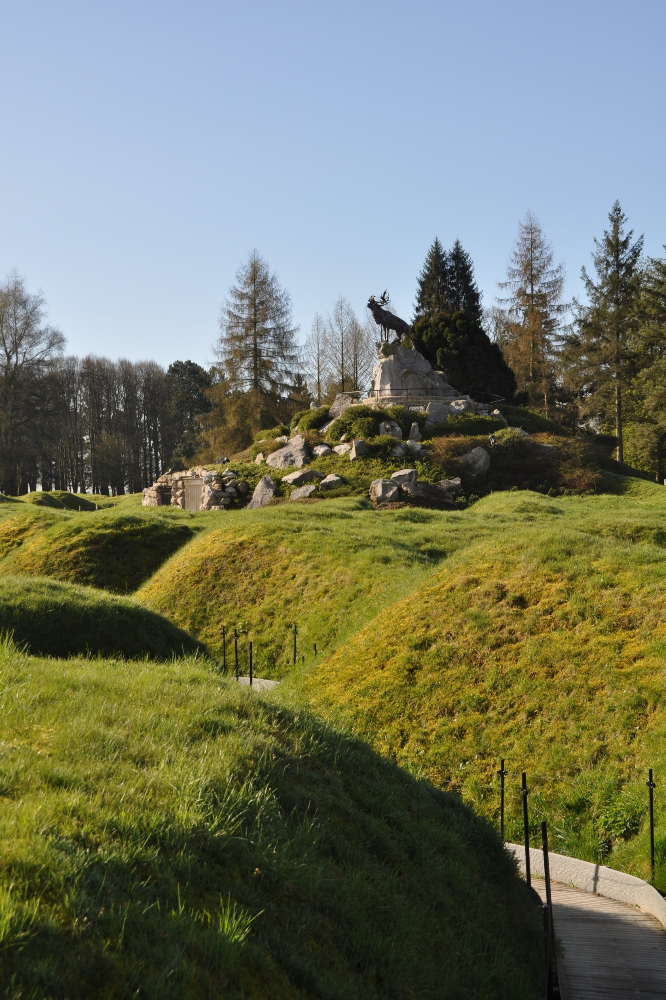
Where is it?
Near the village of Beaumont-Hamel in northern France.
Built on the site of the Newfoundland Regiment’s attack on July 1, 1916—the first day of the Battle of the Somme.
Of the approximately 800 men who went into battle, only 68 were able to answer the roll call the next day. More than 700 were killed, wounded or missing.
In 1921, the Dominion of Newfoundland purchased the land for a battlefield memorial.
Image: Veterans Affairs Canada

Slide 3
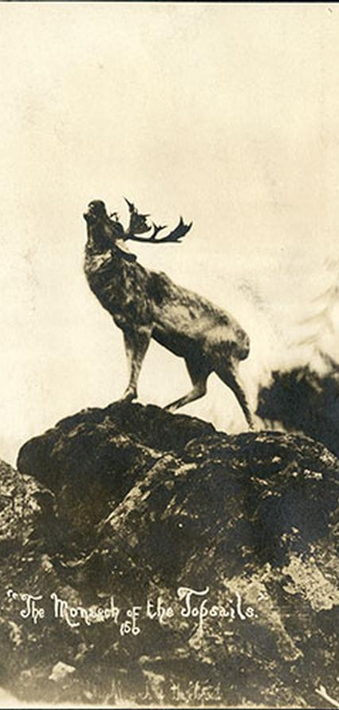
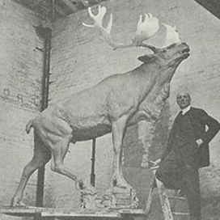
Who designed it?
Designed by British sculptor Captain Basil Gotto whose design was chosen from 16 proposals.
Believed to have been inspired by a famous Newfoundland photograph called The Monarch of the Topsails.
Rudolph Cochius was selected as the landscape architect. He immigrated to Canada from the Netherlands in 1911.
Image: Veterans Affairs Canada
Image: Courtesy of The Rooms provincial archives

Slide 4
Who does it commemorate?
Honours all of the approximately 12,000 people from Newfoundland and Labrador who served during the First World War, including the more than 1,600 who died in service.
As a memorial to the missing, it remembers 821 Newfoundlanders who died during the war with no known grave.
Image: Veterans Affairs Canada

Slide 5
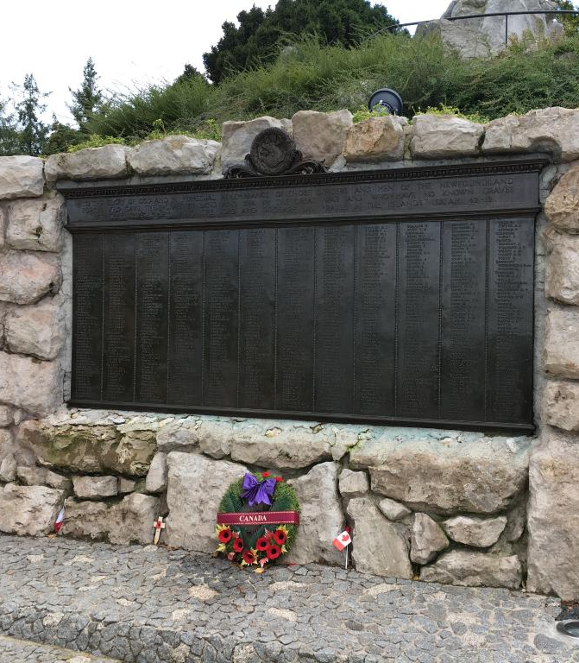
How are the missing remembered?
The names of the missing appear on three bronze tablets at the base of the memorial.
Names include the Newfoundland Regiment, Royal Naval Reserve, and Merchant Navy.
The tablets stand close to the Regiment’s original forward trenches on July 1, 1916.
Image: Veterans Affairs Canada

Slide 6
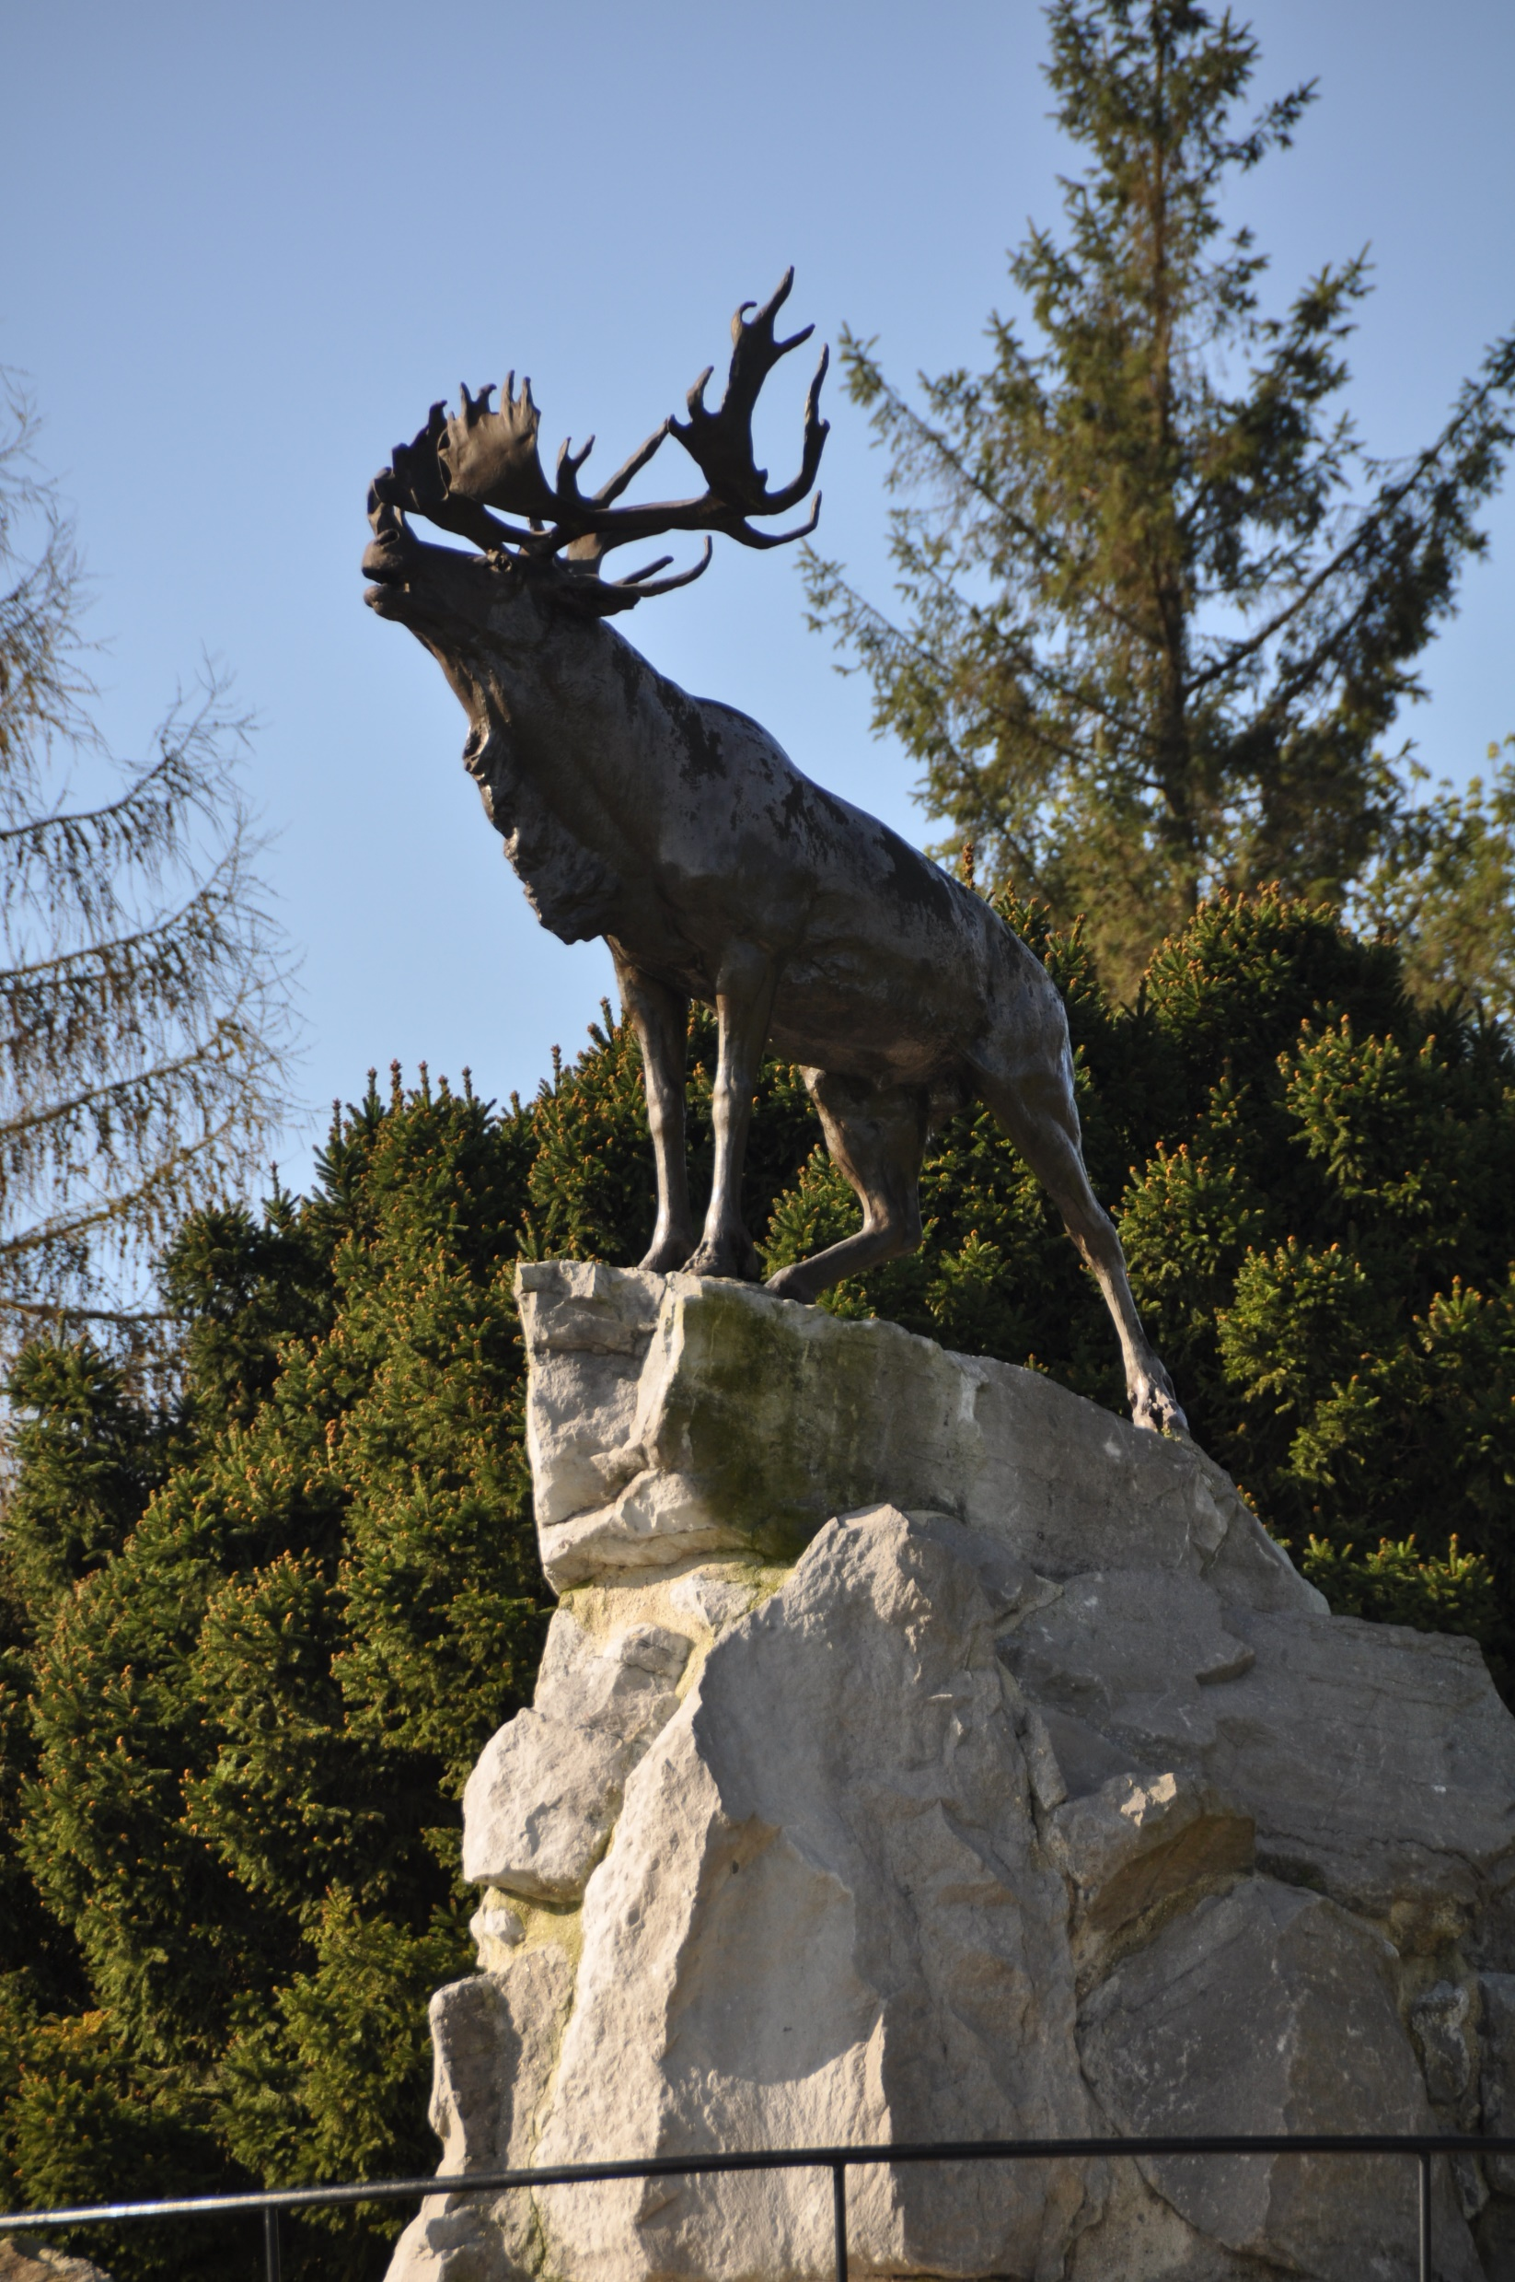
What symbols are used?
The bronze caribou was chosen as the central figure because it was the emblem of the Newfoundland Regiment and symbolized the brave spirit of its soldiers.
It stands on a cairn made of Newfoundland granite, designed to resemble a natural rocky cliff in Newfoundland.
Surrounded by trees and shrubs native to Newfoundland.
The caribou faces the former German lines as it watches over a battlefield that still claims many men with no final resting place.
Image: Veterans Affairs Canada

Slide 7
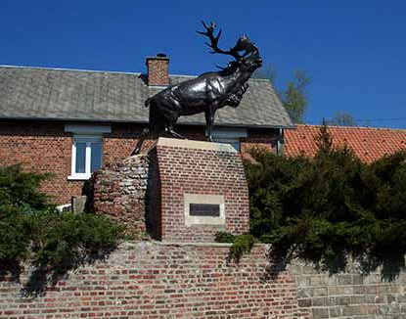
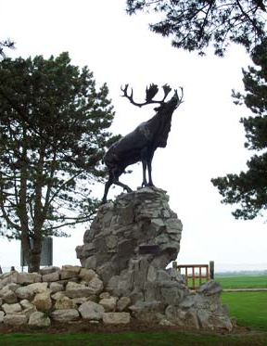
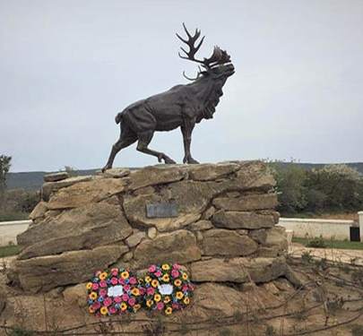
What is the trail of the caribou?
Five caribou memorials were originally placed in France and Belgium at the sites of important battles for the Royal Newfoundland Regiment.
A sixth caribou memorial was built at Bowring Park in St. John’s, NL.
In 2021, a seventh caribou memorial was dedicated in Türkiye recognizing Newfoundland action at Gallipoli.
Together, these memorials are known as the Trail of the Caribou.
Images: Veterans Affairs Canada

Slide 8
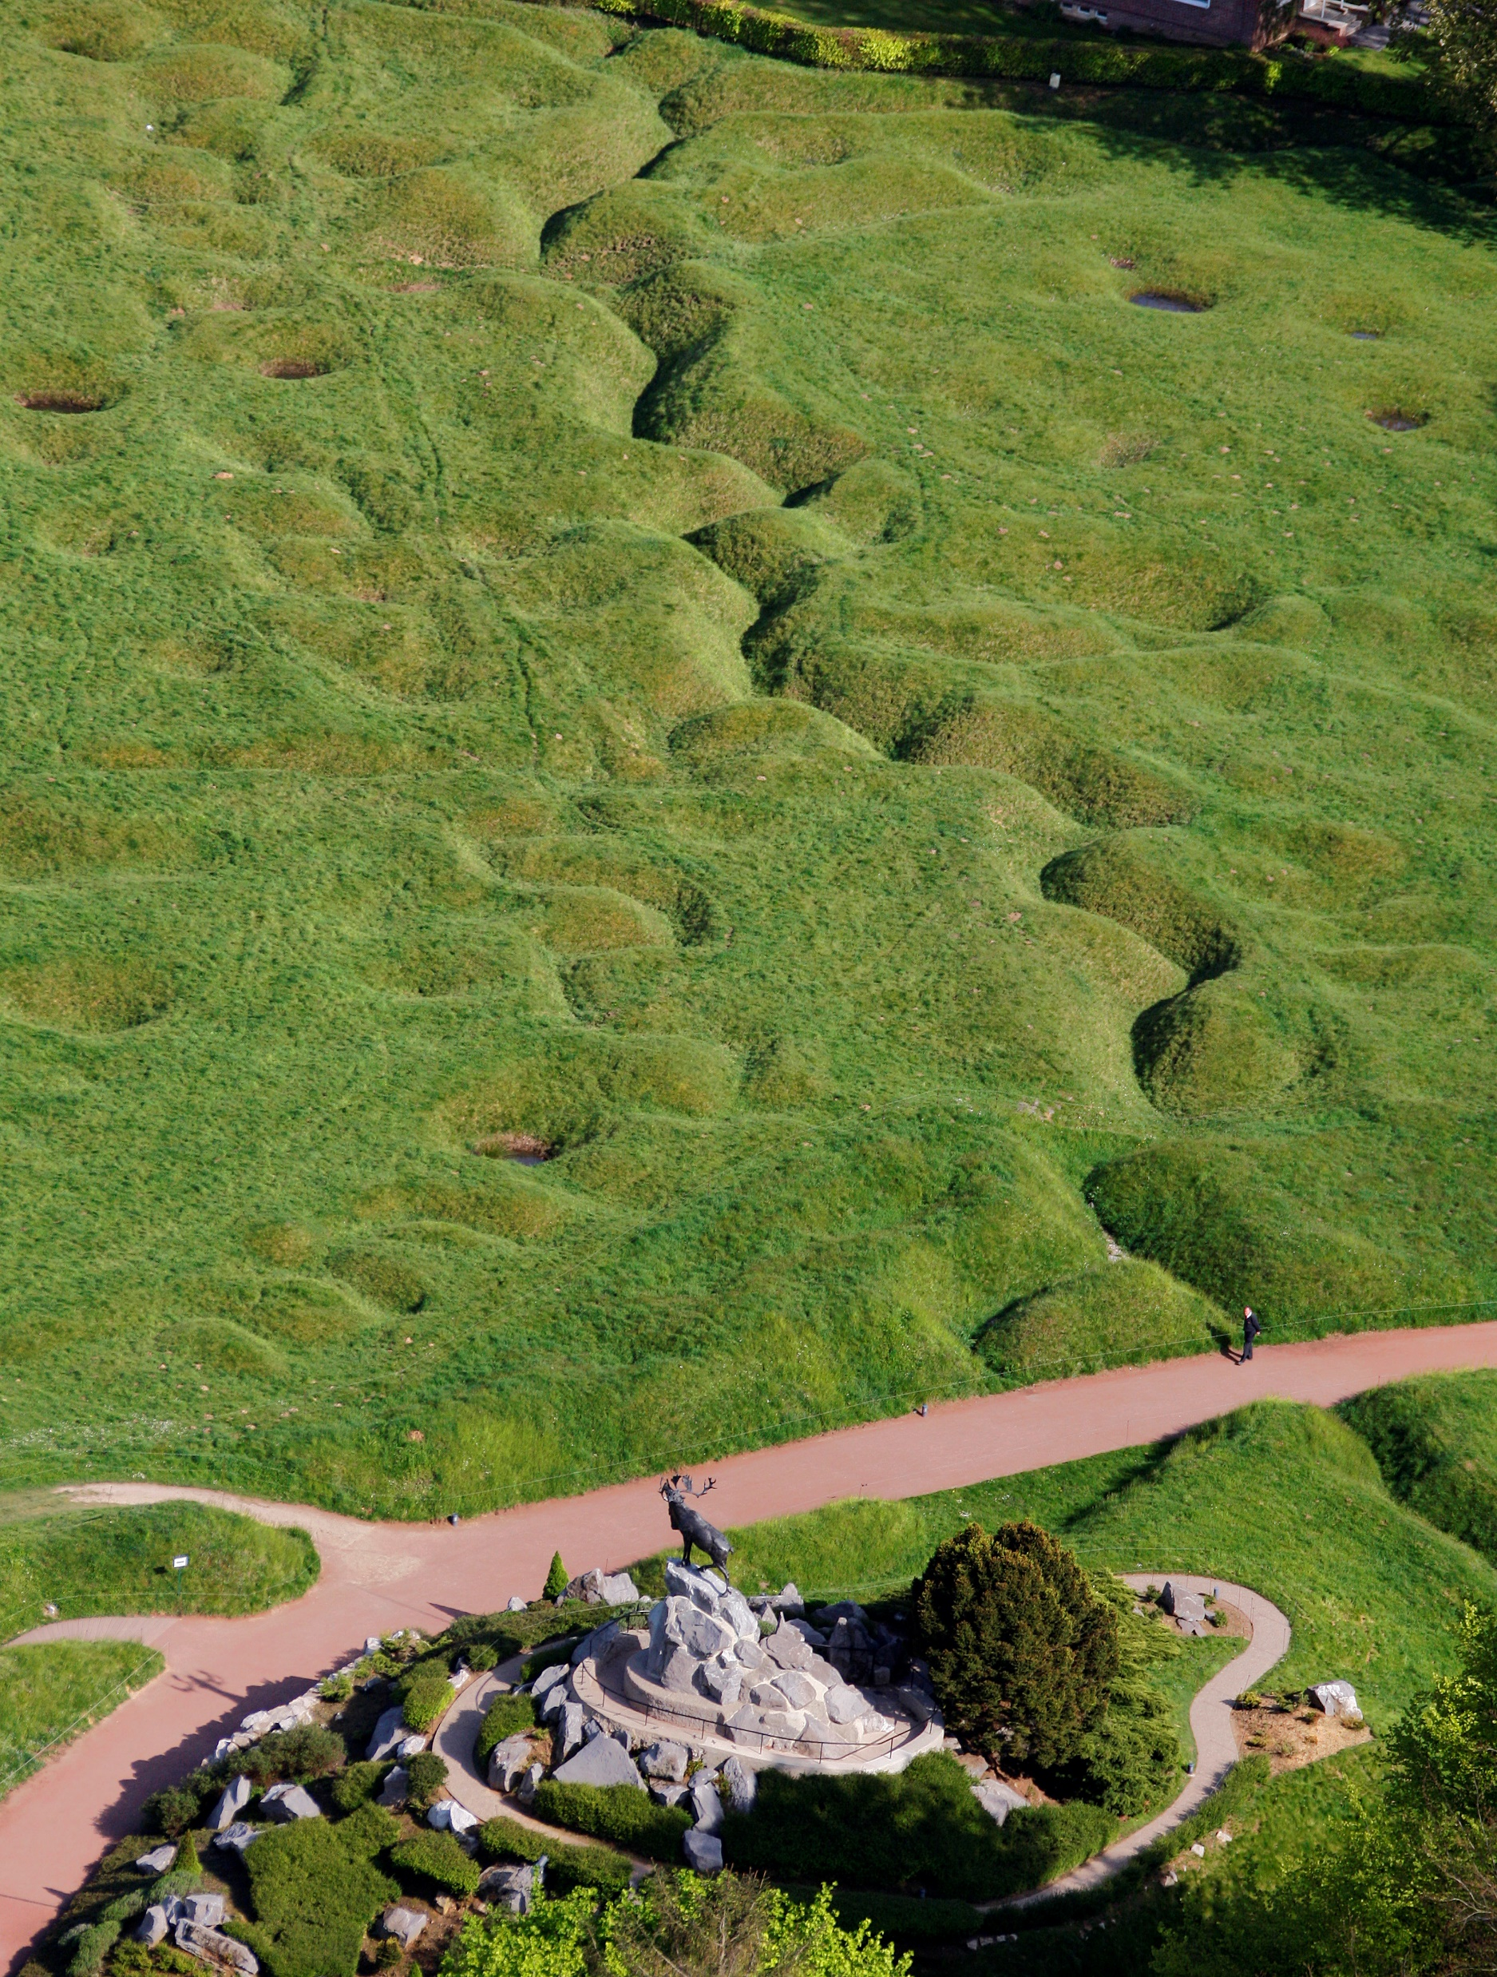
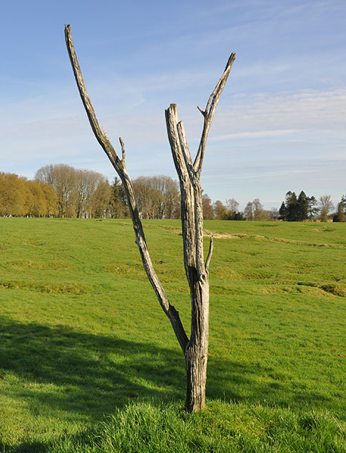
Are there any other features?
The Beaumont-Hamel Newfoundland Memorial is part of a larger battlefield park. It includes preserved battlefields, trenches, and three cemeteries.
Halfway across the battlefield the Danger Tree marked a zone of heavy fire and Newfoundland losses.
The broken and twisted remains of the tree are an important symbol of the battle’s devastation. Today, a replica of the original tree stands in its place.
Images: Veterans Affairs Canada

Slide 9
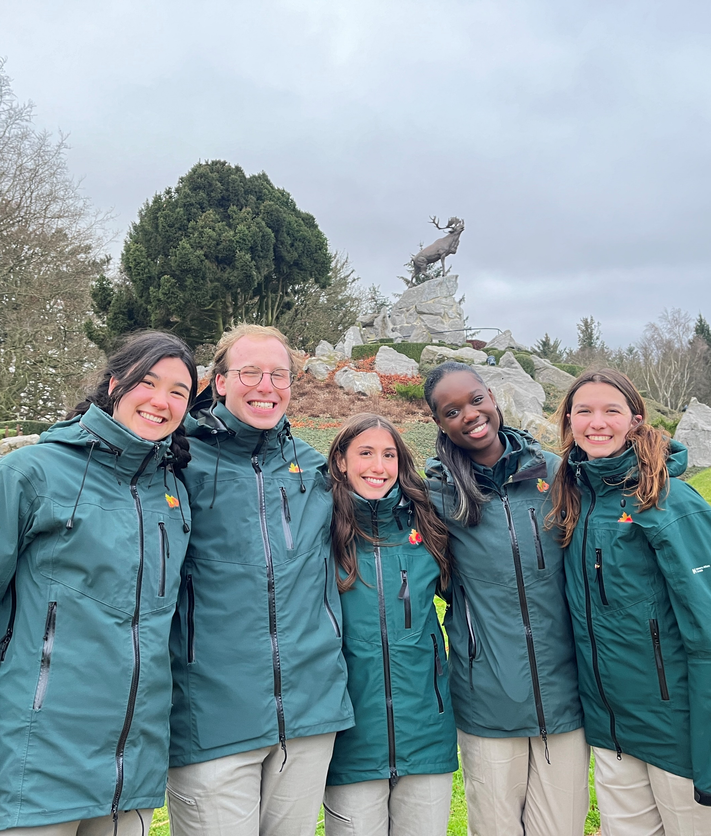
Are there any other features?
A visitor education centre shares Newfoundland’s First World War story.
Student guides from Canadian universities lead tours.
Site is maintained by the Government of Canada.
Image: Veterans Affairs Canada

Slide 10
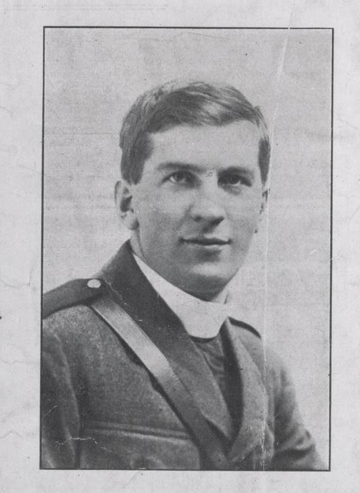
How was it built?
Commemorative efforts in Newfoundland were led by Lieutenant-Colonel Father Thomas Nangle, Padre of the Newfoundland Regiment during the First World War.
Nangle led planning, fundraising and design and also oversaw the memorial’s construction in Europe.
Construction took place between 1922 and 1924
The bronze caribou was cast in England and shipped to the site. It weighs approximately 770 kilograms (1,700 pounds).
Image: Veterans Affairs Canada

Slide 11
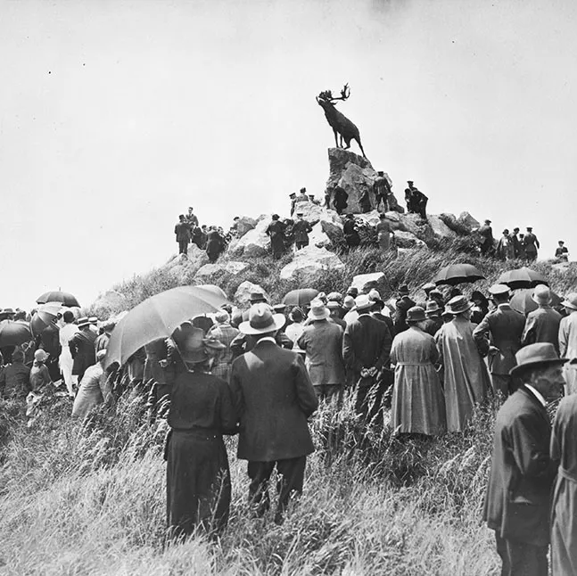
When was it dedicated?
Dedicated on June 7, 1925 by Field Marshal Earl Haig, commander of British forces during the Battle of the Somme.
Attended by veterans of the Newfoundland Regiment, Dominion of Newfoundland representatives, and British/French military participants.
In 1997, Vimy became one of only two National Historic Sites of Canada located outside Canada (the other is the Canadian National Vimy Memorial).
Image: Veterans Affairs Canada

