Slide 1

Missing but not forgotten
Memorials to the missing

Slide 2
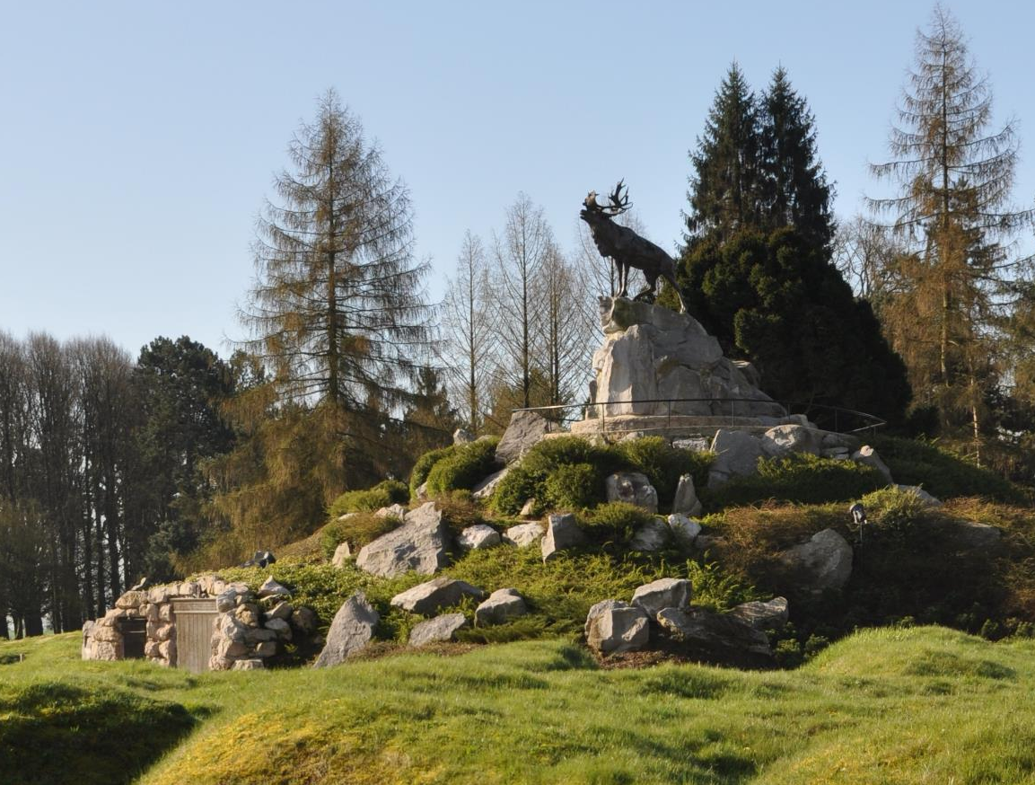
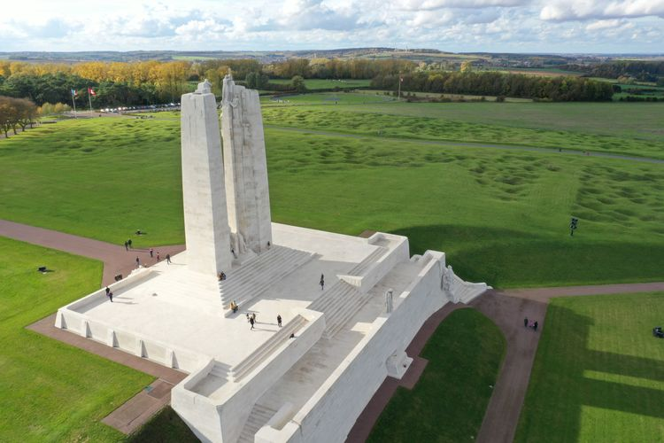
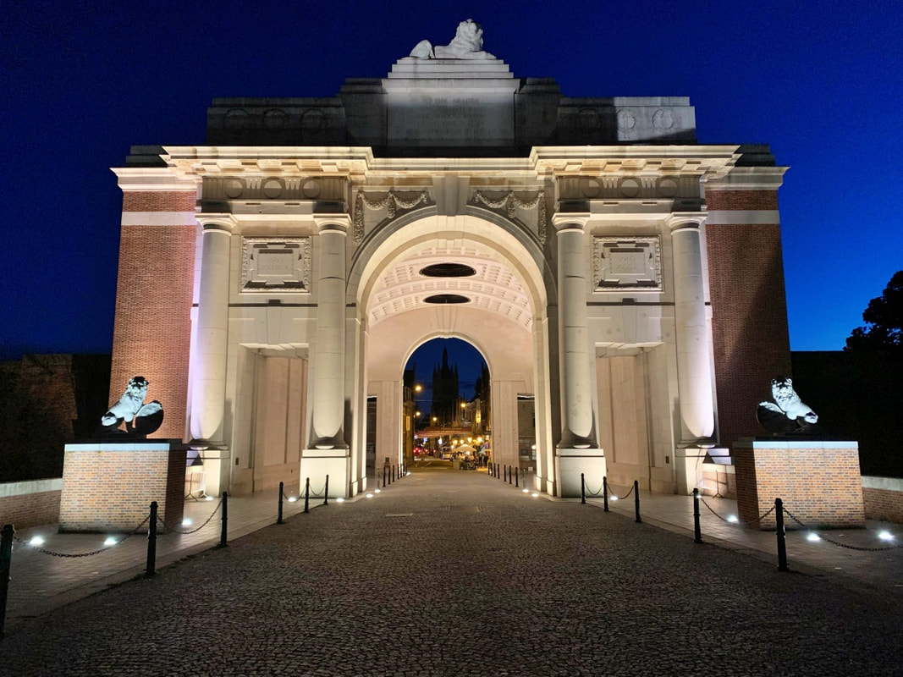
Memorials to the missing
Three memorials in Europe honour Canadians who died in the First World War with no known grave.
Beaumont-Hamel Newfoundland Memorial
Canadian National Vimy Memorial
Menin Gate
Images: Veterans Affairs Canada

Slide 3
We will learn
Why memorials were built for soldiers with no known grave.
Why Canada has two memorials to the missing in France.
Why Canadians are also remembered on the Menin Gate in Belgium.

Slide 4
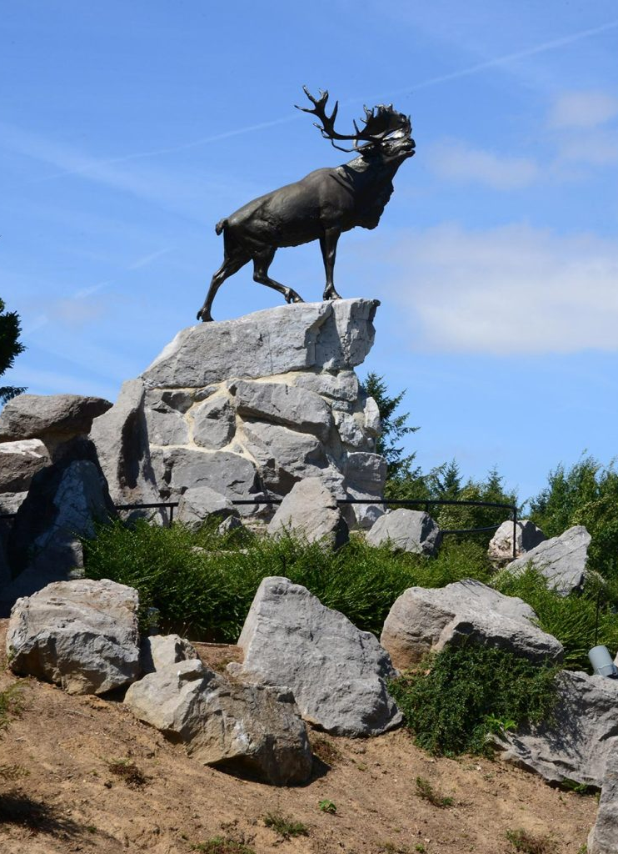
Beaumont-Hamel Newfoundland Memorial
Located in northern France.
Newfoundland and Labrador did not join Canada until 1949. The colony served during the First World War as part of British forces.
Three roles:
  Honours all Newfoundlanders who served
  It is the largest of six memorials in Europe remembering the contributions of Newfoundland and Labrador in the First World War.
  Site of famous battle
  Marks the site of the Newfoundland Regiment’s huge losses on the opening day of the Battle of the Somme in 1916.
  Memorial to the missing
  Bears the names of more than 800 men from Newfoundland and Labrador who died with no known grave in any location during the First World War.
Image: Veterans Affairs Canada

Slide 5
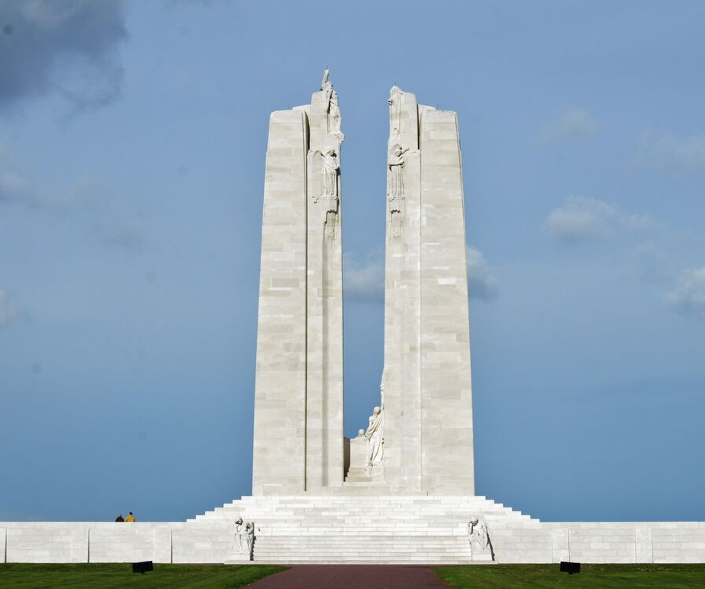
Canadian National Vimy Memorial
Located in northern France.
Three roles:
  Canada’s national war memorial in Europe
  Honours all Canadians who served in the First World War, including the more than 66,000 who died in service.
  Site of famous battle
  Marks the site of the Battle of Vimy Ridge, a defining moment in Canadian history.
  Memorial to the missing
  Bears the names of more than 11,000 Canadians who died in France with no known grave during the First World War.
Image: Veterans Affairs Canada

Slide 6
Menin Gate Memorial
Located in Ypres, Belgium.
One role:
  Memorial to the missing
  Bears the names of almost 55,000 Commonwealth soldiers who died with no known grave in the Ypres Salient area of Belgium before 16 August 1917. This includes almost 7,000 Canadians.
Image: Commonwealth War Graves Commission

Slide 7

Let’s zoom in and learn more!
Split into three memorial groups
  Beaumont-Hamel
  Vimy
  Menin Gate

