Slide 1
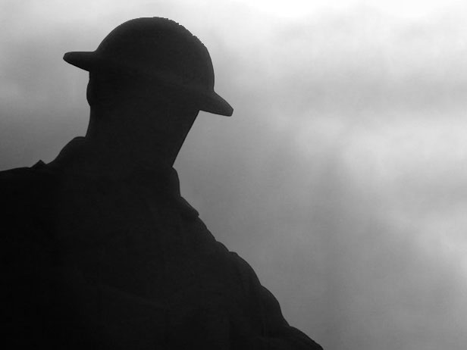

Did he have freckles?
Canada’s Tomb of the Unknown Soldier
Notes:
This presentation includes additional information in the notes section of many of the slides.

Slide 2
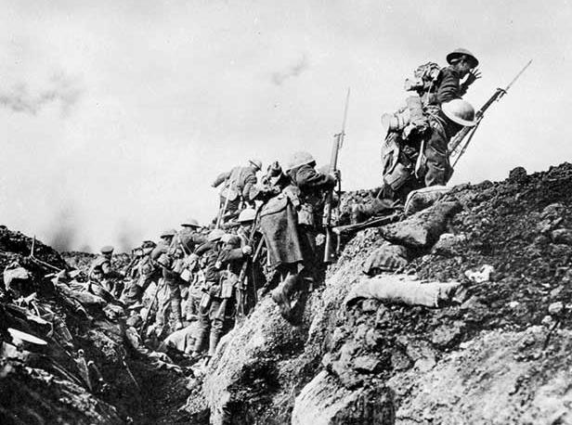
The First World War was one of the deadliest
conflicts in human history.
Notes:
Canadian soldiers going “over the top” and leaving their trenches during a military exercise in northern France during the First World War.
(Photo: Library and Archives Canada)

Slide 3
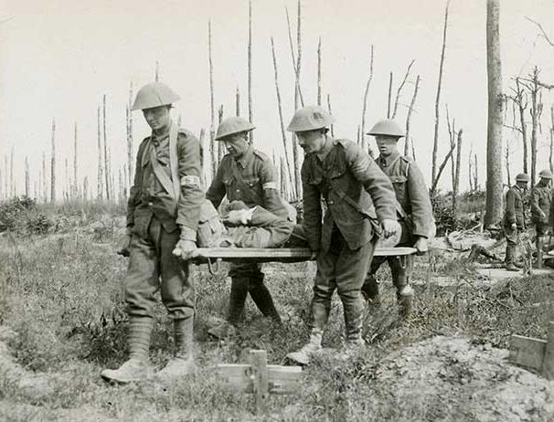
Millions of people were wounded or killed.
Notes:
Canadian stretcher bearers carrying a wounded soldier so he can receive medical aid during the First World War.
(Photo: Canadian War Museum George Metcalf Archival Collection CWM 19920044-509)

Slide 4
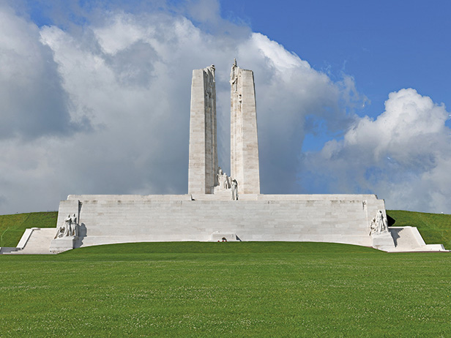
Many of those who died were never found.
Others were not identified.
Notes:
The Canadian National Vimy Memorial is our country’s most famous overseas war monument. Inscribed on its granite base are the names of 11,285 Canadian soldiers who lost their lives fighting in France during the First World War and who then had no known final resting place.
(Photo: Veterans Affairs Canada)

Slide 5
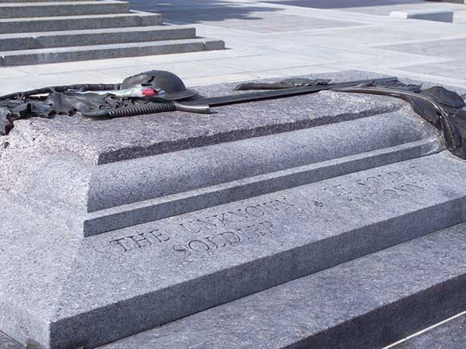
Canada’s Tomb of the Unknown Soldier honours their memory.
Notes:
Canada’s Tomb of the Unknown Soldier is located at the base of the National War Memorial in Ottawa. The Tomb symbolically represents all of the more than 120,000 Canadians who have died in military service over the years – as well as all those who may lose their lives in the future.
(Photo: Veterans Affairs Canada)

Slide 6
Imagine
It reminds us to remember
by asking us to

Slide 7
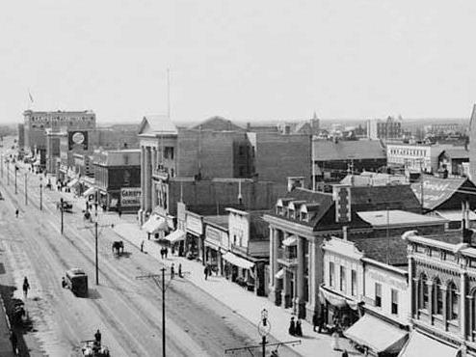
Did he live in a city?
Notes:
Jasper Avenue in Edmonton, Alberta, in the years before the First World War.
(Photo: Library and Archives Canada PA-021244)

Slide 8
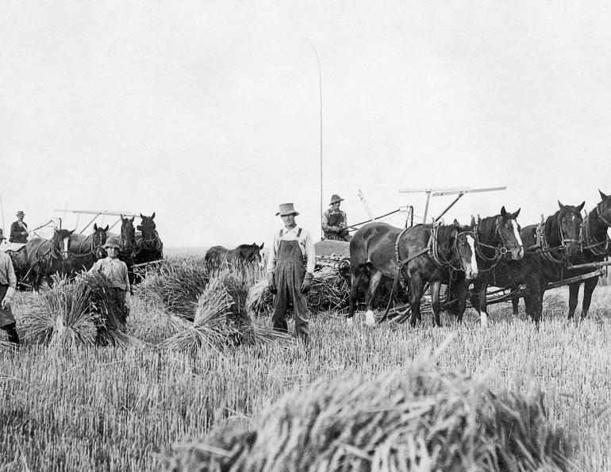
On a farm?
Notes:
People hard at work harvesting wheat in Canada during the years before the First World War.
(Photo: Library and Archives Canada)

Slide 9
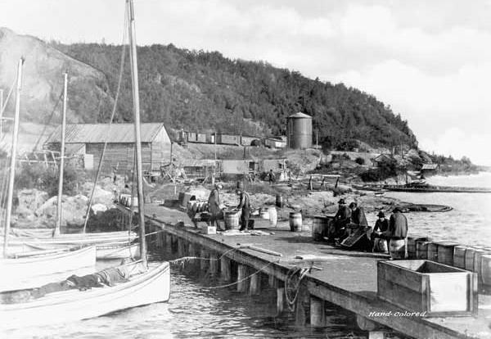
Or maybe in a fishing community?
Notes:
The fishing dock of an Ontario village on the shores of Lake Superior in the years around the First World War.
(Photo: Library and Archives Canada 3336202)

Slide 10
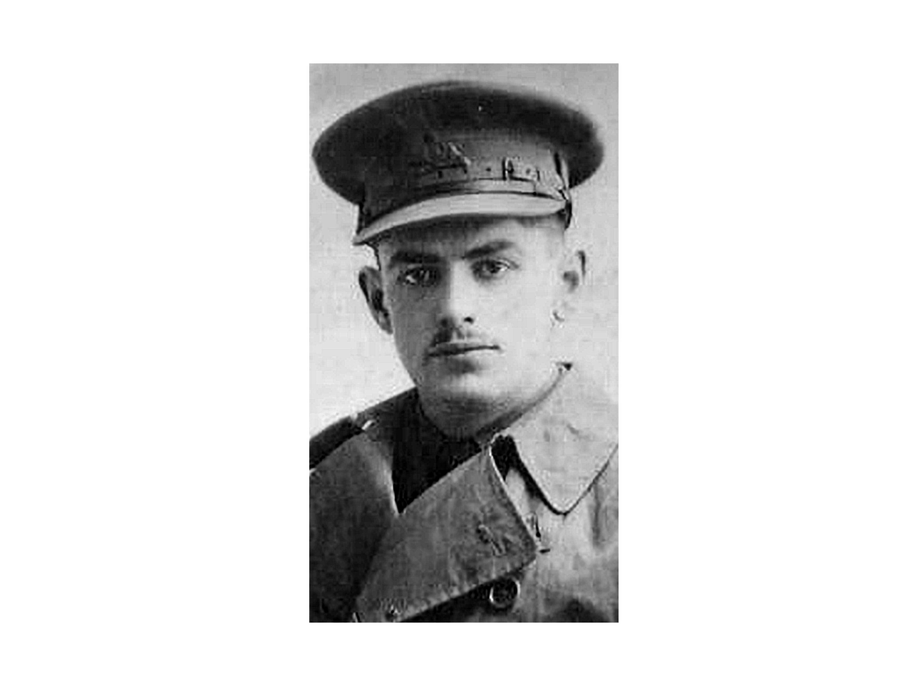
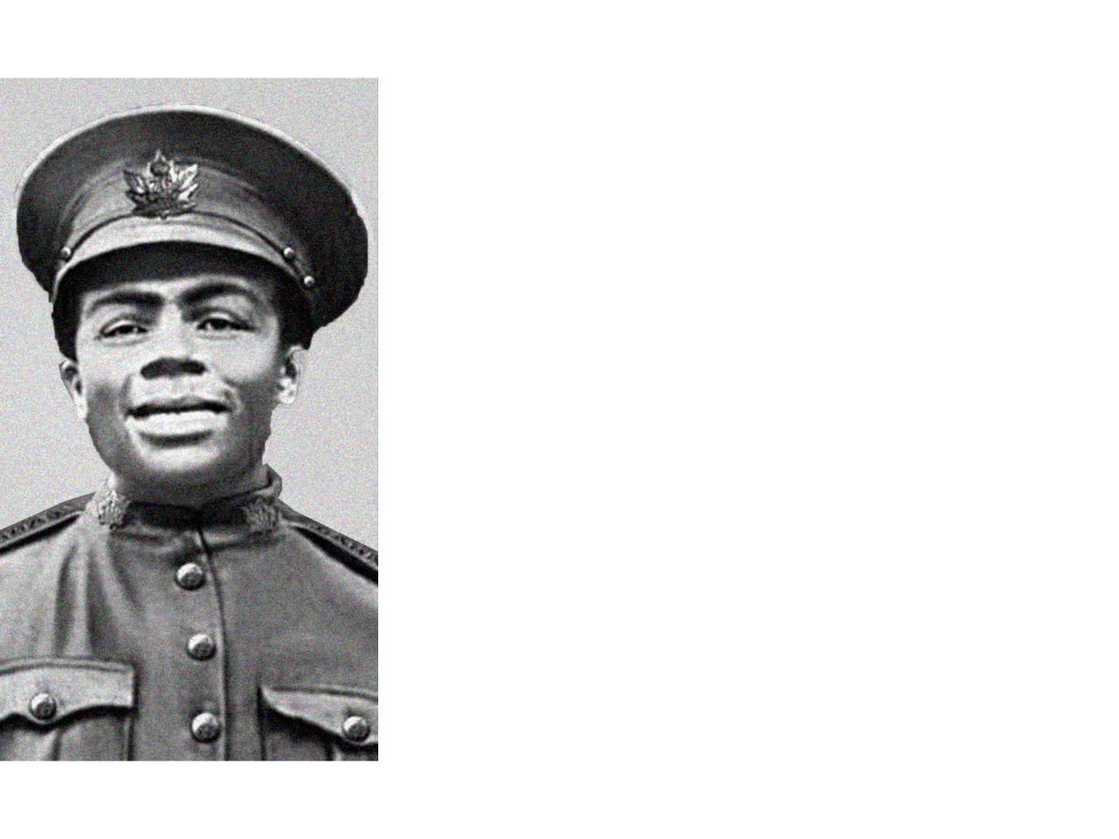
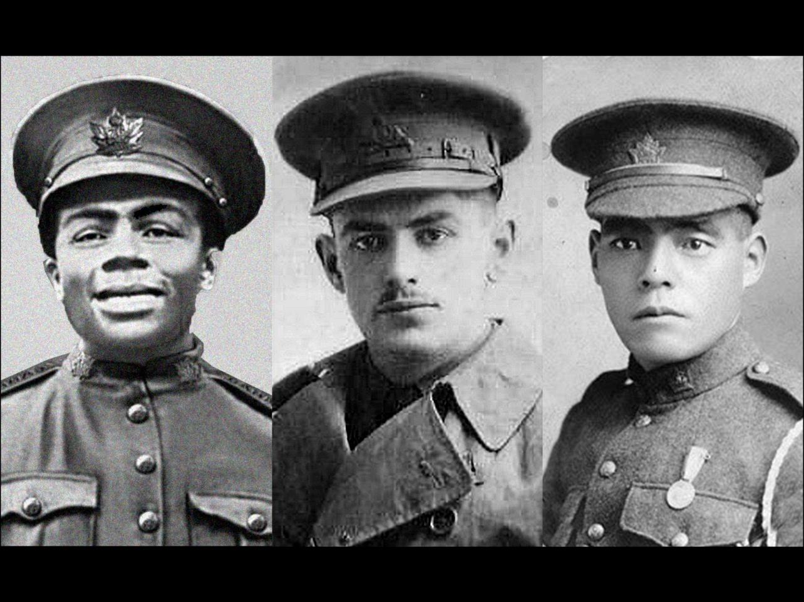
What language did he speak?
Notes:
All of these soldiers have no known final resting place. Their names are listed on the Canadian National Vimy Memorial.
LEFT: James Franklin spoke English. He was born in Mississippi but emigrated to Hamilton, Ontario, with his family as a small child. James joined the Canadian Expeditionary Force at the age of 17. He lost his life in France on October 8, 1916 during the Battle of the Somme.
MIDDLE: Louis “Joseph” Binet spoke French. He worked as a grocery clerk in Quebec City before he enlisted in 1915. Binet was fatally wounded while running through an enemy artillery barrage on September 16, 1916 during heavy fighting at Courcelette, France.
RIGHT: Chikio Hashima spoke Japanese. He was born in Fukushima, Japan, and lived in British Columbia for several years before enlisting. He died in in France on August 21, 1917 during the Battle of Hill 70.
(Canadian Virtual War Memorial – submitted photos)

Slide 11
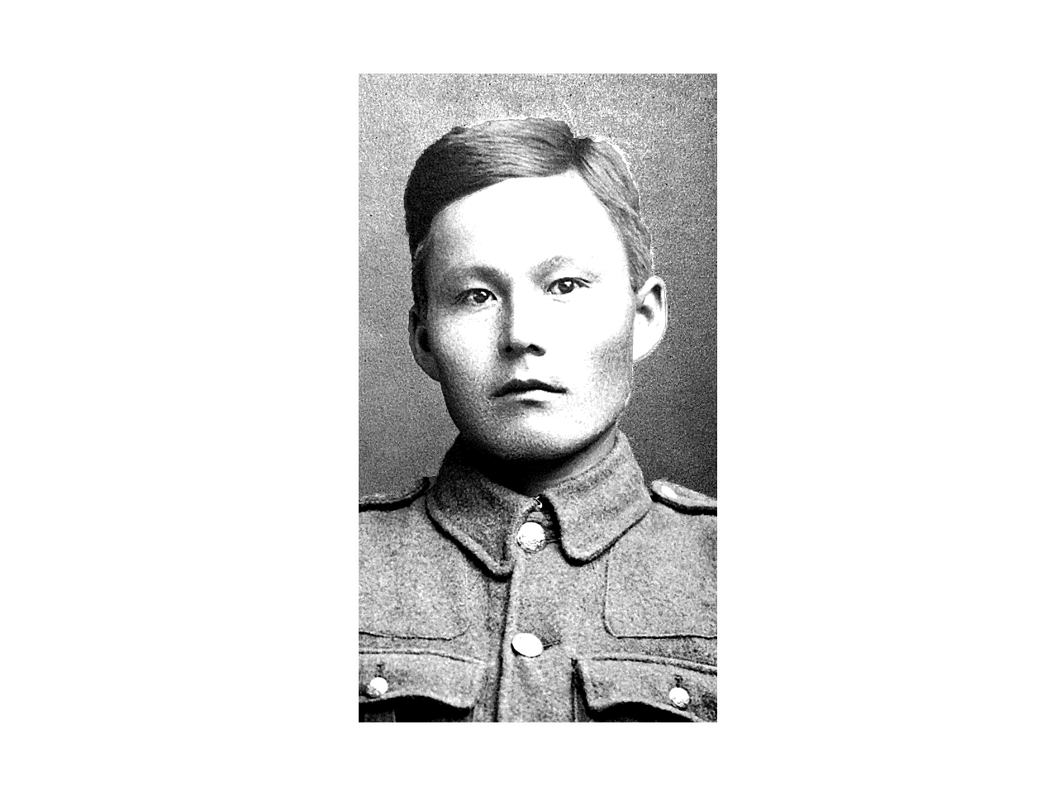
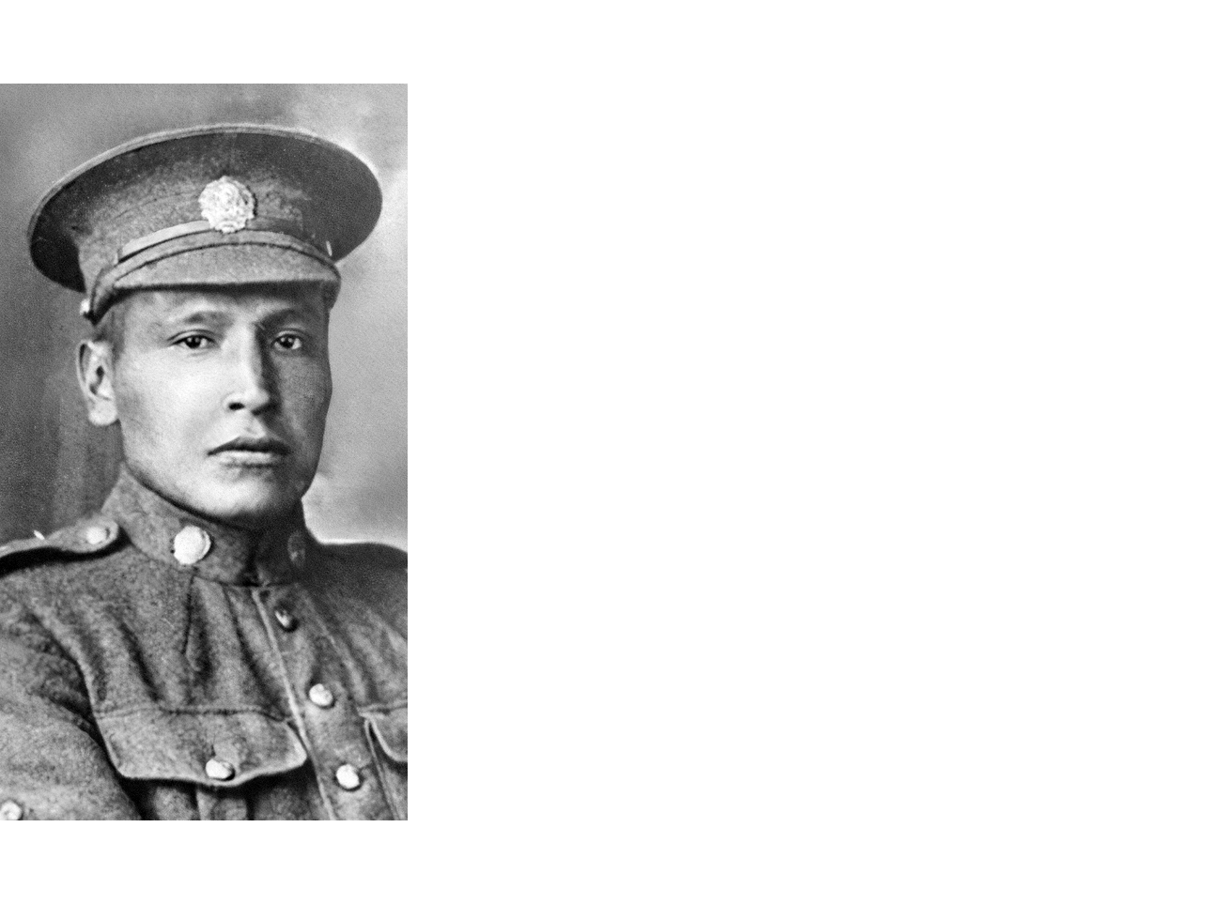
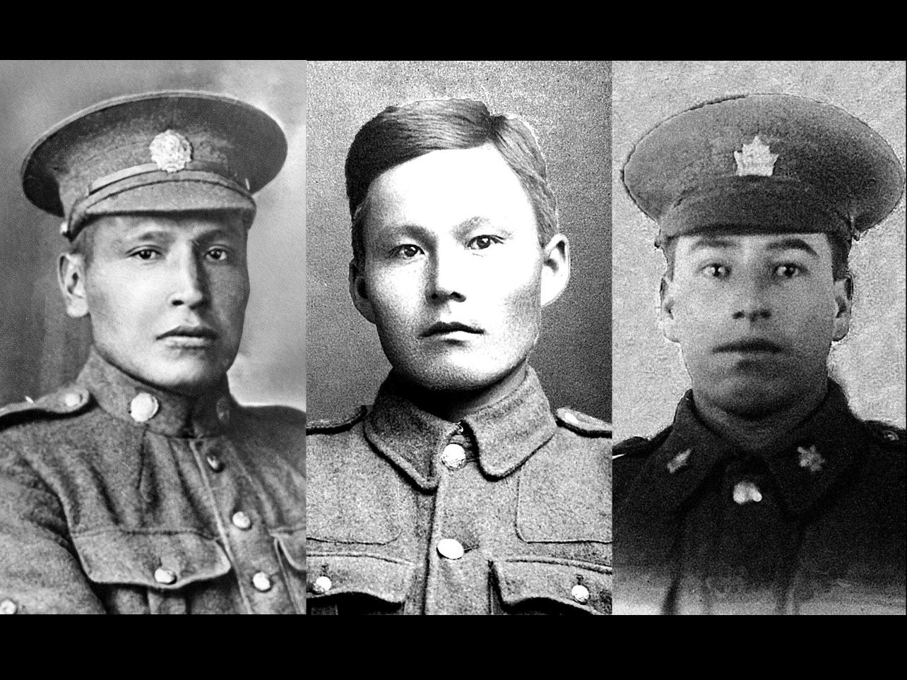
Was he Indigenous?
Notes:
More than 4,000 Indigenous people served in the Canadian military during the First World War. Some Indigenous people also served with Newfoundland forces during the conflict.
Left: Private Joseph Peters was an Indigenous soldier from Saskatchewan who died on April 9, 1917 on the opening day of the Battle of Vimy Ridge. He and his wife were from the Standing Buffalo Dakota Nation.
Middle: Lance Corporal John Shiwak was from Rigolet, Labrador. He was Inuit and was recognized as one of the best scouts and snipers on the Western Front​. John was a member of the Royal Newfoundland Regiment. Because the location of his grave was not known at the end of the First World War, his name is listed on the Beaumont-Hamel Newfoundland Memorial.
Right: James Favell was a Métis soldier from Kelowna, British Columbia. “Jimmy” was killed by an artillery shell in March 1917. He also had three brothers who served in the First World War.
(Canadian Virtual War Memorial – submitted photos)

Slide 12
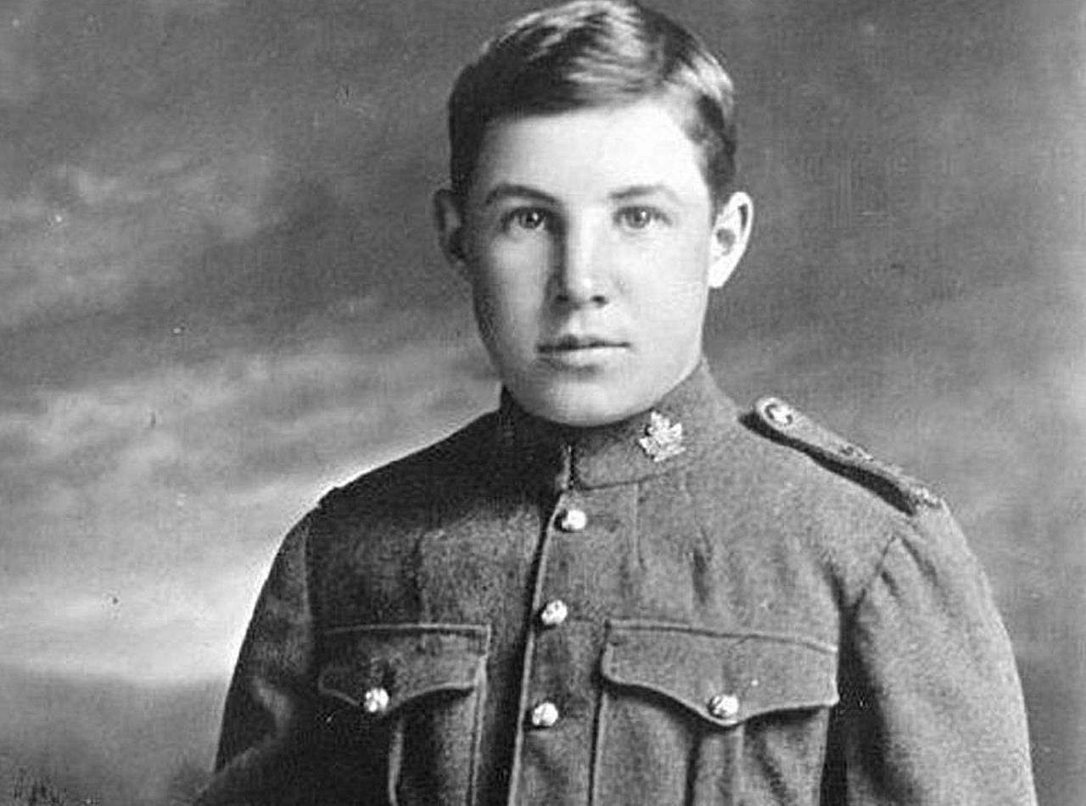
Was he young?
Notes:
Clifford Oulton was just 14 years old when he enlisted in February 1916. He had not yet reached his 16th birthday when he died at the Battle of Passchendaele in Belgium on November 1, 1917.
(Canadian Virtual War Memorial – submitted photo)

Slide 13
Imagine

Slide 14
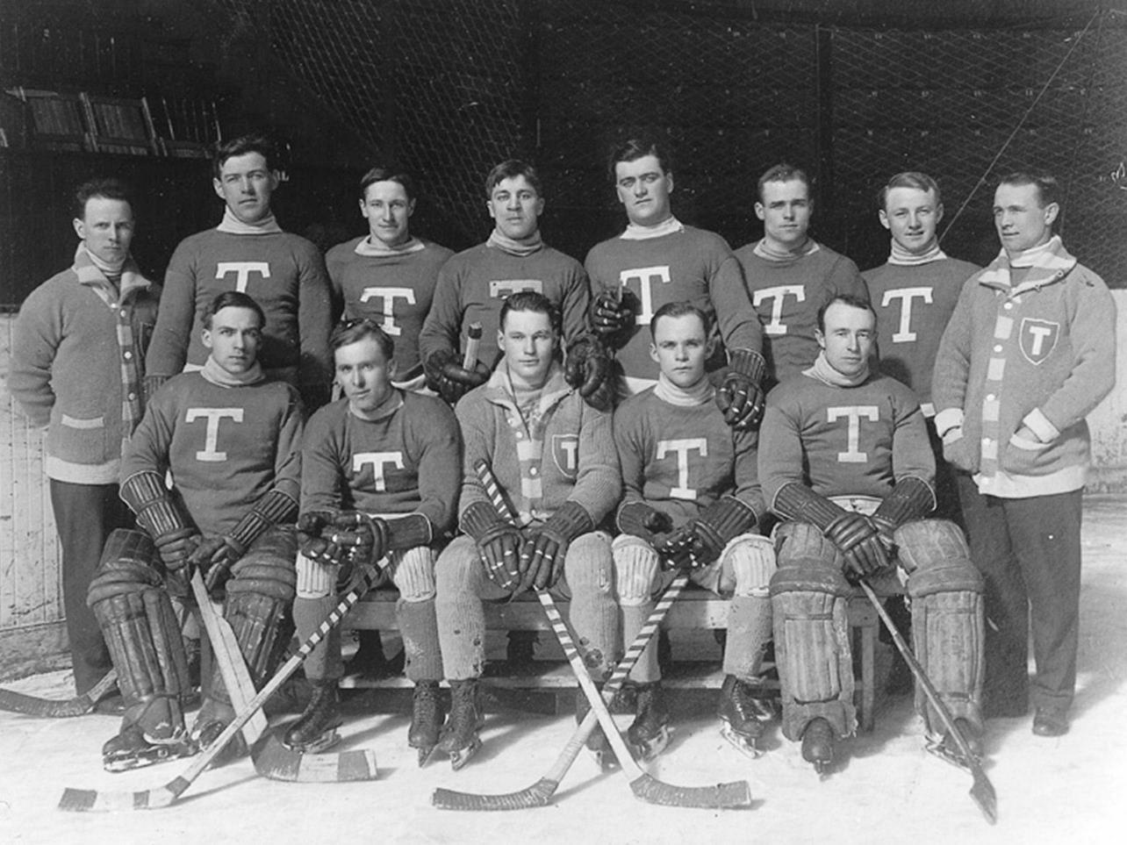
Did he play hockey?
Notes:
Front row, middle: Allan "Scotty“ Davidson is a Stanley Cup winner. He was captain of the Toronto Blueshirts when they won the cup in 1914. He was also the first professional hockey player to volunteer to serve in the First World War. Scotty was killed in the trenches by an enemy shell near Givenchy, France. His final resting place is unknown and his name is listed on the Canadian National Vimy Memorial. Scotty was inducted into the Hockey Hall of Fame in 1950.
(Photo: Musée McCord Museum)

Slide 15
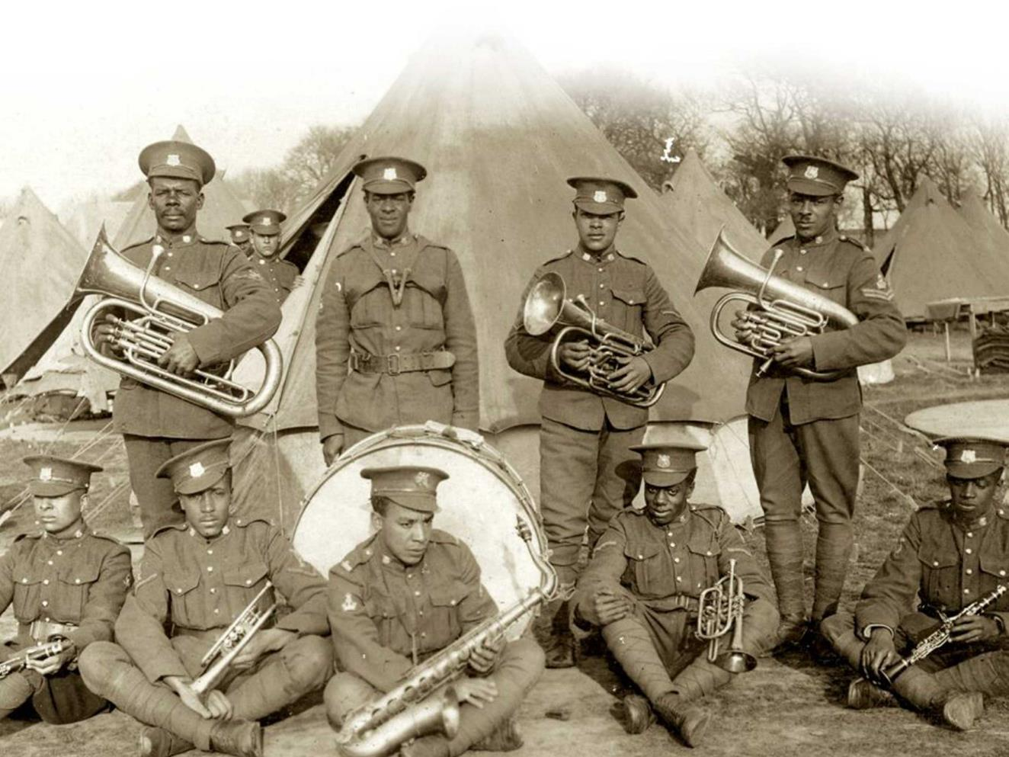
Or a musical instrument?
Notes:
No. 2 Construction Battalion marching band in Truro, Nova Scotia, in 1916. Hundreds of Black Canadian soldiers served in Canada and overseas with this unit during the First World War.
(Photo: Maritime Command Museum)

Slide 16
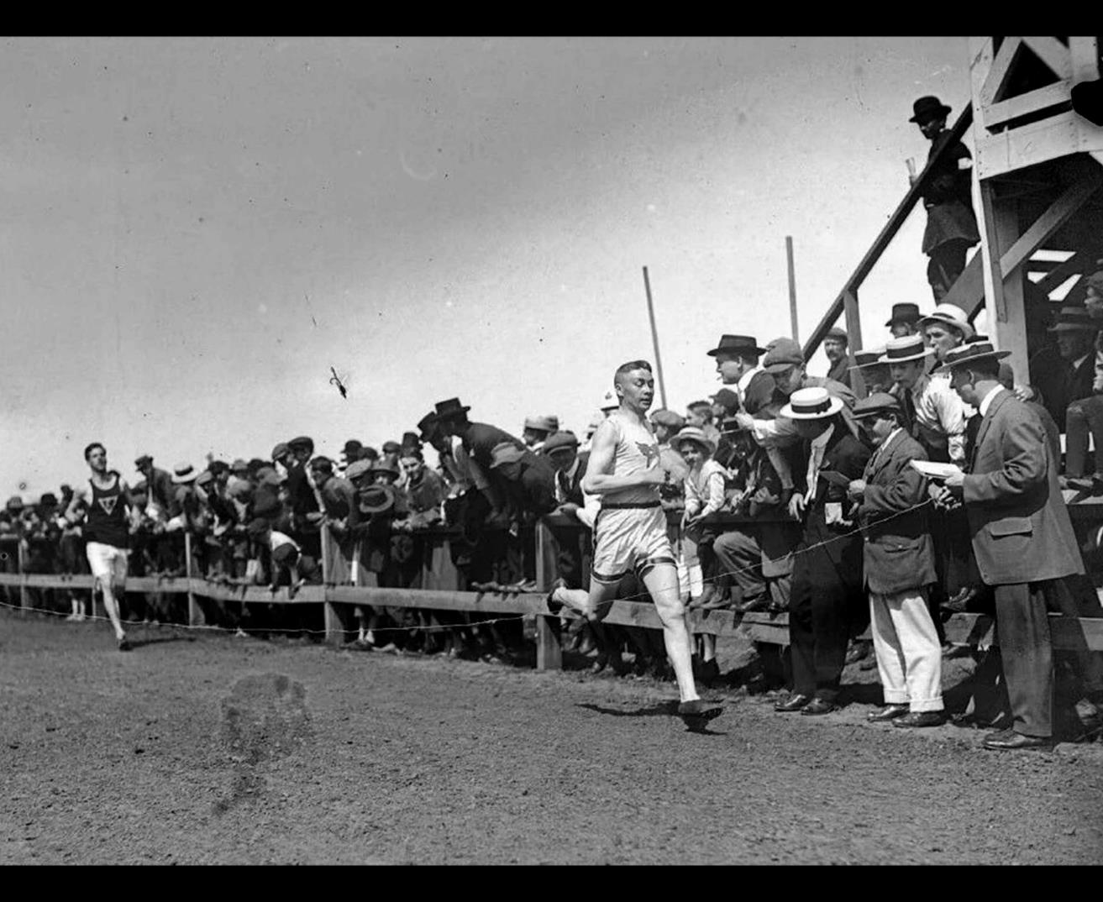
Was he an athlete?
Notes:
Before the First World War, Alexander Wuttunee Decoteau was a police officer in Edmonton, Alberta, – and an internationally recognized long distance runner. He even competed for Canada at the 1912 Olympics in Sweden. Born in Saskatchewan, the Métis runner was killed in the Battle of Passchendaele in October 1917. He is buried in Belgium.
(Photo: Provincial Archives of Alberta)

Slide 17
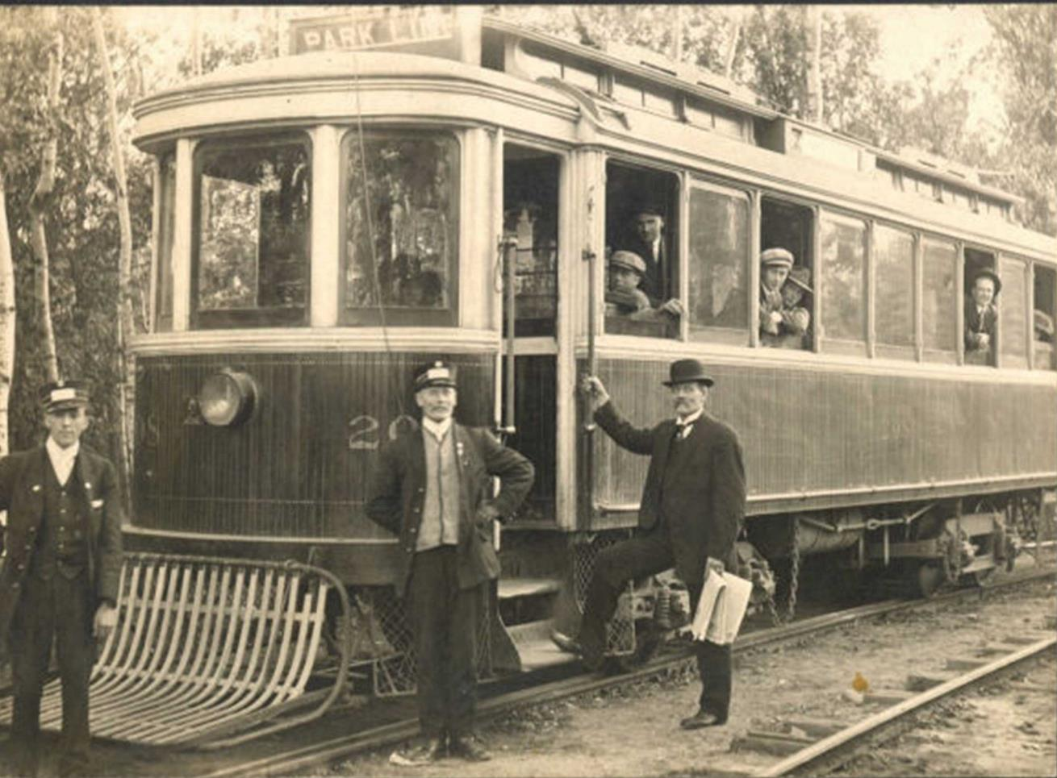
Did he like trains?
Notes:
Front left: Thomas Fyfe was 22 when he moved from Scotland to Winnipeg where he became a streetcar driver. He enlisted with the 78th Battalion in March 1916. Thomas was killed on the Western Front a year later during the Battle of Vimy Ridge.
(Canadian Virtual War Memorial – submitted photo)

Slide 18
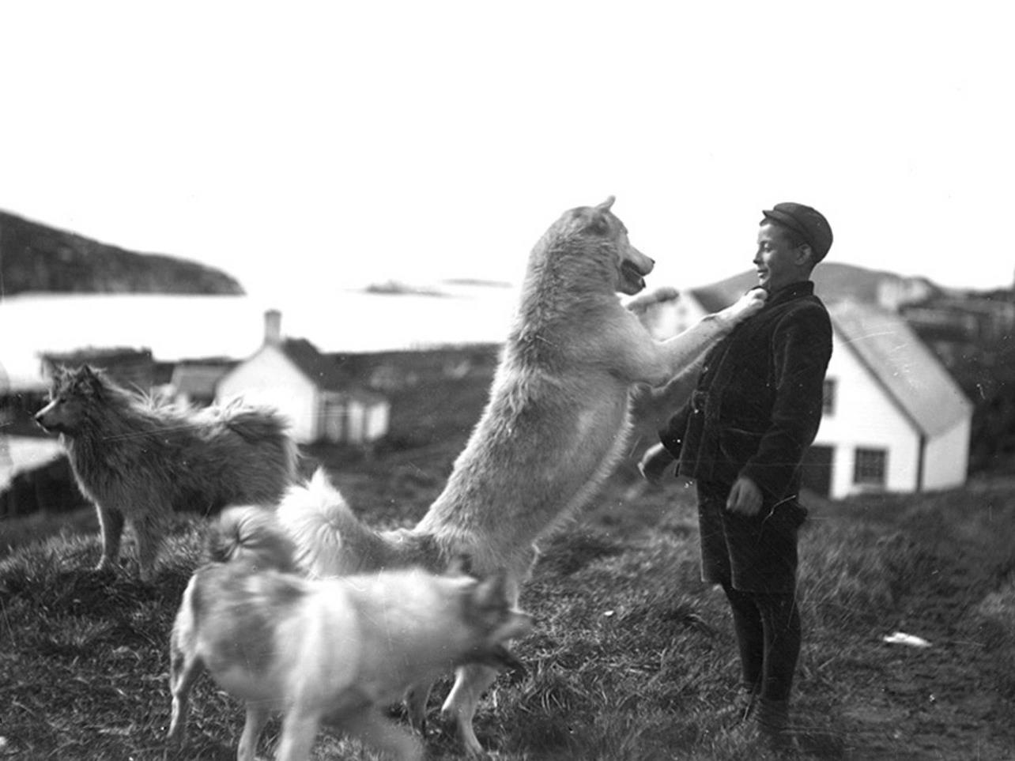
Did he have a dog?
Notes:
This photo shows a young Robert “Bert” Palfrey Holloway from St. John’s, NL, with his husky dog. Bert died with no known grave. His name is listed on the Beaumont-Hamel Newfoundland Memorial in France.
(Photo: The Rooms, Provincial Archives of Newfoundland and Labrador, E2-6)​

Slide 19
Imagine

Slide 20
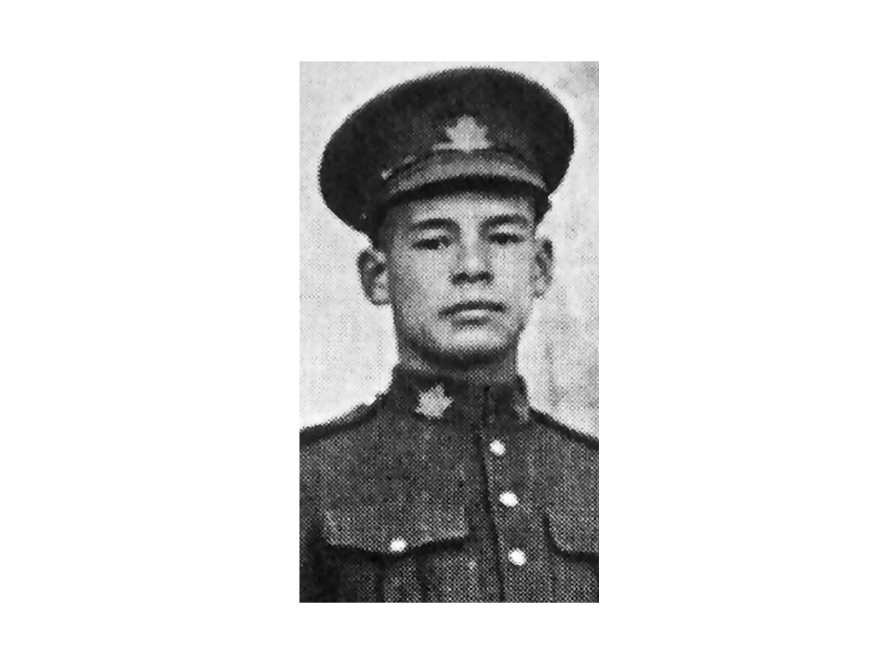
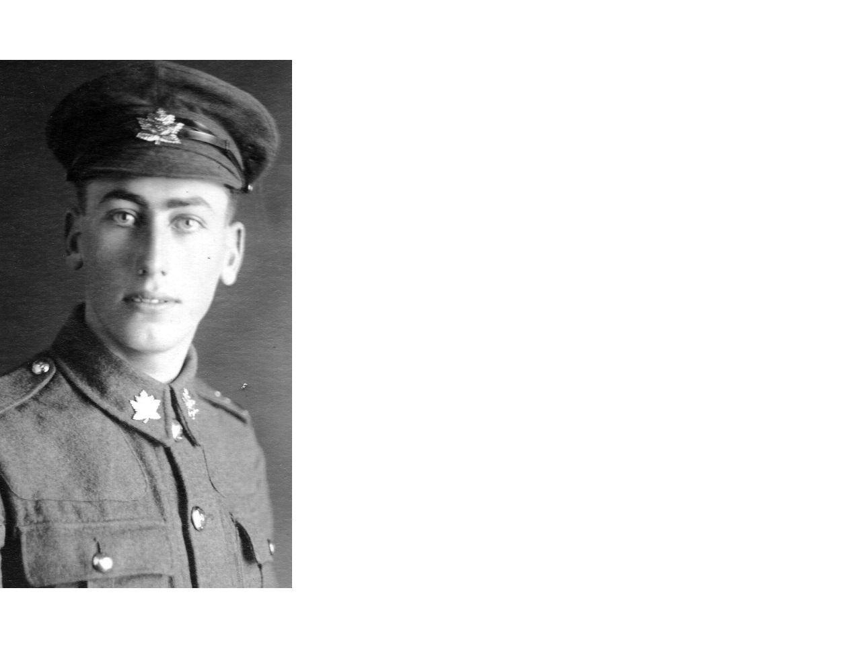
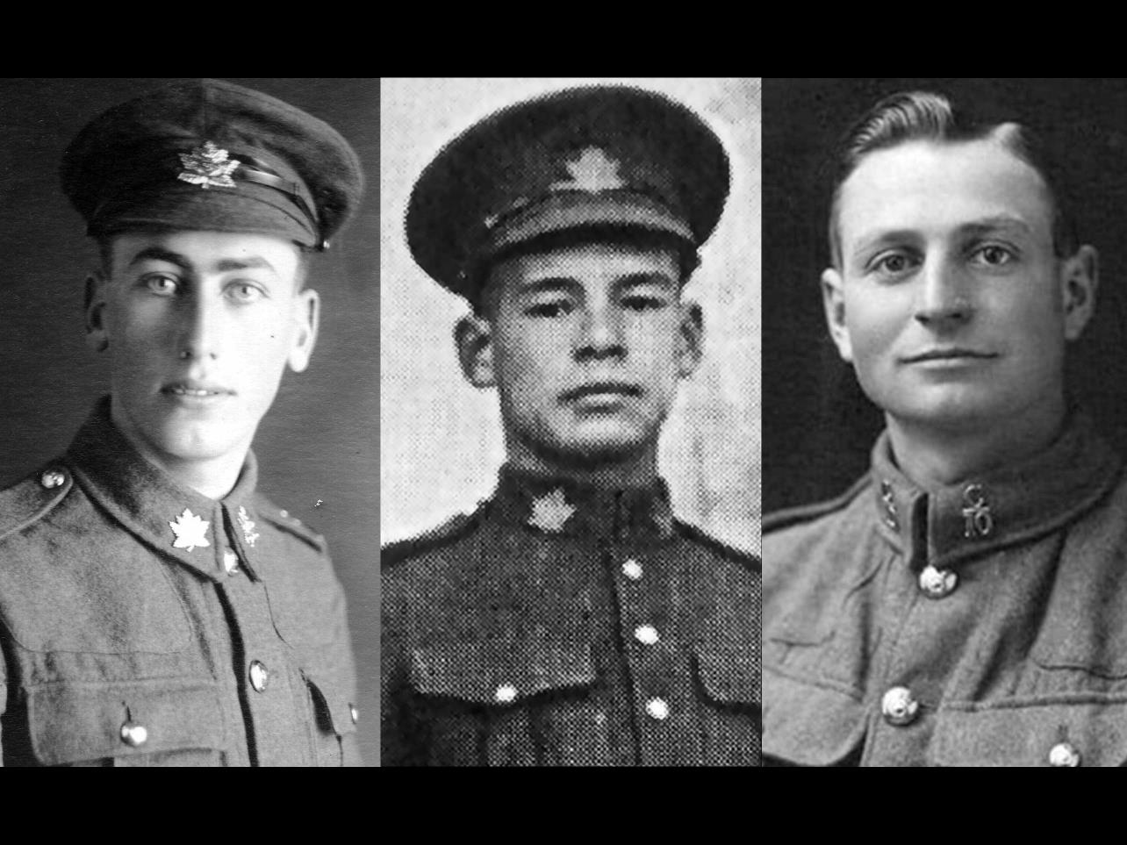
What colour were his eyes?
Notes:
These three soldiers have no known final resting place. Their names are listed on the Canadian National Vimy Memorial.
Left: Frederick Thompson was a Canadian soldier who lost his life in the First World War and has no known final resting place.
Middle: Frederick “Freddy” Lee was one of the first Chinese Canadians to enlist for service in the First World War. He fought in the Battle of Vimy Ridge and was killed in action a few months later in August 1917 during the Battle of Hill 70.
Right: Charles Franklin Broadbent was killed by machine gun fire in September 1918 during fighting at the Canal du Nord in France. He was 24. He had insisted on replacing a father of six in the recruitment line. Charles had earned the Military Medal for his actions at Amiens the month before he died.
(All photos: Canadian Virtual War Memorial – submitted photos)

Slide 21
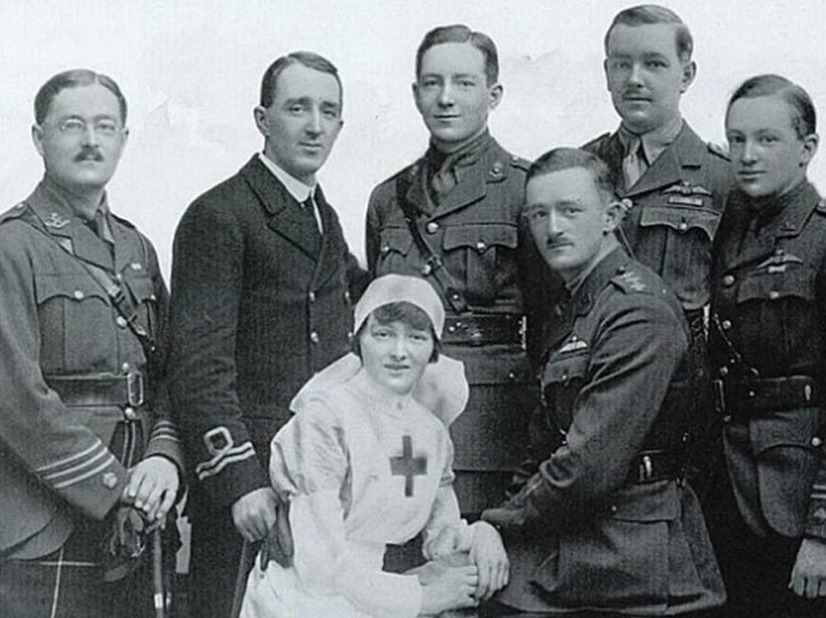
Was he a brother?
Notes:
Duncan Bell-Irving (front row, right) was killed in action in February 1915 while constructing a listening post near the front lines in Belgium. All of the Bell-Irving siblings served during the First World War, including Isabel who was a nurse at Lady Ridley’s Hospital for wounded officers in London. The Bell-Irving family was from Vancouver, British Columbia.
(Canadian Virtual War Memorial – submitted photo)

Slide 22
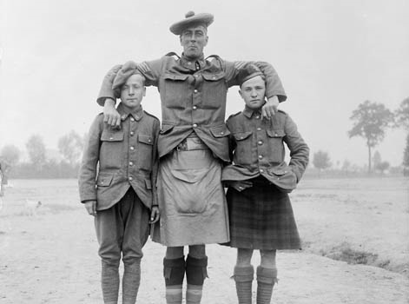
Was he tall?
Notes:
Members of the 13th Battalion (Royal Highlanders of Canada) having fun for the camera in July 1916 during the First World War.
(Photo: Library and Archives Canada PA-000387)

Slide 23
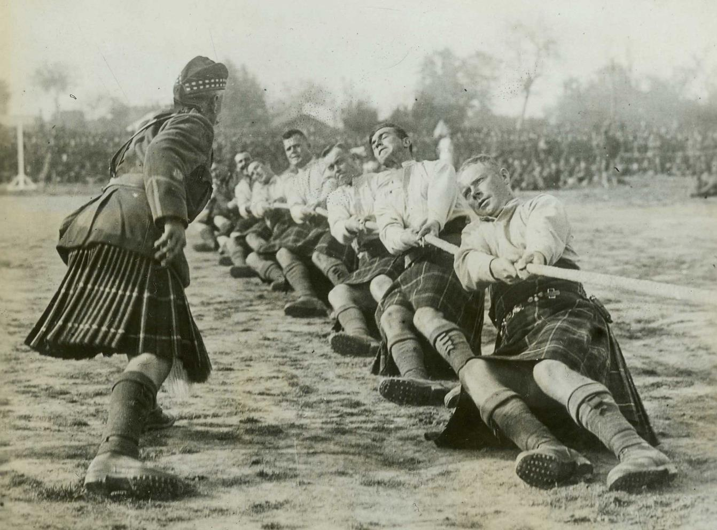
Was he strong?
Notes:
An officer urges on soldiers of the 72nd Battalion (Seaforth Highlanders of Canada) in the tug-of-war finals at the Canadian Championship Athletic Meet in France in 1917.
(Photo: Canadian War Museum George Metcalf Archival Collection CWM 19920085-860)

Slide 24
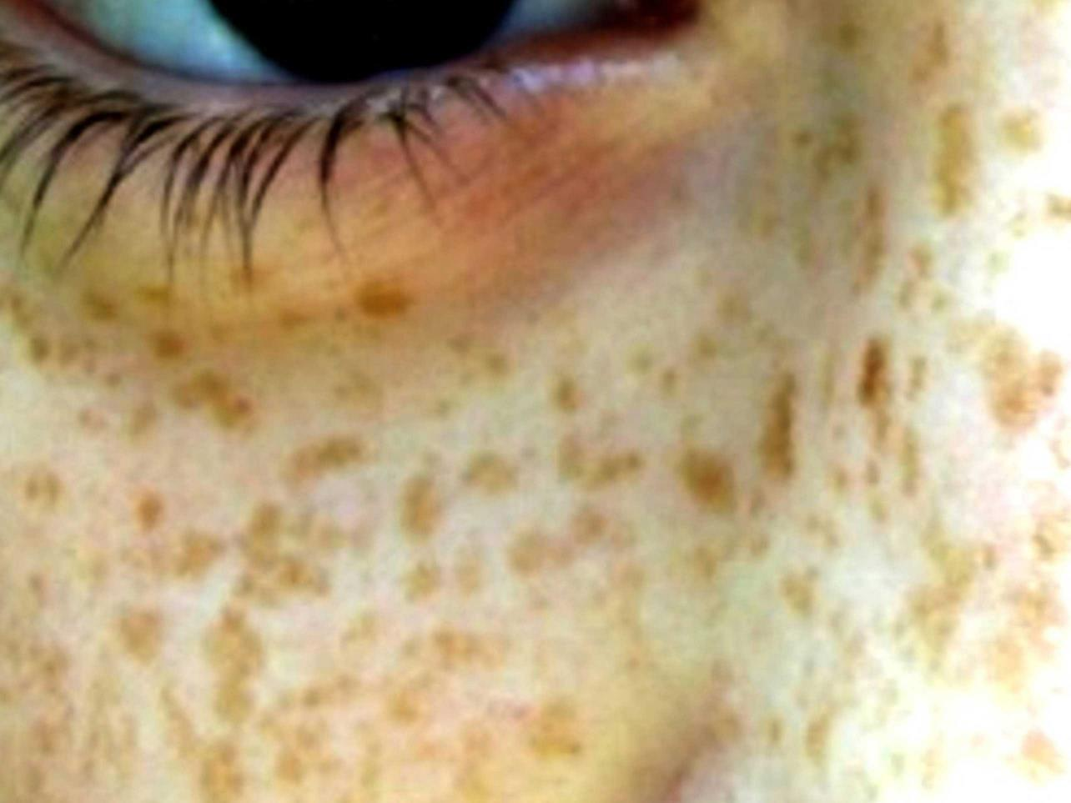
Did he have freckles?

Slide 25
Imagine

Slide 26
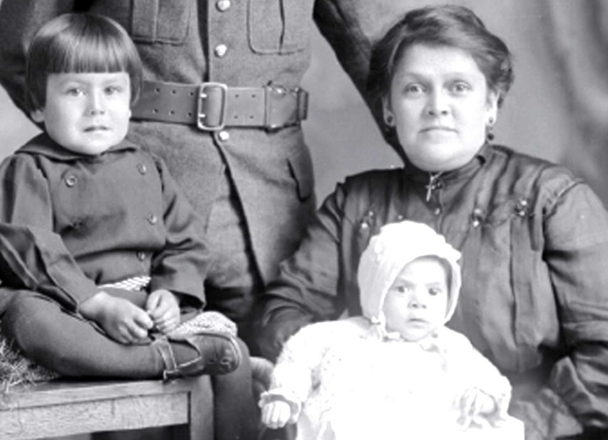
Did he have children?
Notes:
Thomas Paquette was an Abenaki man from the Odanak First Nation in Quebec. He enlisted in February 1916. He died in northern France in July 1917 and has no known final resting place. Thomas is pictured with his wife, Claudia, and his children Philippe and Annie-Rose.
(Canadian Virtual War Memorial – submitted photo)

Slide 27
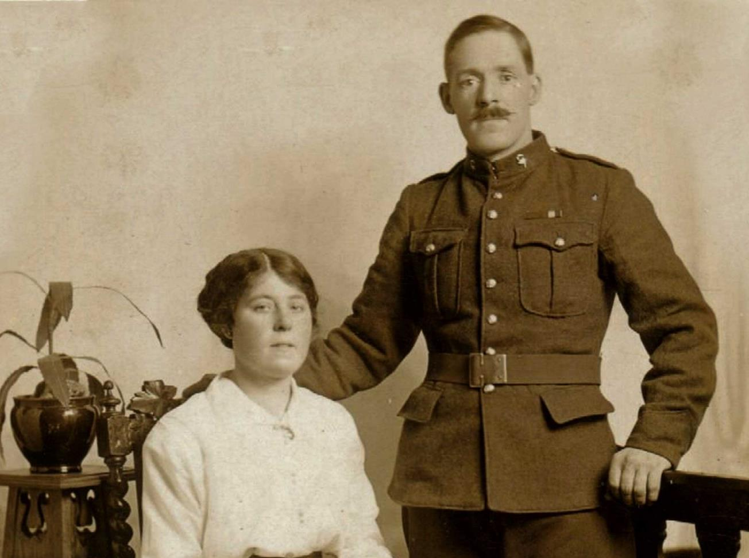
Was he married?
Notes:
Private Thomas Egan and his wife Louise. They were married on June 11, 1916 during the First World War. Thomas served with the British Columbia Regiment and lost his life while serving in uniform.
(Canadian Virtual War Memorial – submitted photo)

Slide 28
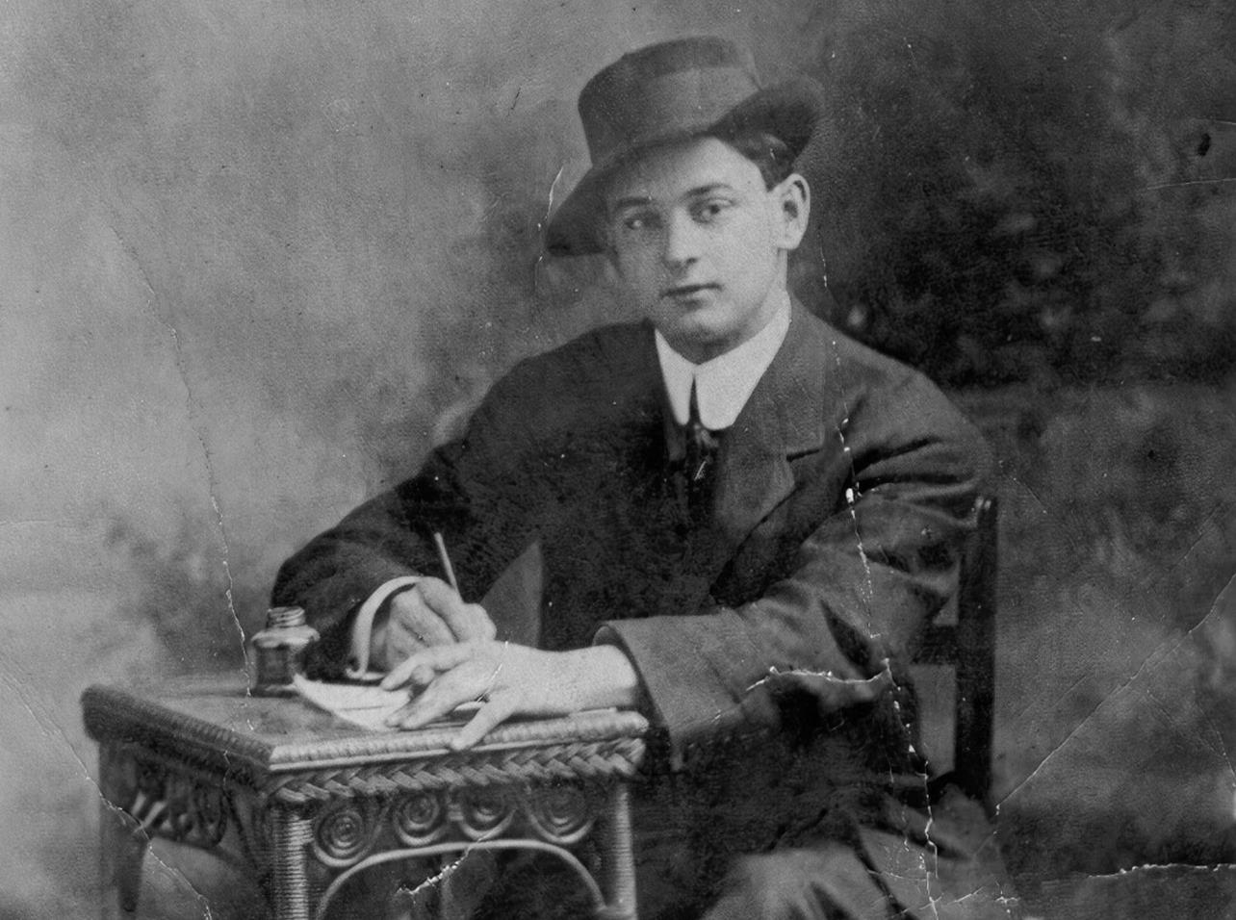
Did he write letters home?
Notes:
Canadian soldiers wrote many letters to worried family and friends back home.
Henri Desroches writing a letter before the war. Private Desroches was from Winnipeg. He lost his life on April 9, 1917 during the Battle of Vimy Ridge. He was 24 years old.
(Canadian Virtual War Memorial – submitted photo)

Slide 29
Was he a good friend?
Notes:
Claude Adams (centre) lost his life during the Battle of Vimy Ridge in April 1917 and has no known final resting place.
(Canadian Virtual War Memorial – submitted photo)

Slide 30
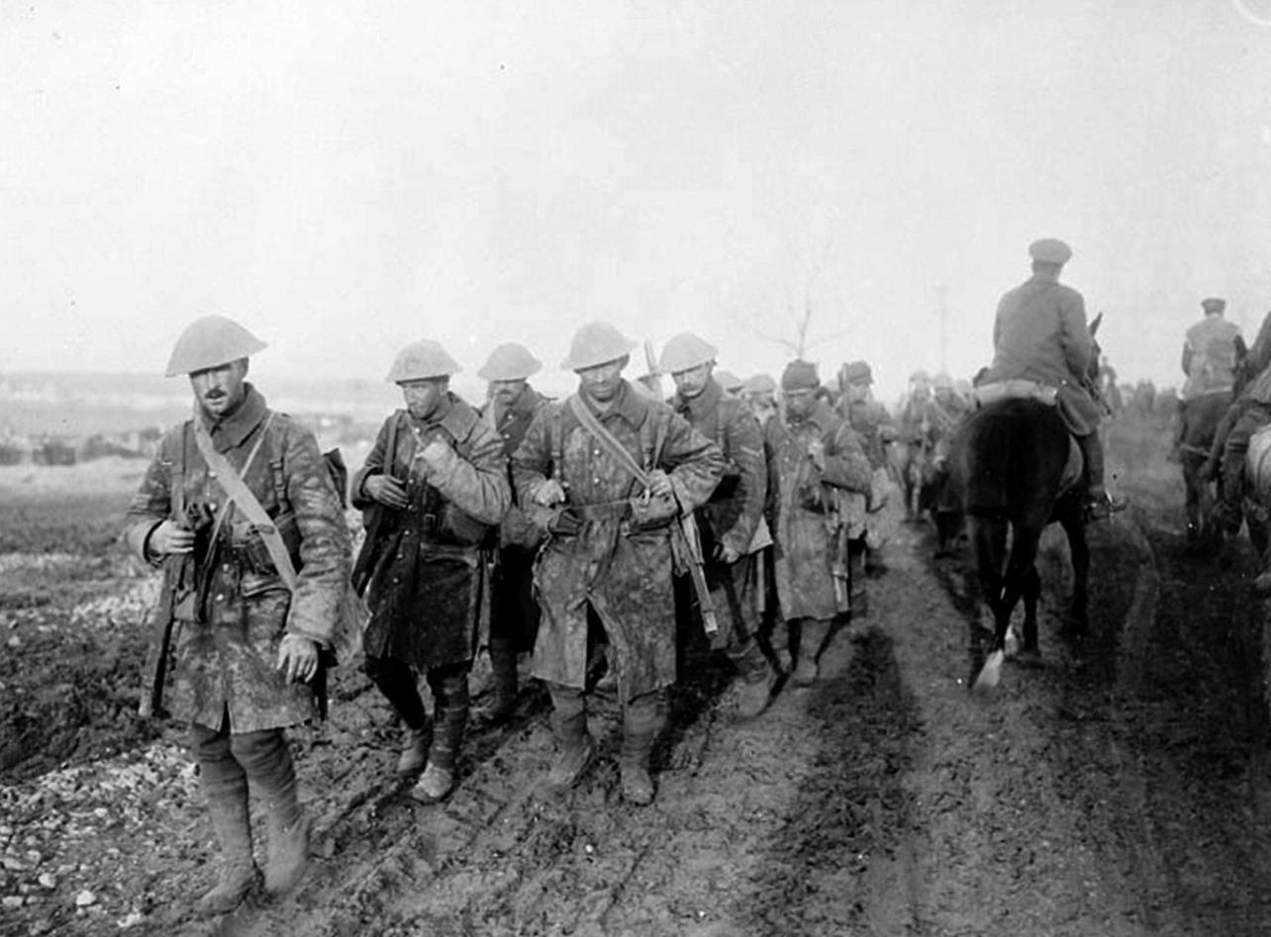
Was he afraid?
Notes:
Battered Canadian soldiers returning from the front lines during the Battle of the Somme in the fall of 1916.
(Photo: Library and Archives Canada PA-000832)

Slide 31
Imagine

Slide 32
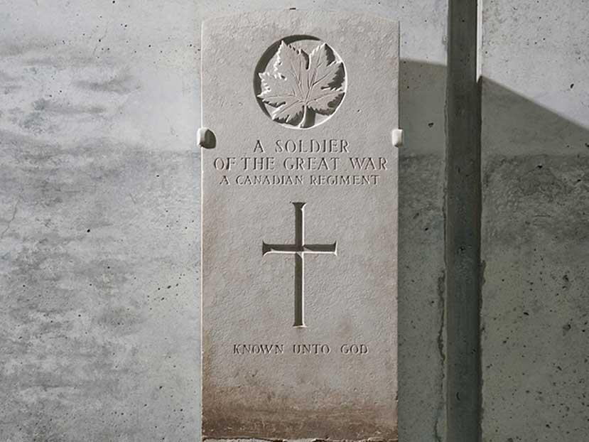
He is unknown.
Notes:
The headstone of Canada’s unknown soldier, originally in the Cabaret Rouge Cemetery in France, is now on display in the Canadian War Museum.
(Photo: Canadian War Museum)

Slide 33
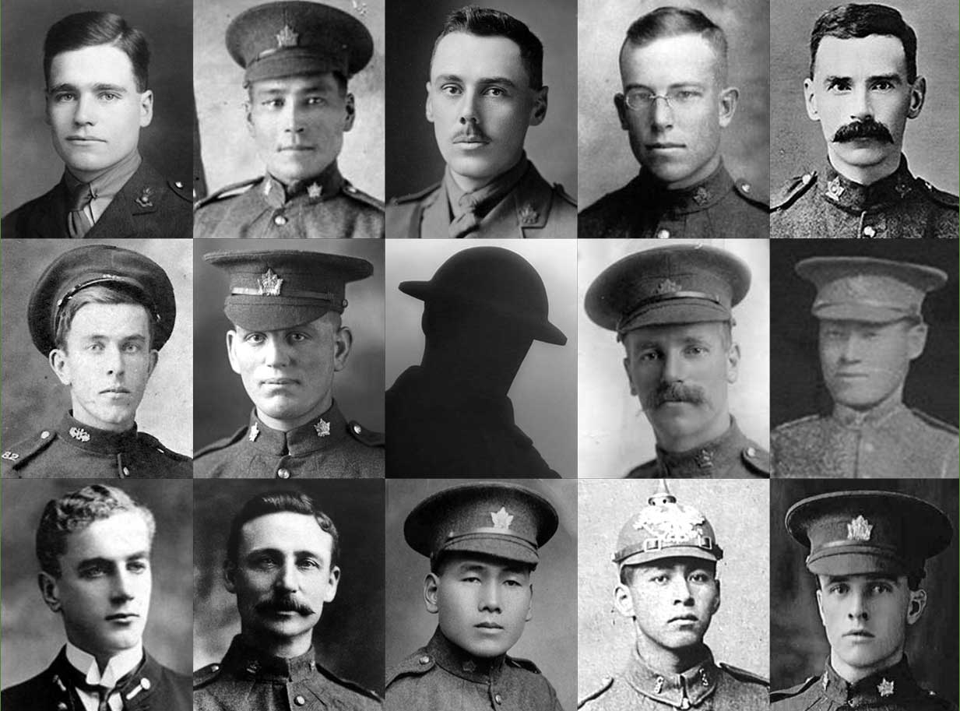
He is everyone.
Notes:
All of the Canadians seen here lost their lives during the First World War. None of them have a known grave.
First row (left to right):
Lieutenant Franklin Sharp Rankin was from Woodstock, New Brunswick. His mother’s name was Jennie and he served with the Royal Flying Corps. Franklin lost his life in October 1916 at the age of 23.
David Stranger was an Indigenous soldier born in Manitoba in 1874. The father of seven fought on the Western Front during the First World War. He was killed in action in France on March 29, 1917 at the age of 42.
Lieutenant Dudley Acheson was born in 1888 in Winnipeg. Upon his enlistment in Saskatoon in March 1916, he was immediately made an officer. He was killed in action on November 5, 1916 during the Battle of the Somme. His obituary described his death as “one of the saddest … of the war,” and said that he was “prominently spoken of” as an officer for the dedication he showed to his platoon.
Private Harold Adair died in France on August 8, 1918 during the Battle of Amiens.
Private Vivian Abbott’s nickname was “Bunny.” He lost his life at the age of 36 on August 21, 1917 during the Battle of Hill 70. Vivian was a member of the British Columbia Regiment and had also served in the South African War.
Second row (left to right):
Private Merrill Marshall of Prince Edward Island joined the Canadian Expeditionary Force in May 1915. He was killed on April 9, 1917 – the opening day of the Battle of Vimy Ridge.
Private Joseph Doughty was born in 1895 and served with the 38th Battalion during the First World War. He lost his life on November 18, 1916 during the Battle of the Somme at the age of 21.
Private Douglas Freeman Sr. was a British immigrant who served with the Canadian Expeditionary Force and died during the Battle of the Somme. Before the war, he worked for Eaton’s in Toronto. His eldest son, Douglas Jr., also served during the First World War. He was killed in action two years before his father.
Sergeant Fumio Tatsuoka was a highly respected Japanese Canadian soldier. He refused an offer to go to officer training school, saying, “I volunteered with 200 Japanese and I do not want to be an officer and be apart from them. It would not be right to be saluted by my comrades.” His death in August 1917 during the Battle of Hill 70 was mourned by his battalion.
Third row (left to right):
- Midshipman Malcolm Cann graduated from the Royal Naval College of Canada in 1914. He was selected to serve in the Royal Navy on board HMS Good Hope. On November 1, 1914 his ship was sunk off the coast of Chile. All hands were lost. Cann was one of four Canadian sailors to lose their lives that day – the first Canadian battle casualties of the First World War.
- Sergeant Frederick Hobson was 44 years old and a father of five. He earned the Victoria Cross at Hill 70 in August 1917. The 29th Battalion member dug out a gunner and sacrificed his life while a Lewis gun was being repaired. He said, "You get that gun online. I'm going to buy you as much time as I can.“
Private Katsukuma Katayama was born in Japan and came to Canada as a young man. Eager to serve his new country during the First World War, he enlisted in Calgary in 1916. He lost his life on May 7, 1917 while fighting on the Western Front with the 30th Battalion. He was 29 years old.
Private Peter Lavelley was an Indigenous soldier who served with the 3rd Battalion. He lost his life at the age of 20 on April 10, 1917 during the Battle of Vimy Ridge. He had come from a long line of warriors. His great-great-great-great grandfather was the Grand Chief of the Algonquins during the War of 1812.
Private Henry Ashton was born in 1886. He joined the Canadian Expeditionary Force during the First World War and served with the 31st Battalion. He was killed on September 15, 1916 during the Battle of the Somme. Henry was 30 years old.
(Canadian Virtual War Memorial – submitted photos)

Slide 34
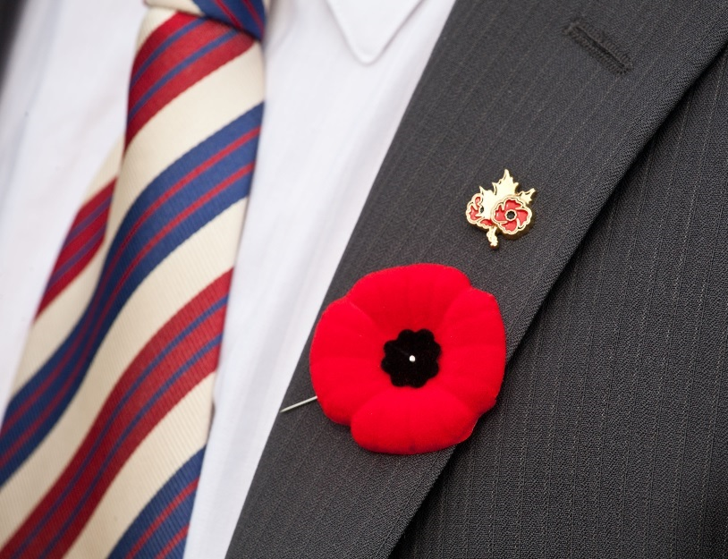
He is ours.
Notes:
Many people wear The Royal Canadian Legion red poppy every year in the lead-up to Remembrance Day.
(Photo: Veterans Affairs Canada)

Slide 35
Imagine

