Slide 1

Community cenotaphs across Canada

Slide 2
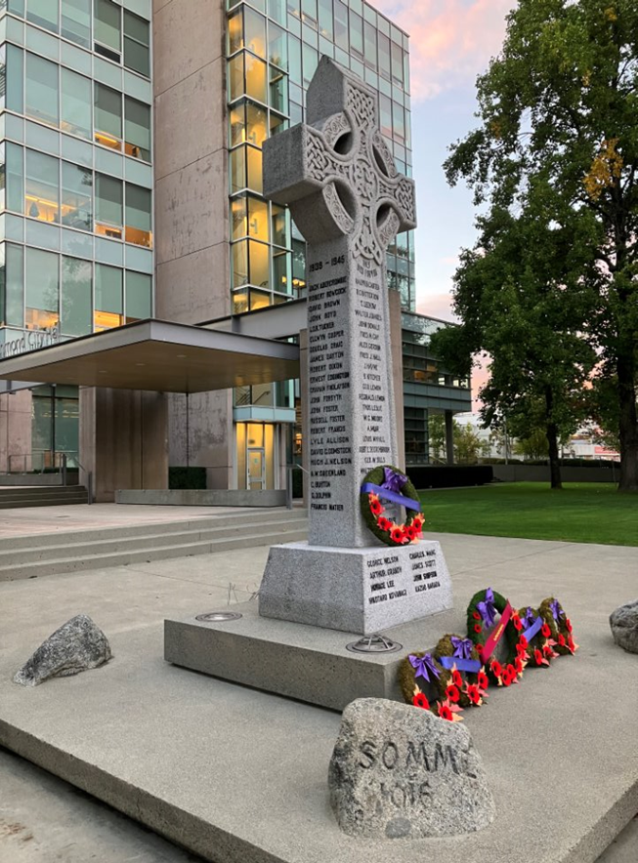
What is a cenotaph?
Cenotaphs represent everyone buried elsewhere regardless of whether their exact grave is known or not. The term is often used to describe community memorials.
To build a cenotaph, communities must raise funds, choose a design and location, and select materials.
Cenotaphs come in many shapes and forms. They are often found in central spaces like town squares or near city halls.
Most community cenotaphs in Canada were built after the First World War.
Image credit: Debbie Jiang

Slide 3
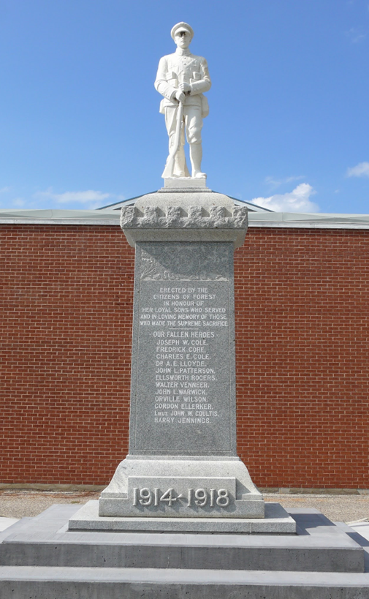
Cenotaph statues
Many community cenotaphs feature statues of soldiers.
Statues are often made of bronze or marble because these materials are durable and allow for detailed designs.
Some statues used real people as models while others are meant to represent all who served.
This marble statue is located in Forest, Ontario. It is one of many marble statues carved in Italy for Canadian cenotaphs. Italian artists used photographs of Canadian soldiers to ensure the uniform matched Canadian regiments.
Image: Veterans Affairs Canada

Slide 4
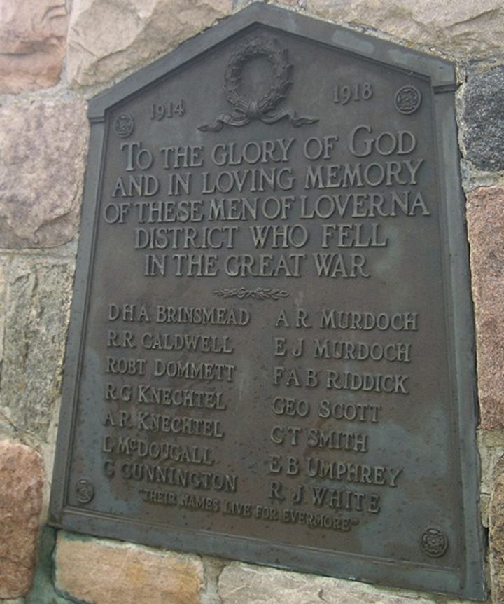
Names and dates
Many community cenotaphs include the names of local people who died during military service.
Dates of wars or conflicts may also be engraved, and these can vary between communities.
Names and dates might appear on stone, plaques or other materials.
Some cenotaphs include quotes, prayers or poems.
Image: Veterans Affairs Canada

Slide 5
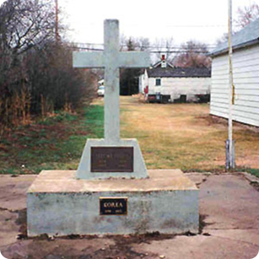
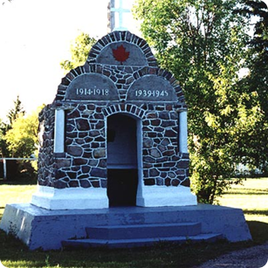
Symbols
Cenotaphs are themselves a symbol of remembrance.
They also use other symbols to help tell a story.
The shape of the memorial may be symbolic (cross, cairn, maple leaf, etc.)
Other symbols may appear on or beside the cenotaph
  a cross may symbolize Christian values
  a flag or maple leaf could evoke patriotism
  a poppy could represent remembrance or loss
  a dove might symbolize peace
The symbols chosen for a cenotaph can help us learn about the history of a community and the people who built or designed it.
Image: Veterans Affairs Canada
Image: Veterans Affairs Canada

Slide 6
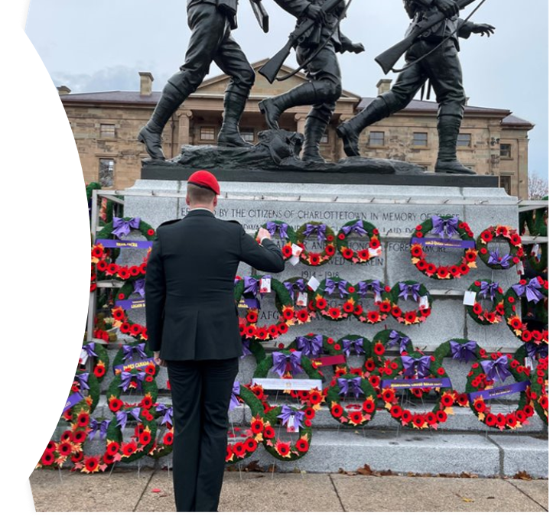
A public gathering place
Community cenotaphs serve as places for people to gather on important anniversaries.
Many Canadians gather each year at their local cenotaph on November 11 for Remembrance Day ceremonies.
They lay wreaths, give speeches and read poems like In Flanders Fields to honour and remember those who gave their lives for our freedom.
Photo: VAC

Slide 7
Cenotaph research activity
Select one of the cenotaphs shown in this presentation, or choose another by searching our memorials database.

Slide 8
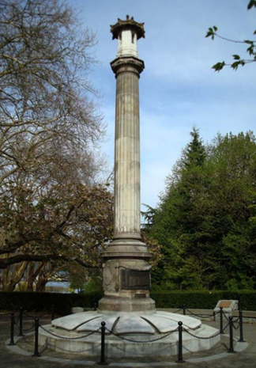
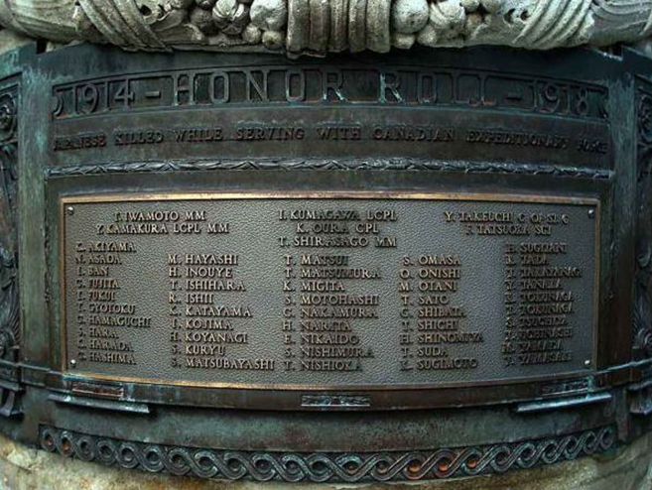
Japanese Canadian War Memorial
Vancouver, British Columbia
Built to commemorate the service of Japanese Canadians during the First World War.
Includes the names of approximately 55 war dead, along with the names of those who returned.
Features a limestone column on a granite base with bronze panels. A Japanese pagoda-style lantern sits at the top.
The cenotaph is surrounded by hundreds of symbolic cherry trees.
Images: Veterans Affairs Canada
More information:
Japanese Canadian War Memorial (Veterans Affairs Canada)
Japanese Canadian War Memorial (Canada’s Historic Places)

Slide 9
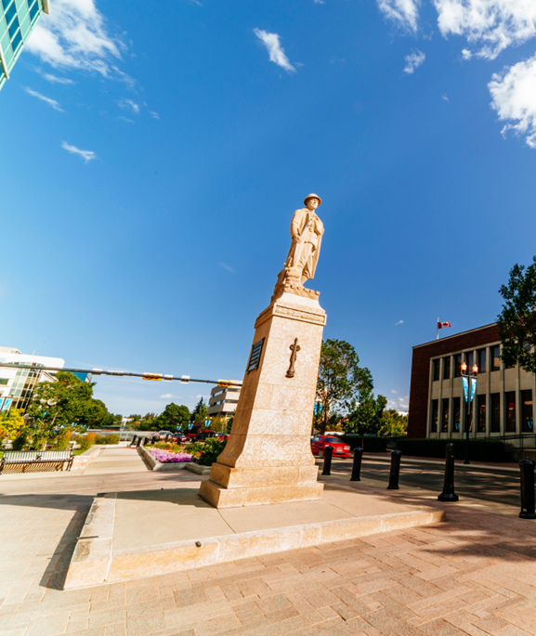
Red Deer Cenotaph
Red Deer, Alberta
Built to honour the 850 men and women from Red Deer who served in the First World War, including 118 who were killed.
The statue, known locally as The Unknown Soldier, faces the railway station from which many of those who served departed.
The names of those who served in the First World War are preserved in a unique way inside the base.
Image: Veterans Affairs Canada
More information:
Red Deer Cenotaph (Veterans Affairs Canada)
Red Deer Cenotaph, Downtown Heritage Sites Gallery (Available in English only)
Alberta Register of Historic Places – Red Deer Cenotaph (Available in English only)

Slide 10
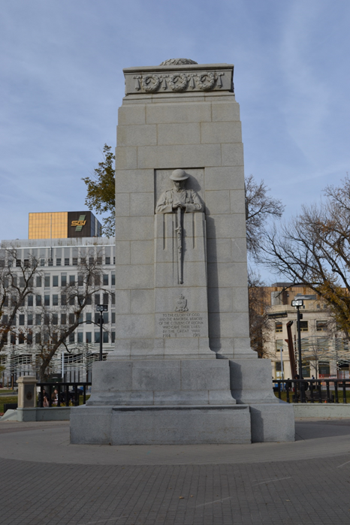
Regina Cenotaph
Regina, Saskatchewan
Unveiled on November 11, 1926 to honour local soldiers killed in the First World War.
Features a small version of The Brooding Soldier sculpture by local architect Frederick Clemesha. The original stands at the St. Julien Canadian Memorial in Belgium.
The cenotaph has been rededicated twice to recognize additional conflicts.
Image: Veterans Affairs Canada
More information:
Regina Cenotaph (Veterans Affairs Canada)
Video: Regina unites at Victoria Park Cenotaph for Remembrance Day

Slide 11
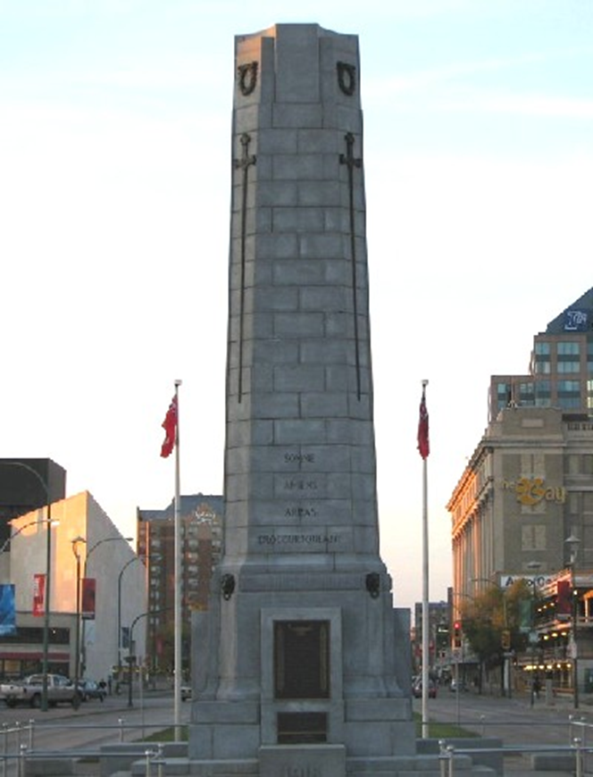
Winnipeg Cenotaph
Winnipeg, Manitoba
Located on Memorial Boulevard near Memorial Park.
Designed by a local architect after a controversial national design competition rejected the original winning design because the artist, Emanuel Hahn, was born in Germany.
Features a stone column with bronze symbols and several inscriptions, including:
Know all ye who pass by
that for your tomorrow
we gave our today.
More information:
Winnipeg Cenotaph (Veterans Affairs Canada)
Winnipeg Memorial Park (Veterans Affairs Canada)
Manitoba Historical Archives Society (Available in English only)
Image: Veterans Affairs Canada

Slide 12
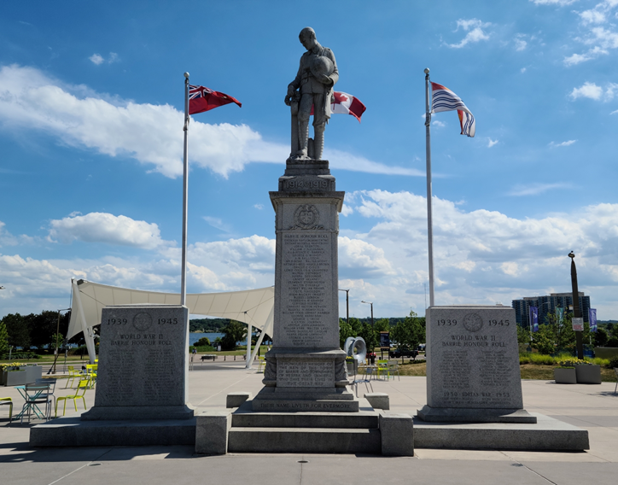
Barrie Cenotaph
Barrie, Ontario
The Barrie Cenotaph is 23 feet tall
Lists 1919 as the end of the war, marking the signing of the Treaty of Versailles.
The numbers 157 and 177 are etched on the side to recognize local forestry battalions.
Additional blocks were added later to commemorate casualties of later conflicts.
More information:
Barrie Cenotaph (Veterans Affairs Canada)
The Boys From Barrie (Available in English only)
Honouring our Canadian Armed Forces (Available in English only)
Image: Veterans Affairs Canada

Slide 13
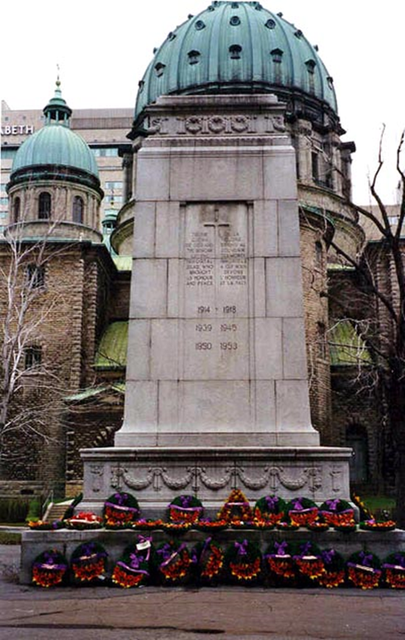
Montreal Cenotaph
Montreal, Quebec
Replica of a memorial in London, England.
Unveiled on November 11, 1924. Before it was built, Montreal used a portable cenotaph made of plaster that was wheeled out of storage for ceremonies.
Dedicated by Lieutenant‑General Sir Julian Byng, who commanded the Canadian Corps at the Battle of Vimy Ridge. After the First World War he became Viscount Byng of Vimy and was Governor General of Canada from 1921-1926.
Image: Veterans Affairs Canada
More information:
Montreal Cenotaph (Veterans Affairs Canada)
Montreal Cenotaph (For Kids) (Available in English only)
Viscount Byng of Vimy (Westminster Abbey) (Available in English only)

Slide 14
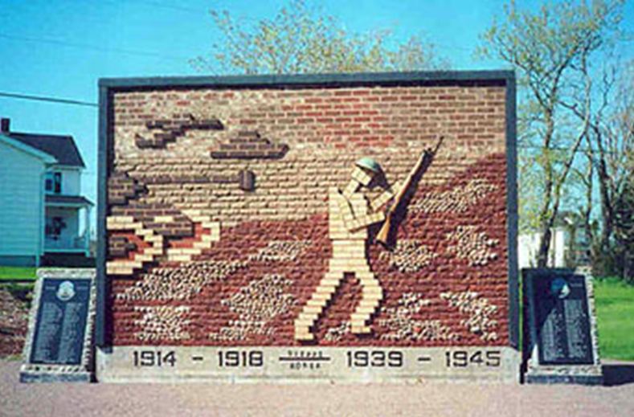
Dieppe Cenotaph
Dieppe, New Brunswick
The village of Leger Corner renamed itself Dieppe in 1946. Dieppe’s cenotaph was dedicated in 1981.
Children in Dieppe, France, helped build it. They gathered 913 stones from local beaches to represent Canadians who died there during The Dieppe Raid in 1942.
The design uses bricks and stones to create a scene representing The Dieppe Raid. Inscriptions appear in English and French.
Image: Veterans Affairs Canada
More information:
The Dieppe Cenotaph (Veterans Affairs Canada)
The Dieppe Cenotaph (video YouTube)

Slide 15
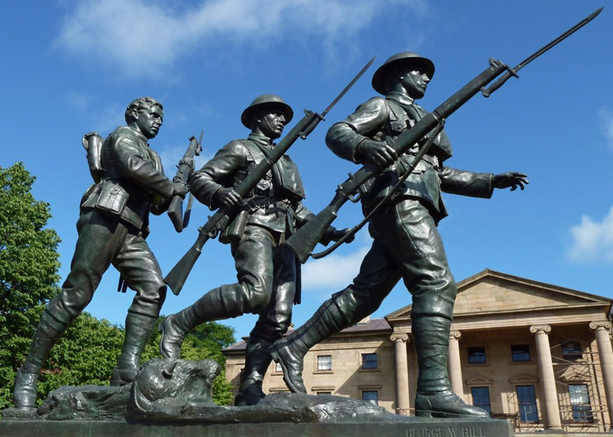
Soldiers' Monument
Charlottetown, Prince Edward Island
Features a bronze statue of three Canadian soldiers advancing during the First World War.
Designed by Quebec artist George William Hill to honour all Prince Edward Islanders who died in service.
Unveiled in 1925 by Matilda McLean, mother of Nursing Sister Rena McLean. Rena was the only women from Prince Edward Island to lose her life during the First World War. She died when the hospital ship Llandovery Castle was sunk.
More information:
Soldiers’ Monument (Veterans Affairs Canada)
Rena McLean Veterans Garden (Veterans Affairs Canada)
Image: Veterans Affairs Canada

Slide 16
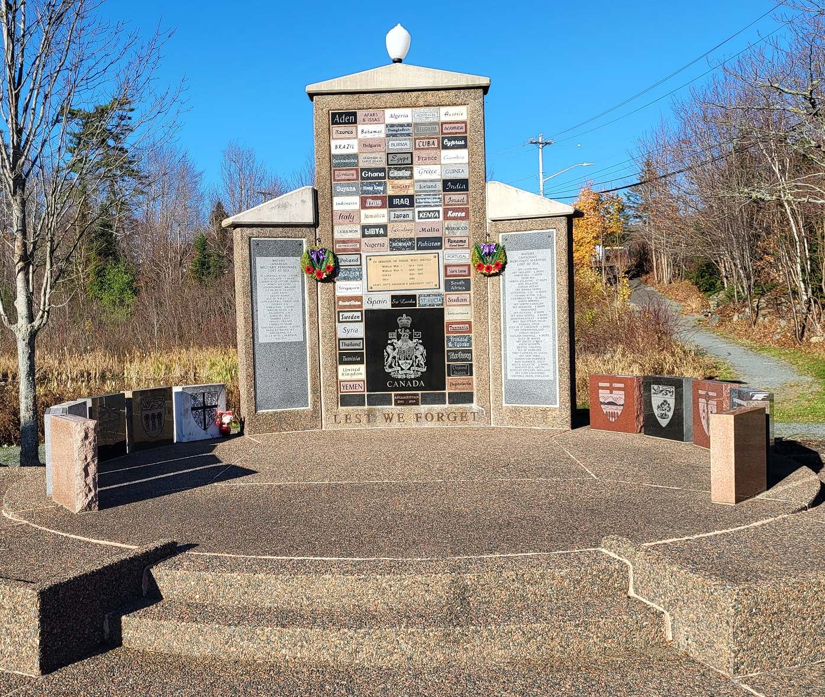
Lest We Forget Cenotaph
Lower Sackville, Nova Scotia
Dedicated in 1996.
Includes stones from 73 countries where Canadians are buried along with stones from other Canadian provinces.
Community groups and schools placed time capsules inside the cenotaph. They will be opened in 2047.
More information:
Lest We Forget Cenotaph (Veterans Affairs Canada)
Image: Veterans Affairs Canada

Slide 17
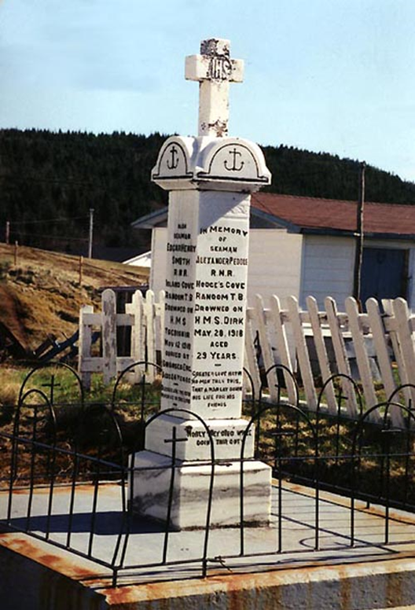
Hodge's Cove Cenotaph
Hodge's Cove, Newfoundland and Labrador
Built by local citizens and located in front of St. Mary’s Anglican Church.
Lists the names and dates of death of four local men who died in the First and Second World Wars:
  Alec Peddle
  Edgar Smith
  Willis Drover
  William James Vey
Ceremonies are held here each year on Remembrance Day (Nov. 11) and Memorial Day (July 1 in Newfoundland and Labrador).
More information:
Hodge’s Cove Cenotaph (Veterans Affairs Canada)
Image: Veterans Affairs Canada

Slide 18
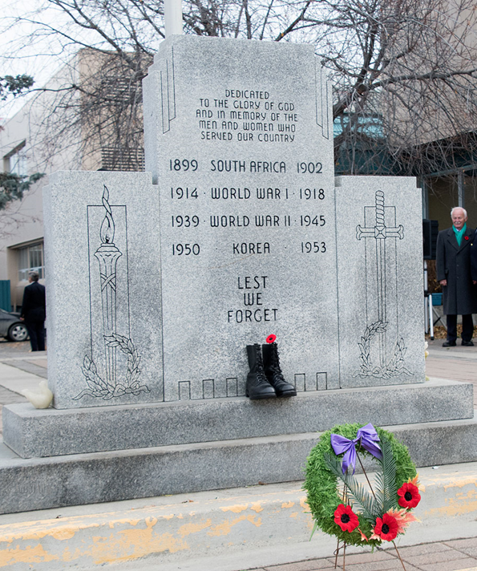
Whitehorse Cenotaph
Whitehorse, Yukon
Built by the City of Whitehorse and unveiled in 1954.
Names of local fallen are inscribed on plaques beside the memorial.
Includes the name of Michael James O’Rourke, a Victoria Cross and Military Medal recipient.
More information:
Whitehorse Cenotaph (Veterans Affairs Canada)
Whitehorse Cenotaph (The Whitehorse Star) (Available in English only)
Image: Veterans Affairs Canada

Slide 19
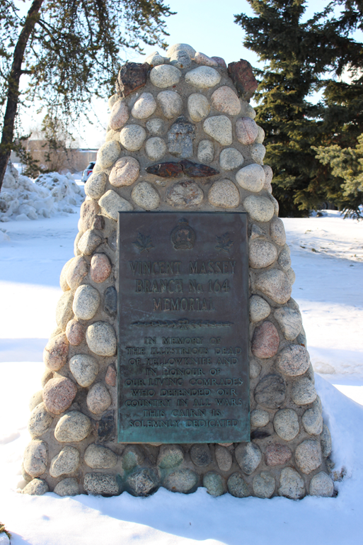
Yellowknife Cenotaph
Yellowknife, Northwest Territories
Like many cenotaphs in the Northwest Territories, this one is in the shape of a cairn. Cairns have been symbols of remembrance for centuries.
The cenotaph is a community gathering spot on Remembrance Day. It is located near city hall.
In 2005, a new Yellowknife Veterans Monument was unveiled nearby. It was designed by Inuvialuit artist Eli Nasogaluak from Tuktoyaktuk.
More information:
Yellowknife Cenotaph, NWT (Veterans Affairs Canada)
In pictures: Remembrance Day in Yellowknife (Cabin Radio) (Available in English only)
Cairn and Cenotaph – Glossary of Memorial Terms (Veterans Affairs Canada)
Image: Veterans Affairs Canada

Slide 20
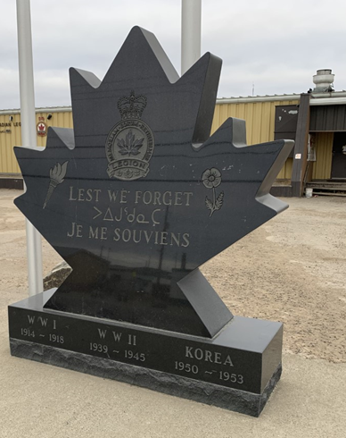
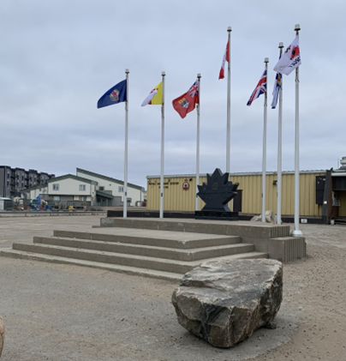
Iqaluit Veterans Memorial
Iqaluit, Nunavut
The original cenotaph was built in 1985; it was later replaced with the current design.
Located in front of the Royal Canadian Legion.
Features the Royal Canadian Legion crest, torch and poppy.
Surrounded by flags representing the Legion, Nunavut, Canada, the Nova Scotia/Nunavut Command (RCL), and historical flags.
Lest we forget is engraved in English, French and Inuktitut.
More information:
Iqaluit Veterans Memorial (Veterans Affairs Canada)
Wreaths laid in Iqaluit to honour Indigenous Veterans (Nunatsiuk News) Remembrance Day in Iqaluit (Nunatsiuk News)
Image: Veterans Affairs Canada

