Slide 1

Canada’s National War Memorial

Slide 2
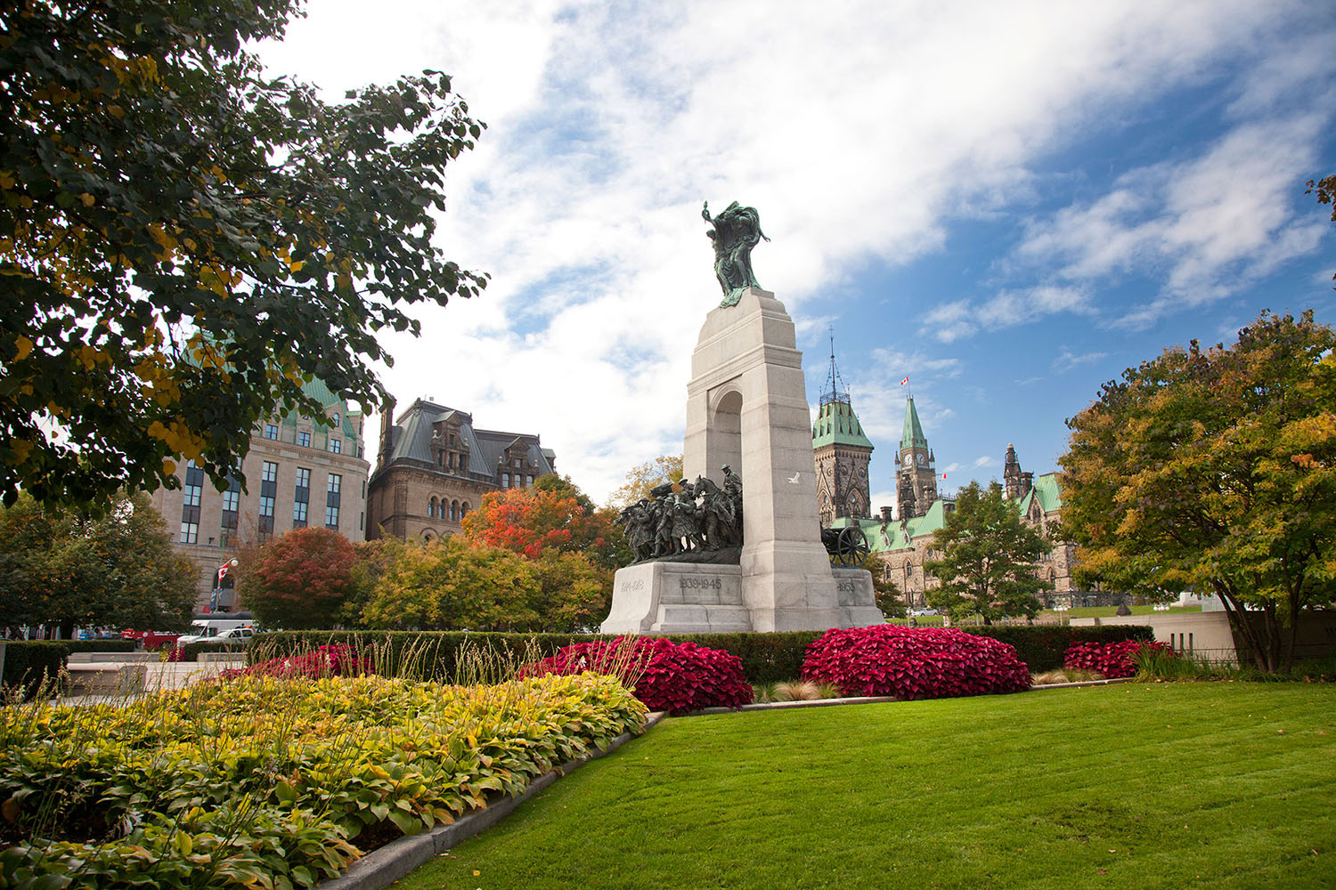
The National War Memorial
Canada’s National War Memorial symbolizes the service and sacrifice of all who have served Canada in the cause of peace and freedom – past, present and future.
Image: Canadian Heritage

Slide 3
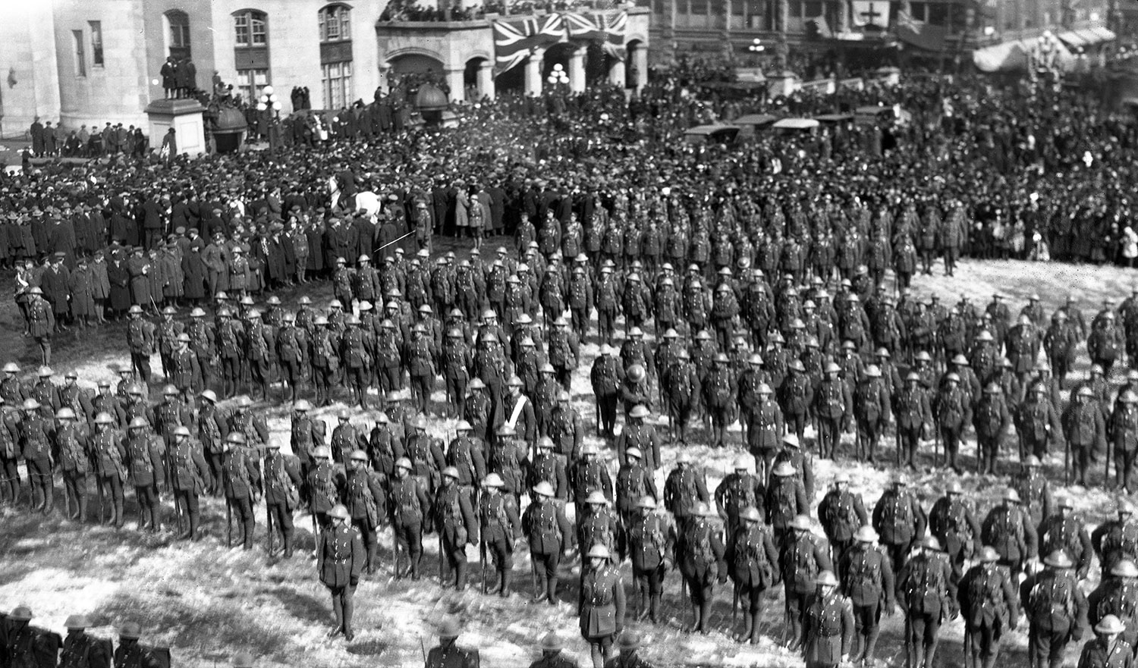
A nation in mourning
The First World War touched almost every community in Canada.
From a population of just 8 million when the war began:
  nearly 620,000 Canadians served
  more than 172,000 were wounded
  over 66,000 died
The need for a national war memorial was clear.
Image: City of Ottawa Archives

Slide 4
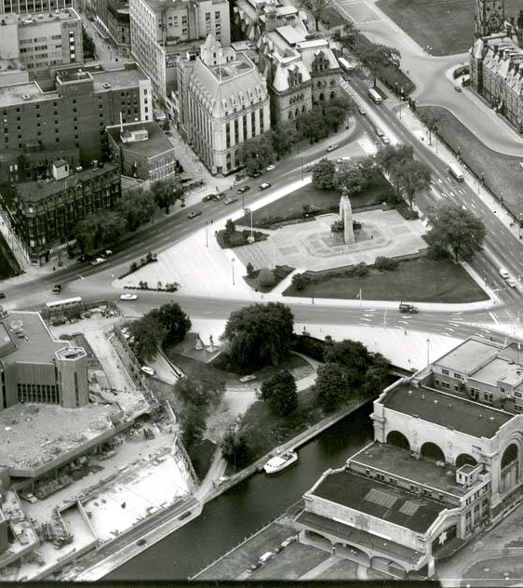
At the heart of Canada
The National War Memorial is located in Canada’s capital, Ottawa.
The Memorial stands at the centre of Confederation Square, a major downtown Ottawa intersection where several of the city’s busiest streets converge.
The site has become the focal point of national Remembrance Day events.
Image: Library and Archives Canada

Slide 5
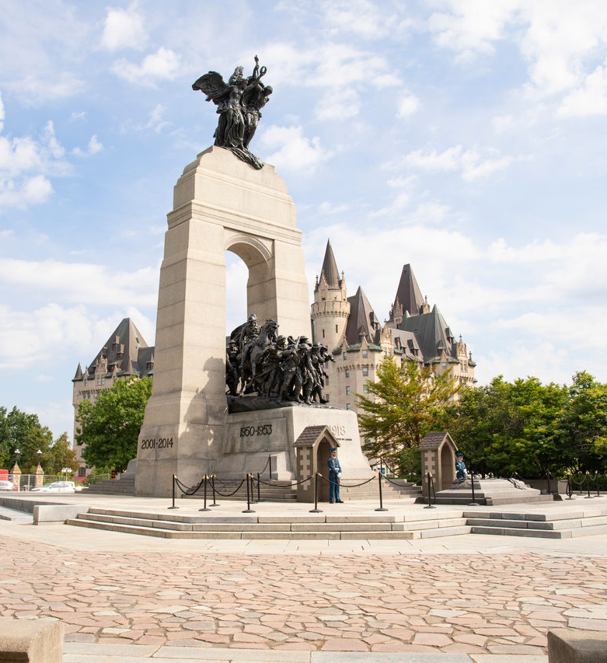
An inspired design
An international design competition in 1925 attracted 127 submissions from Canada and abroad.
British sculptor Vernon March’s submission was chosen.
His design is known as The Response because it portrays the powerful response of Canadians who were called to war.
March died in 1930 with the work unfinished, but his siblings completed the project.
Image: Canadian Heritage

Slide 6
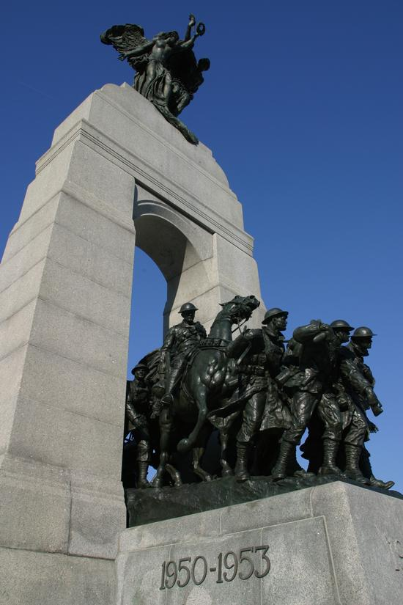
Design: The arch
The memorial features a granite arch and a bronze procession of service members moving forward.
According to Vernon March, this movement through the archway represents "the going forth of the people and the triumph of their achievements overseas."
The years of the First World War appear on the front of the memorial:
1914-1918
Image: Veterans Affairs Canada

Slide 7
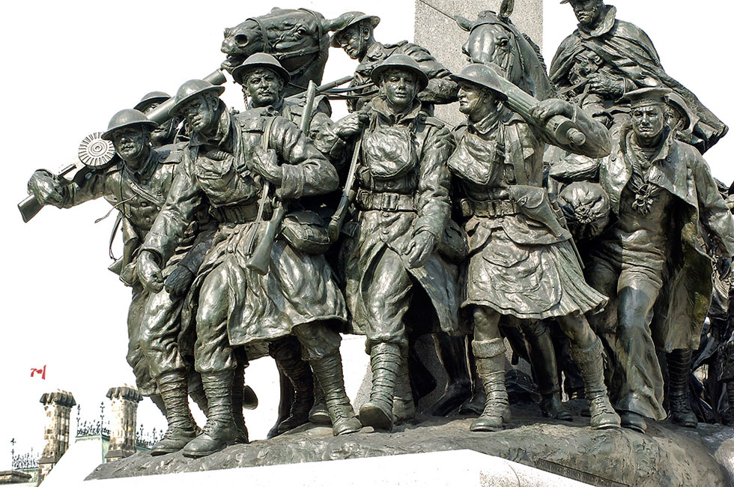
Design: Bronze figures
The 22 bronze figures at the centre of the memorial are life-sized and include service members representing the wide range of Canadians who served.
They include infantry, cavalry, riflemen, gunners, pilots, sailors, nursing sisters, and lumbermen.
Image: Bob Hurley Photography

Slide 8
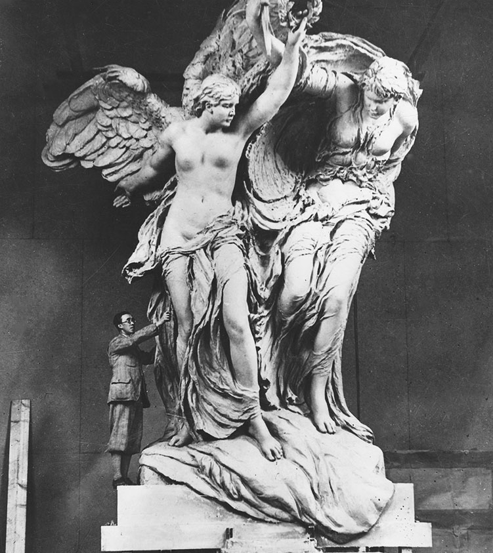
Design: Peace and freedom
At the top of the arch are two symbolic figures representing Peace and Freedom.
These figures represent the cause for which Canadians served.
They symbolize the enduring values Canadians continue to defend.
They are placed at the top of the arch because they are giving the blessings of peace, liberty, and victory to the Canadians passing through the archway below as they depart for war.
Image: City of Ottawa Archives

Slide 9
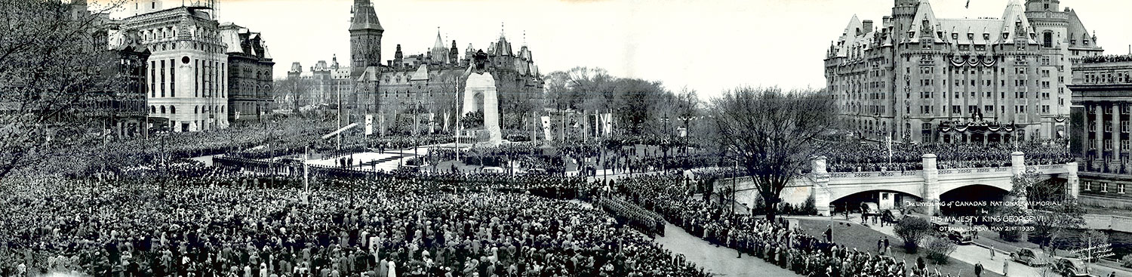
Evolution: Unveiling
The National War Memorial was unveiled on May 21, 1939.
100,000 Canadians gathered in the spring sunshine to witness the dedication.
King George VI spoke at the ceremony, describing the Memorial as a symbol of great truth
“Without freedom there can be no enduring peace,
and without peace no enduring freedom.”
Image: City of Ottawa Archives

Slide 10
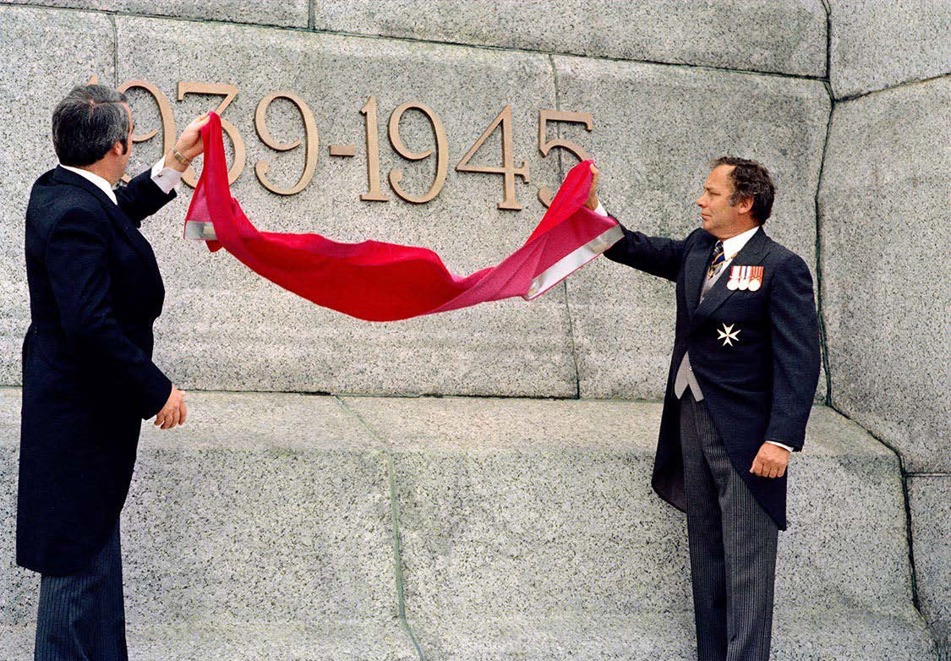
Evolution: 1982 Rededication
In 1982, Canada rededicated the National War Memorial to commemorate all Canadians who have served in war.
Two new date inscriptions were added to recognize the Second World War and the Korean War:
1939-1945
1950-1953
Image: Veterans Affairs Canada

Slide 11
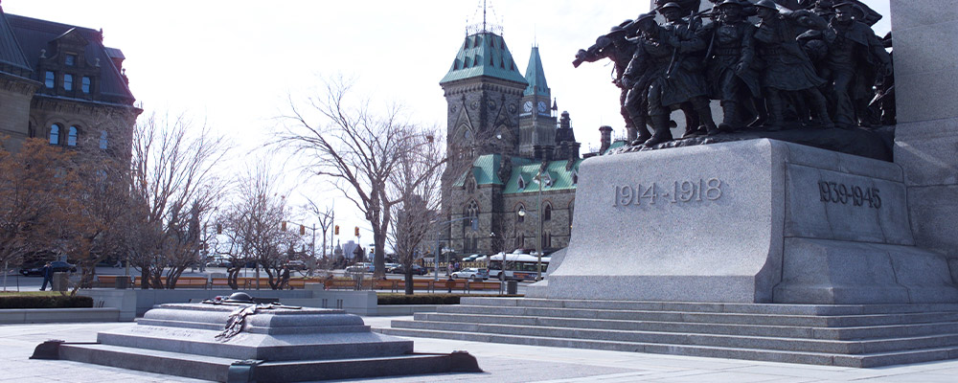
Evolution: Tomb of the Unknown Soldier
Added in 2000, placed directly before the Memorial.
Contains the remains of an unknown Canadian soldier recovered from a cemetery near Vimy Ridge, France.
The tomb symbolizes all Canadians with no known grave, giving families a place to mourn and remember.
Image: Veterans Affairs Canada

Slide 12
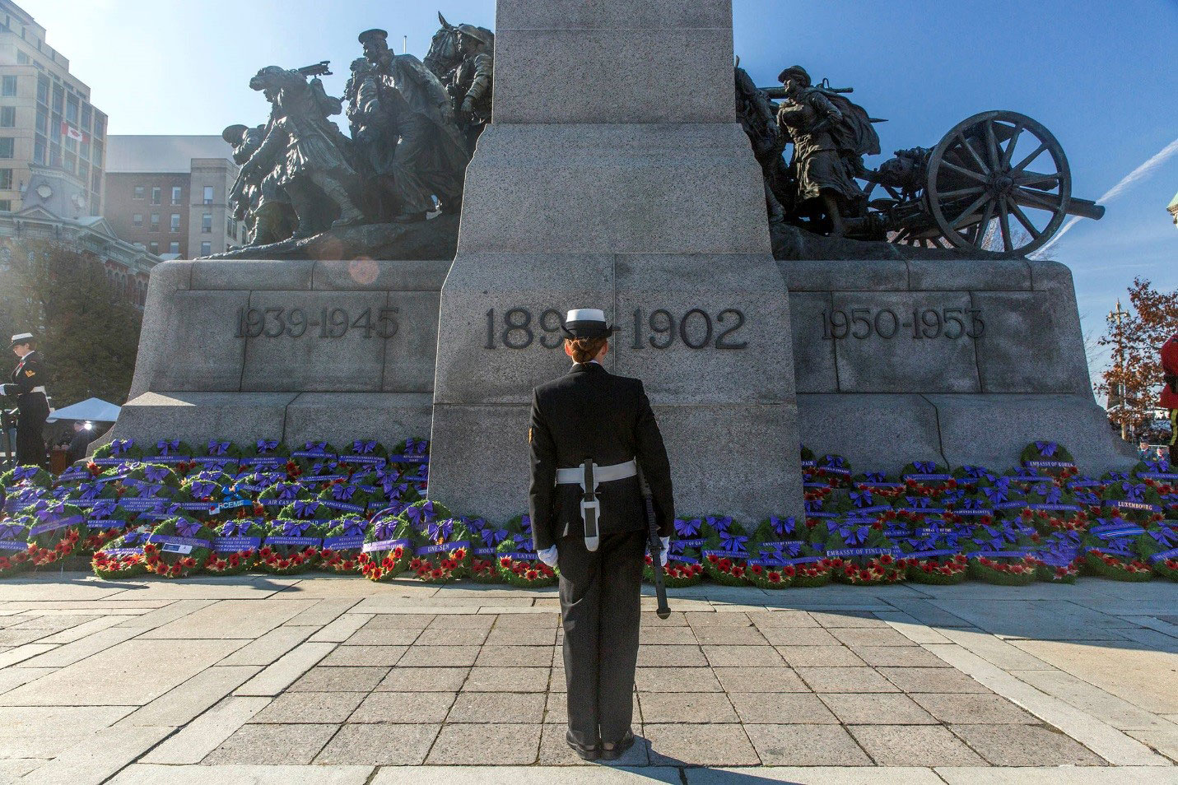
Evolution: 2014 Rededication
Two new date inscriptions were added to recognize the South African War (1899 to 1902), and Canada’s mission in Afghanistan (2001 to 2014):
1899-1902
2001-2014
Wording was also added to honour all Canadians who have served in uniform, past and present:
IN SERVICE TO CANADA
AU SERVICE DU CANADA
Image: Canadian Heritage

Slide 13
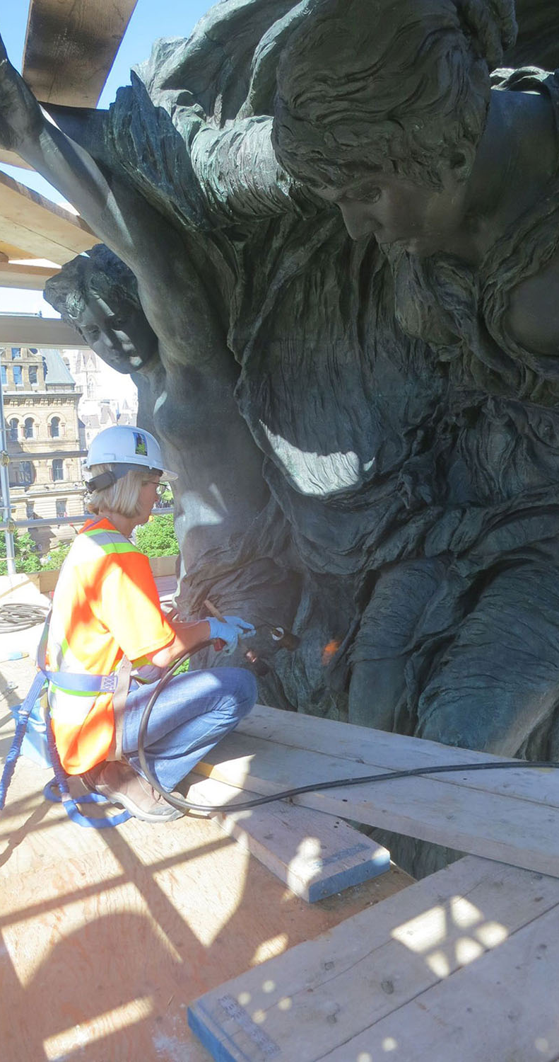
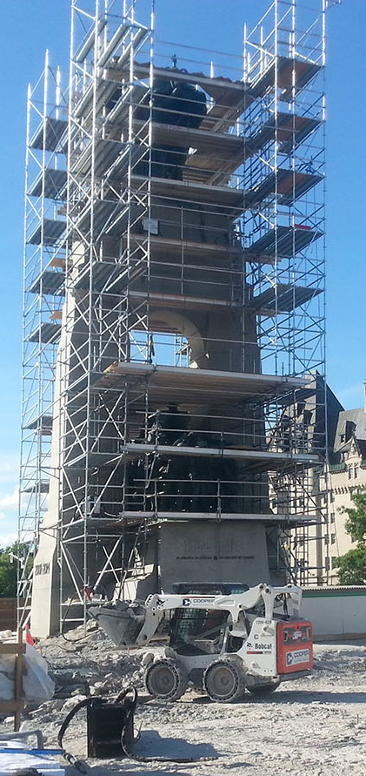
Evolution: Restoration
In 2016, the Government of Canada undertook a major restoration.
Work included:
  Replacing the concrete slab
  Cleaning and repairing the memorial
  Re‑waxing all bronze figures with a protective coating
Images: Public Services and Procurement Canada

Slide 14
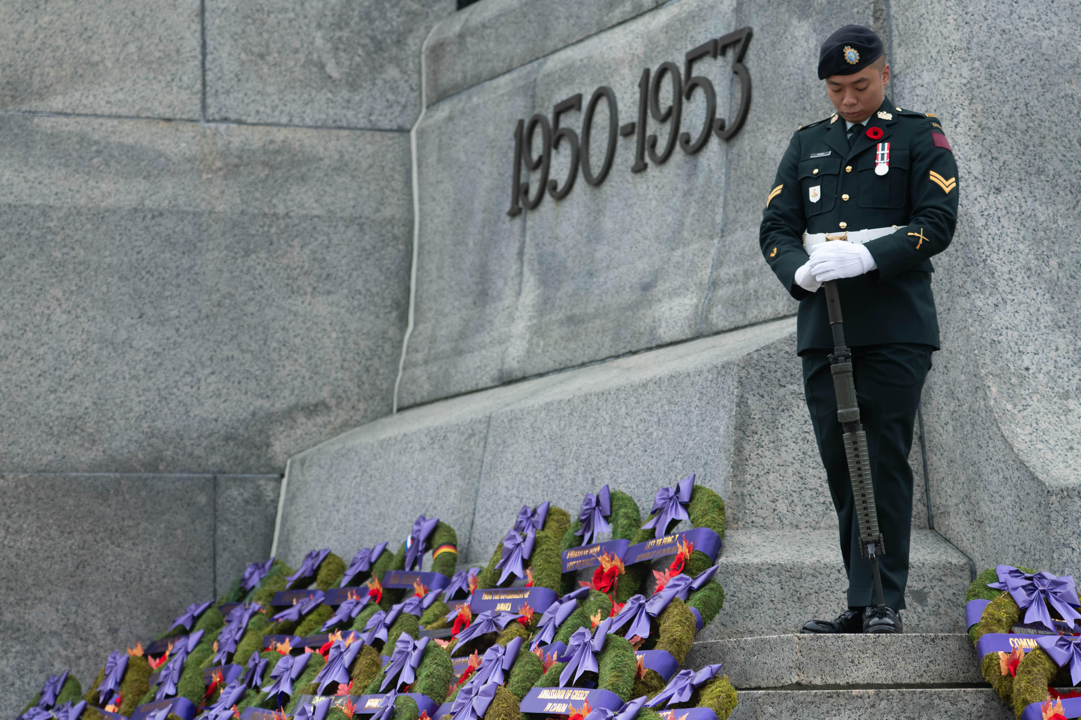
We will remember them
The National War Memorial reflects Canada’s evolving understanding of service and sacrifice.
Its design and inscriptions tell the story of Canadians who served across multiple conflicts and generations.
It stands as a national symbol of memory, gratitude, and identity.
Image: Veterans Affairs Canada

