Slide 1

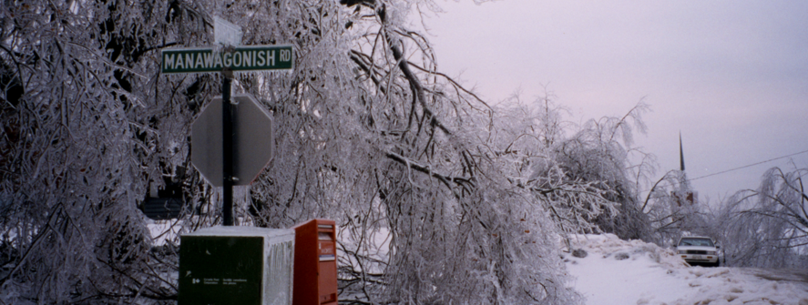
Saint John (New Brunswick) covered with ice in January 1998.
Be prepared for natural disasters

Slide 2
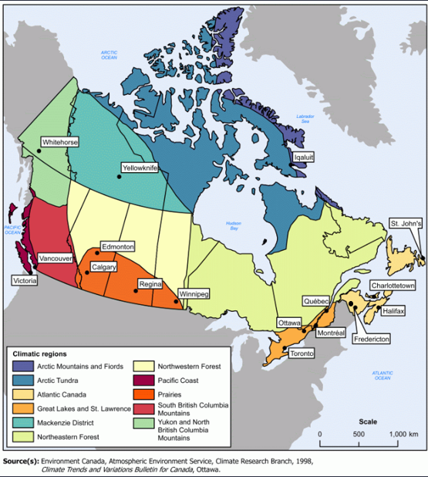
Canadian climate zones
Canada is a big country!
There are several different climate zones in Canada.
Many factors influence our climate.

Slide 3

Seasons in Canada
No matter where you live in Canada, each year you will experience the change of the seasons.
Each season has special activities…
Skiing
Going to a sugar shack
Bicycling
Picking apples

Slide 4
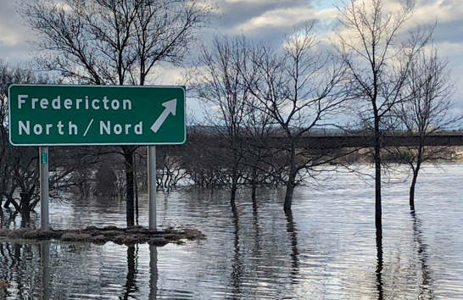
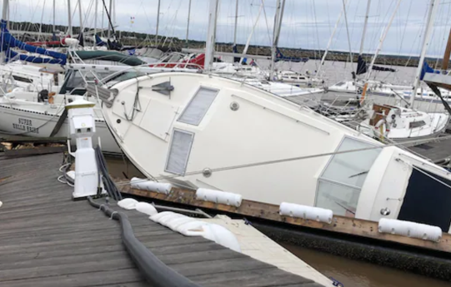
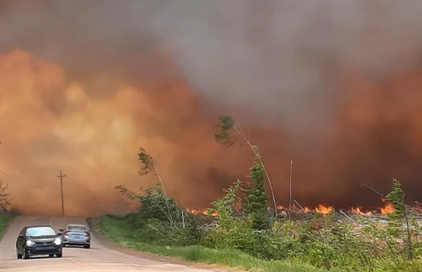
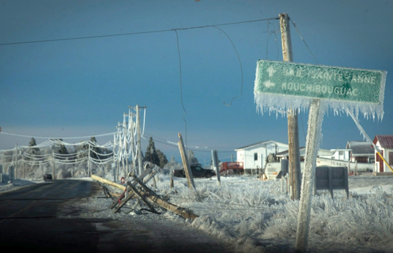
Seasons in Canada
Weather varies each day, but it is mostly predictable. We can plan what we will wear and what we will do based on the forecast.
But sometimes weather can be unpredictable. We can experience big challenges, like…
Floods
Hurricanes
Forest fires
Ice storms

Slide 5
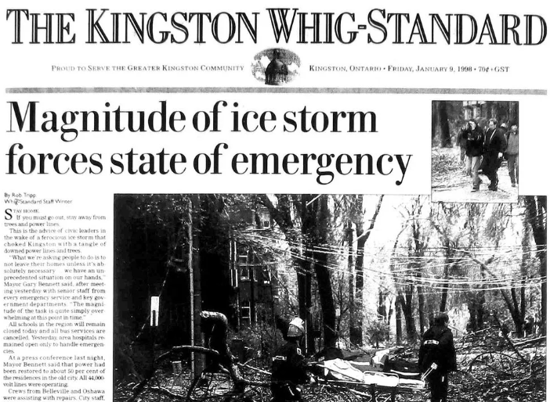
The Great Ice Storm of 1998
In January 1998, Eastern Canada was hit by the biggest ice storm in our country’s history.

Slide 6
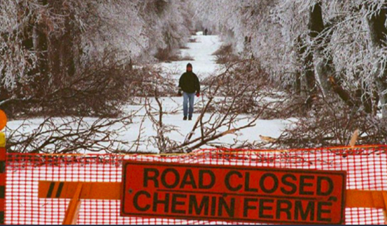
The Great Ice Storm of 1998
A devastating ice storm struck parts of Ontario, Quebec and New Brunswick.

Slide 7
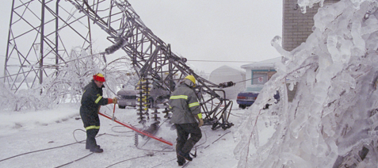
Utility poles and high-voltage towers were toppled.

Slide 8
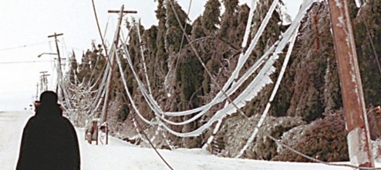
Four million people lost their power during winter.

Slide 9
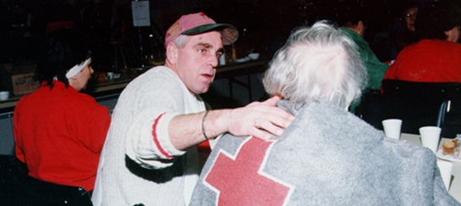
People needed help.

Slide 10
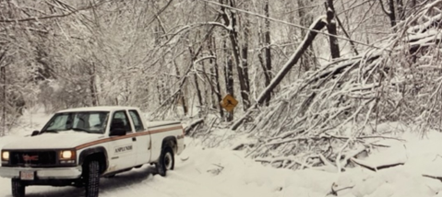
Fallen trees needed to be removed.

Slide 11
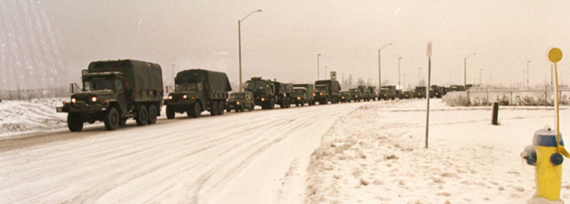
The Canadian Armed Forces responded.
Military trucks leaving CFB Gagetown to provide support after the Great Ice Storm of 1998.
Operation Recuperation was launched on 8 January 1998.
More than 15,000 regular and reserve force personnel from 200 units across Canada helped local authorities.

Slide 12
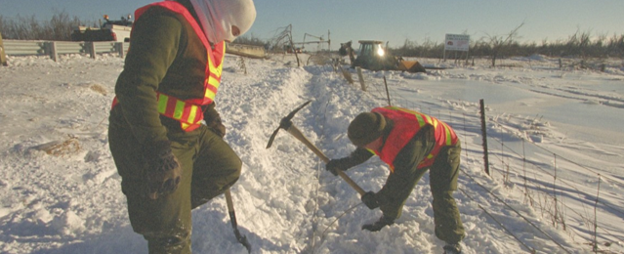
Canadian Armed Forces members helped restore power.
Canadian Armed Forces members help dig electrical lines buried in snow.

Slide 13
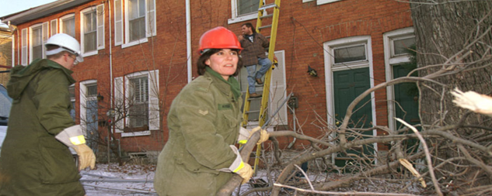
Soldiers helped clear debris and rescued stranded people.
Soldiers clearing broken tree limbs.

Slide 14
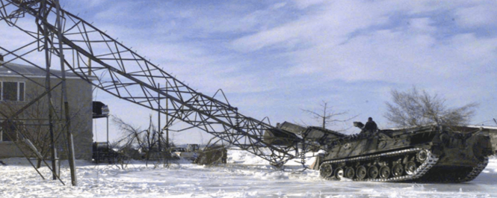
Military engineers and technicians helped repair downed power and telephone lines.
A military vehicle pulling a downed electrical tower.

Slide 15
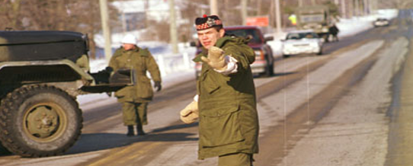
Soldiers helped police to maintain law and order.
A Canadian soldier directing traffic in Quebec after the 1998 Ice Storm.

Slide 16
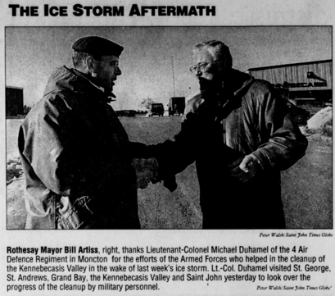
The population was thankful.
Rescued people did countless acts of kindness for those who were helping them after the 1998 Ice Storm.
Canadian Armed Forces members, civilian workers and volunteers were applauded, given coffee and cookies and offered heartfelt handshakes.

Slide 17
Why are we learning about the 1998 Ice Storm today?
No students in this classroom were born in 1998.
Your parents and teachers were likely very young in 1998!
There are many reasons to learn about the 1998 Ice Storm…
  It was a major event in Canadian history, affecting millions of people.
  The 1998 Ice Storm was a big catastrophe and could have turned out even worse.
  We should be thankful to those who helped people recover after the storm.
  We must learn from the past to be better prepared if a major event happens again.

Slide 18

Natural hazards in Canada
Canada is surrounded by three oceans, stretches across six time zones, and encompasses mountains, plains, forests and tundra.
Our weather patterns change often! They can go from heavy rains to drought and from numbing cold to heat waves.
When a natural hazard harms people and damages properties, the event becomes known as a disaster.

Slide 19









Natural hazards in Canada
Public Safety Canada lists many types of natural hazards that can affect our country:
Earthquakes | Floods | Hail
Icebergs, sea ice and fog | Landslides and avalanches | Tornadoes
Tsunamis and storm surges | Volcanic eruptions, fires | Winter Storms

Slide 20




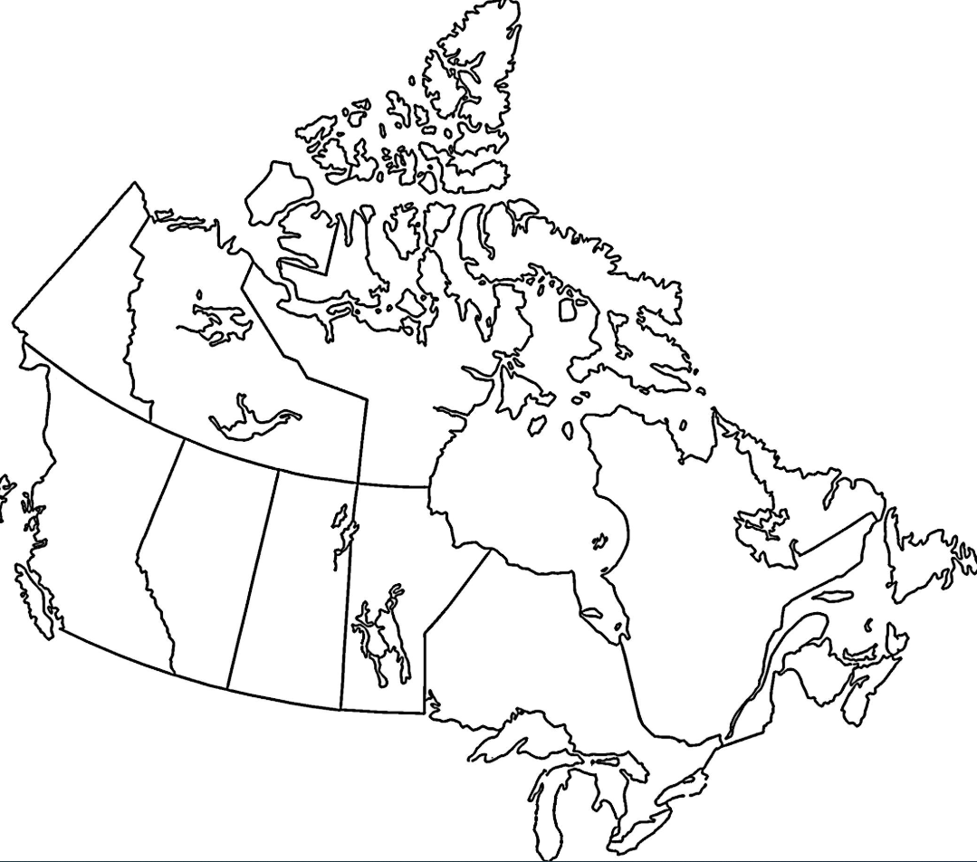
Canadian Veterans have helped many times
The Canadian Armed Forces uses the codename Operation Lentus for its responses to domestic natural disasters. Here are a few examples of where our Veterans have helped keep Canadians safe in recent years:
2014: Manitoba - Flooding
2015: Saskatchewan - Wildfires
2016: Alberta - Wildfires
2017: Quebec - Flooding
2018: Ontario - Flooding
2019: New Brunswick - Flooding
2020: Newfoundland and Labrador - Snowstorm
2021: Yukon - Flooding
2022: Prince Edward Island, Nova Scotia - Hurricane
2023: British Columbia - Wildfires
2024: Alberta - Wildfires
Pictograms: Flaticon

Slide 21
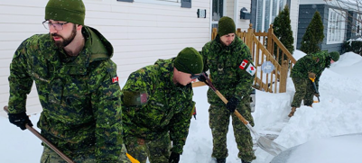
Op Lentus 2020 - Newfoundland and Labrador snowstorm
Canadian Armed Forces members helping with snow removal.

Slide 22
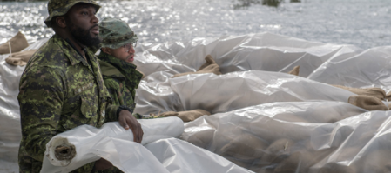
Op Lentus 2021 – Yukon floodings
Canadian Armed Forces members waterproofing sandbags barriers.

Slide 23
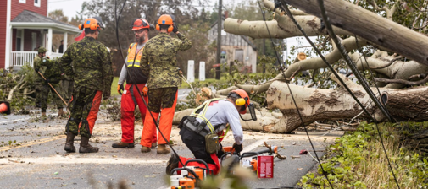
Op Lentus 2022 – Nova Scotia hurricane
Canadian Armed Forces members removing fallen trees.

Slide 24
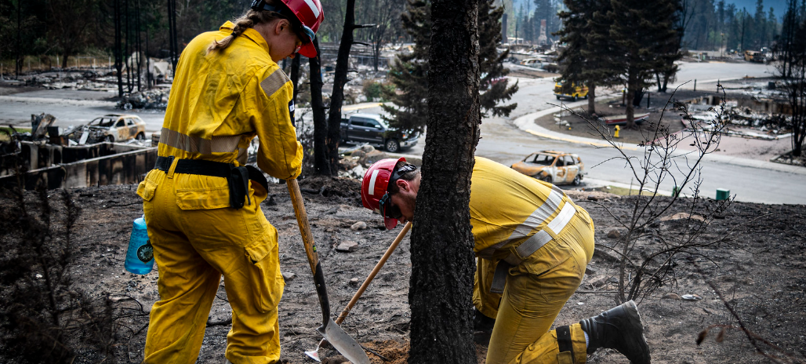
Op Lentus 2024 – Alberta wildfires
Canadian Armed Forces members clearing out hot spots.

Slide 25

Being prepared for an emergency
When a natural disaster hits, you may not be able to solve the problem by yourself. But being prepared helps!
One way you can be ready is by assembling an emergency kit at home!
?
What should you include in an emergency bag?
Be prepared! Be ready! Stay safe!

