Slide 1
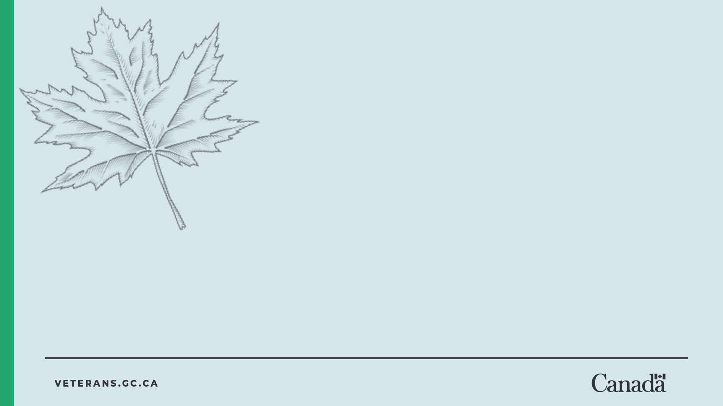
Decoding war memorials
Every memorial tells a story...
Notes:
Teacher Notes
Explain that decoding means figuring out meaning by looking closely
Emphasize that memorials are carefully designed to communicate ideas
Ask: What might a memorial be trying to say?

Slide 2
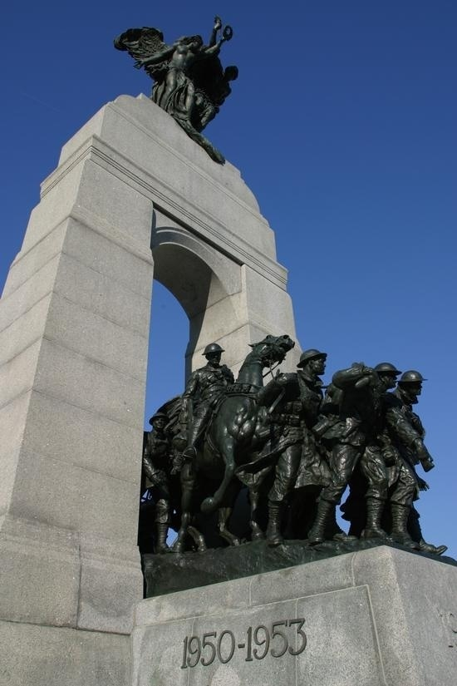
What is a war memorial?
A war memorial is something created to honour and remember
brave people who died as a result of their military service
important events in Canada’s military history
National War Memorial
Notes:
Teacher Notes
Emphasize honour + remembrance as the purpose
Ask: What details on this memorial show it is a place for remembering?

Slide 3
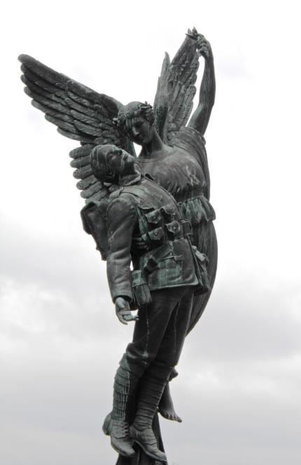
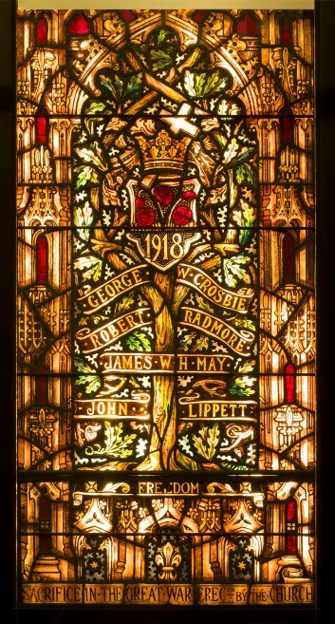
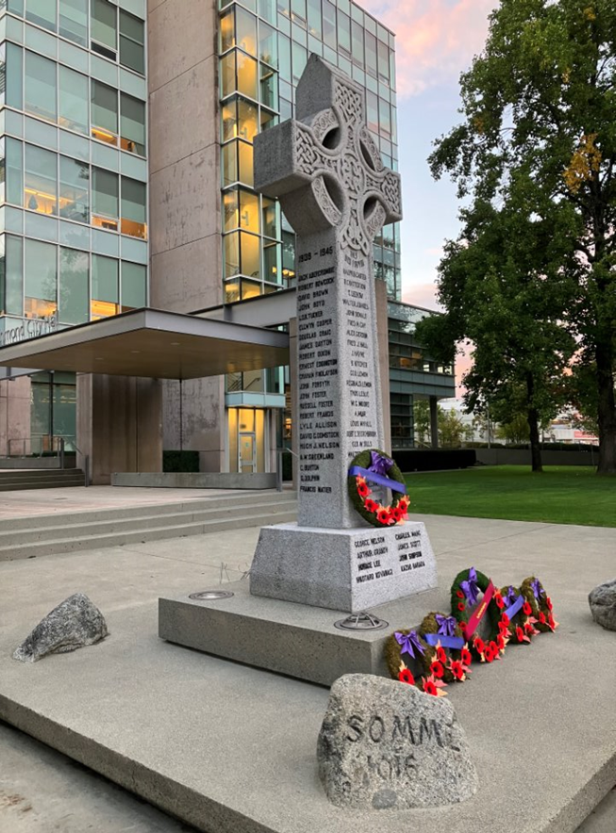
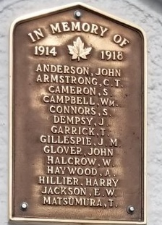
War memorials take many forms
War memorials are found in communities across Canada and around the world.
They can look very different, for example:
plaques with names
statues or monuments
crosses or cenotaphs
stained glass windows
parks, bridges or schools
Each memorial tells a story in its own way.
Winged Victory
Zion Memorial Window
Richmond Cenotaph
Cumberland Memorial Arch
Notes:
Teacher Notes
Emphasize that memorials can look different but share a common purpose
Ask: What details help you understand what each memorial represents?
Ask: How does the design change what you notice or feel?

Slide 4
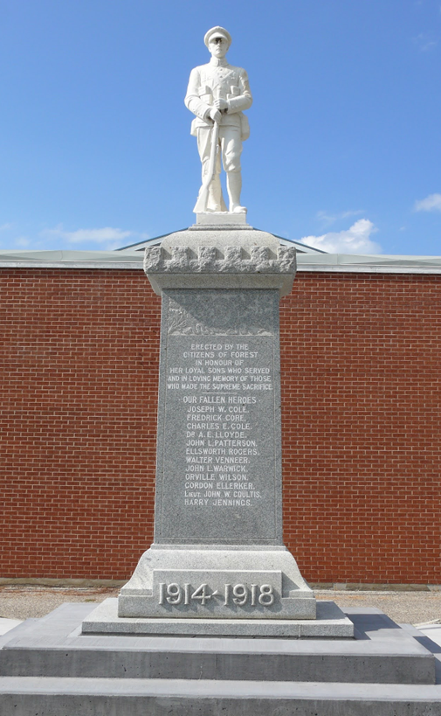
Remembering in our community
Many communities have their own memorials.
These memorials often:
honour local people who served
include names from the community
are places people gather on Remembrance Day
They help us connect history to where we live.
Forest Cenotaph
Notes:
Teacher Notes
Connect to a local example, if possible. Consider updating this slide with an image of a memorial or cenotaph in your community.
Ask: Why is it important to remember people from our own community?
Ask: How might this feel more personal than a national memorial?

Slide 5
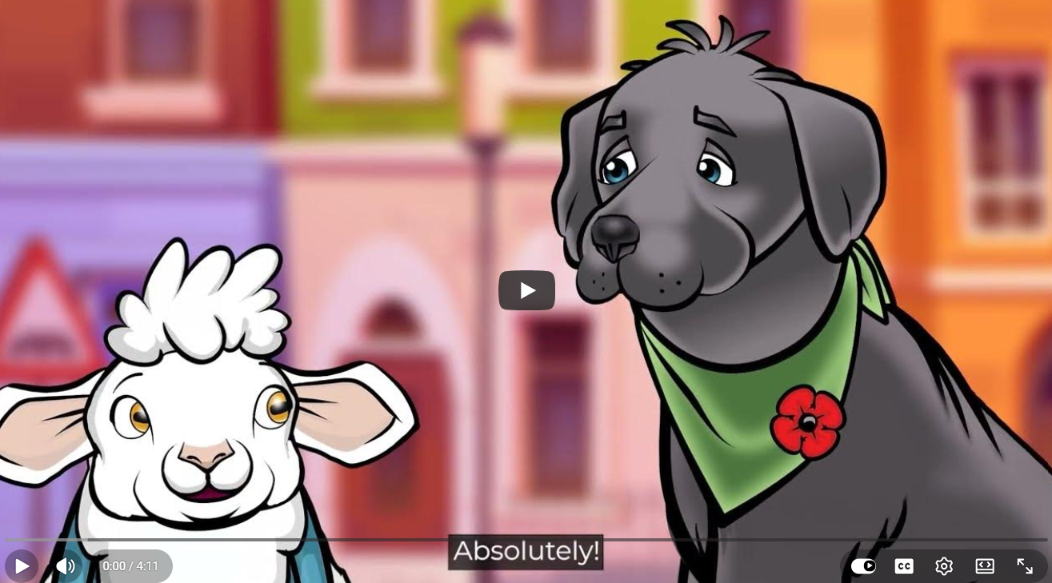
Let’s watch a video to learn more about memorials!
Notes:
Teacher Notes
Set a clear viewing purpose: Noticing details and thinking about the design of each memorial
Remind students they will use what they see later
Optional: Pause the video at the end of a memorial segment and ask students to share one detail they noticed
Video links:
EN: https://youtu.be/Jud06elFFew
FR: https://youtu.be/vkqYmkdWlbo

Slide 6
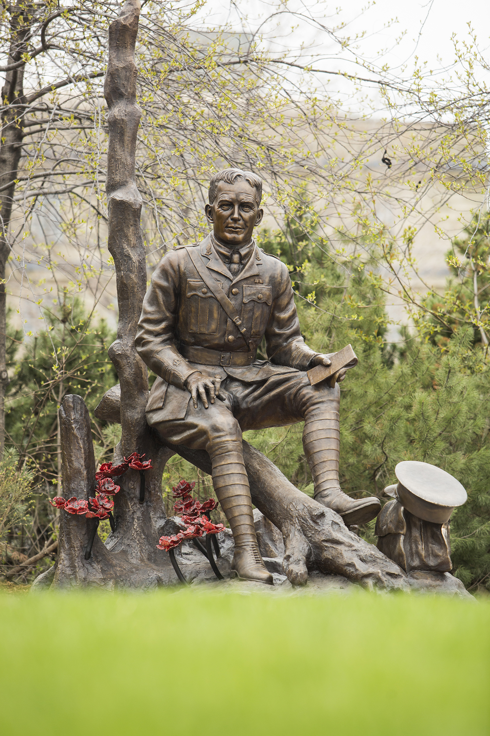
Every memorial tells a story…
Memorials help us remember real people.
Each name represents a life, a family and a story.
Memorials help us learn about the past.
They remind us of events that changed lives.
Remember Flanders
Notes:
Teacher Notes
Emphasize that each name represents a real person
Ask: Why is it important to remember individuals, not just events?
Ask: How can a memorial help us understand the past?

Slide 7
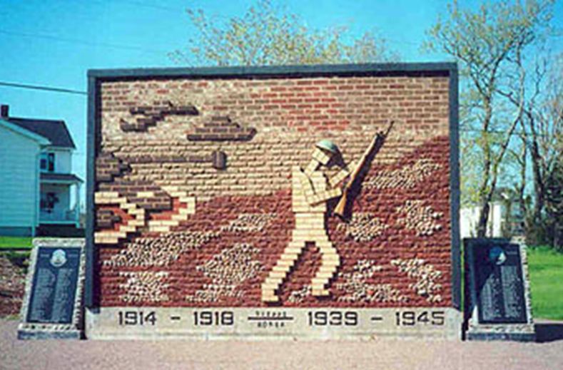
Decoding war memorials as art
To understand a memorial, we need to look closely at its design.
This is called decoding.
When we decode a memorial, we look at:
symbols
shapes and figures
words, names and dates
materials and details
These features help us understand the story the memorial is telling.
Dieppe Cenotaph
Notes:
Teacher Notes
Explain that decoding is looking for clues to understand meaning
Emphasize that different people may notice different details
Ask: What kinds of clues might artists include in a memorial?

Slide 8
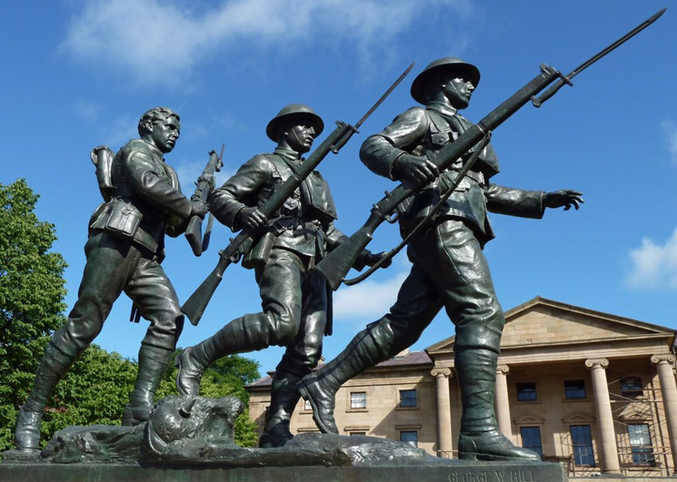
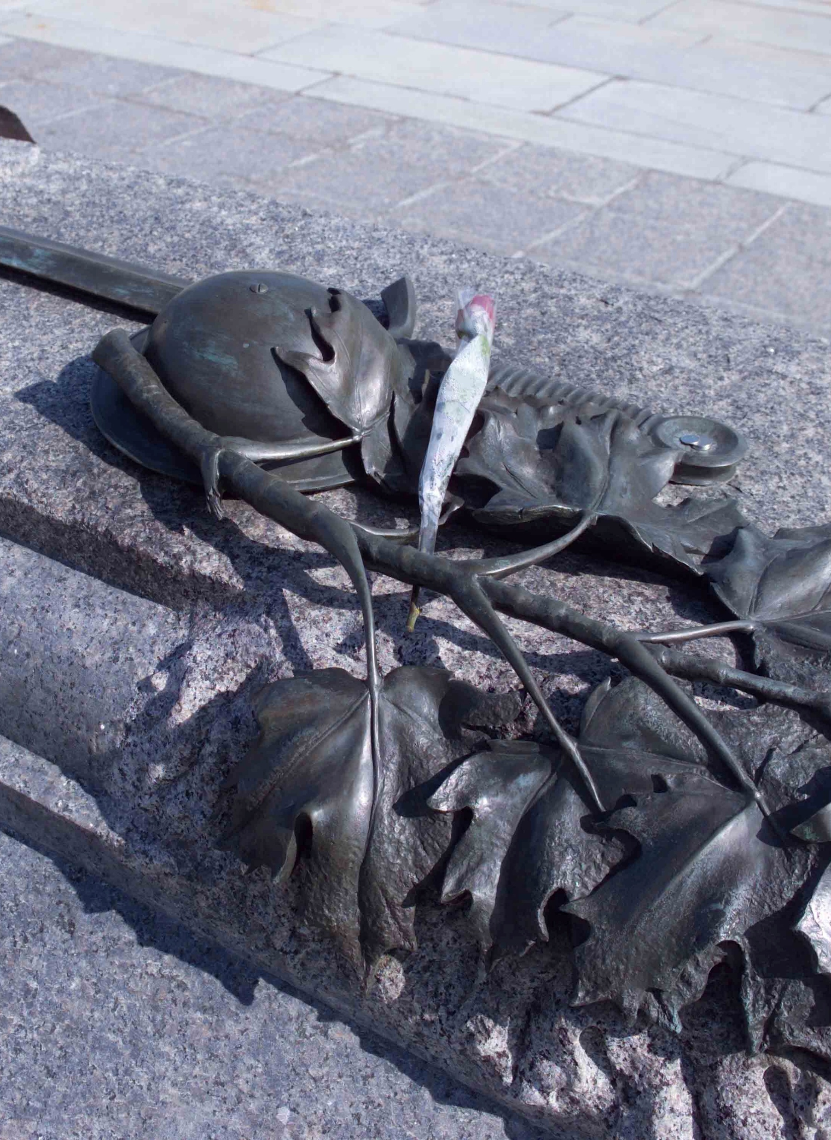
What designs can mean
Memorials use design to share ideas and tell stories.
For example:
A statue may represent those who served
A poppy can represent remembrance
A helmet or sword can show war or conflict.
Names tell us who is remembered
Dates, places or uniforms tell us about events
Materials (like stone or bronze) might be local
or have a special meaning
A wreath can represent remembrance
Tomb of the Unknown Soldier
Notes:
Teacher Notes
Highlight that every design choice is intentional
Transition: Students will now apply this thinking to real memorial examples…

Slide 9
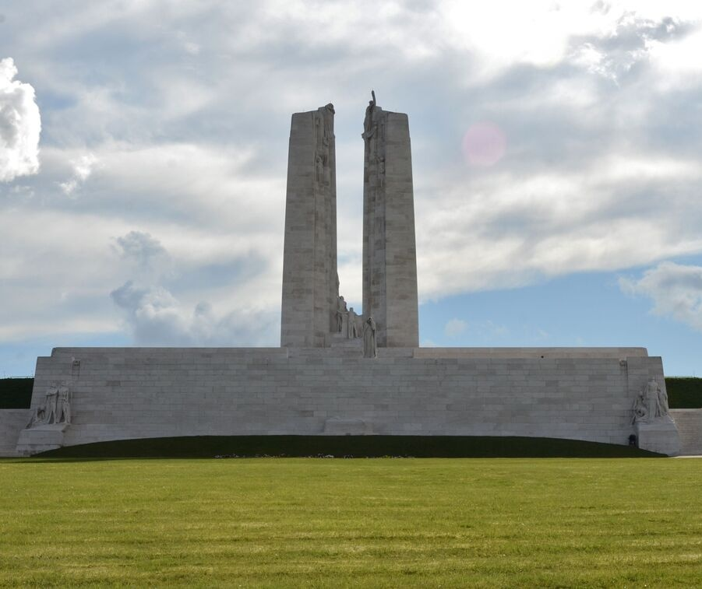
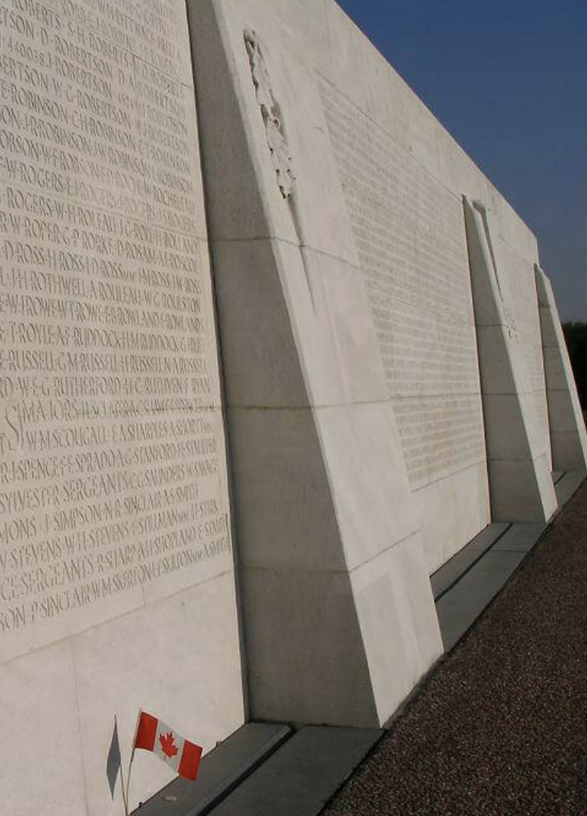
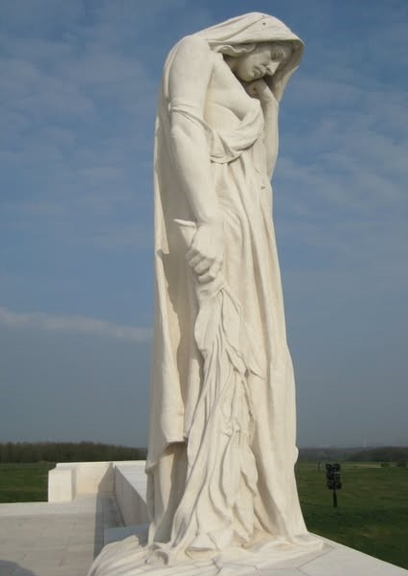
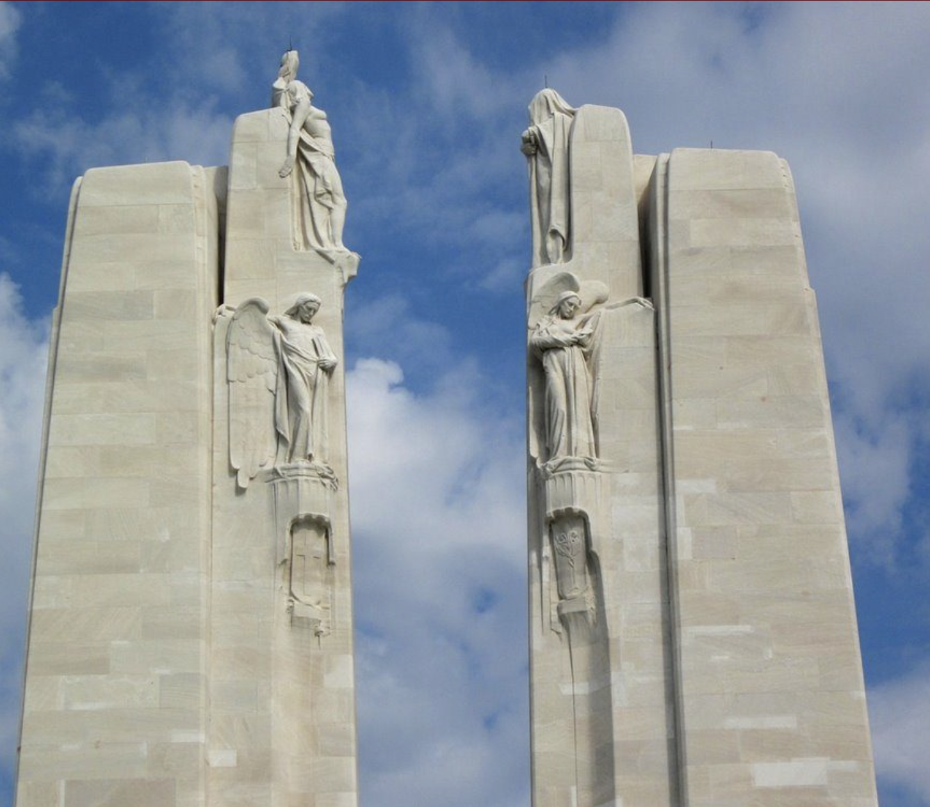
Decoding the Canadian National
Vimy Memorial
What story does this memorial tell?
People
Over 11,000 names are carved on its base. Each one represents a Canadian soldier who died.
Friendship
The two large towers stand for Canada and France, brought together by shared loss and remembrance.
Courage and belief
There are 20 statues on the memorial. They represent ideas like sacrifice, loss and the values Canadians fought to defend.
Sadness
The statue of Mother Canada tells the story of grieving families and communities at home.
Canadian National Vimy Memorial
Notes:
Teacher Notes
Connect each feature to a specific meaning or idea
Emphasize how multiple elements work together to tell a layered story
Reinforce that memorials can show both pride and loss at the same time

Slide 10
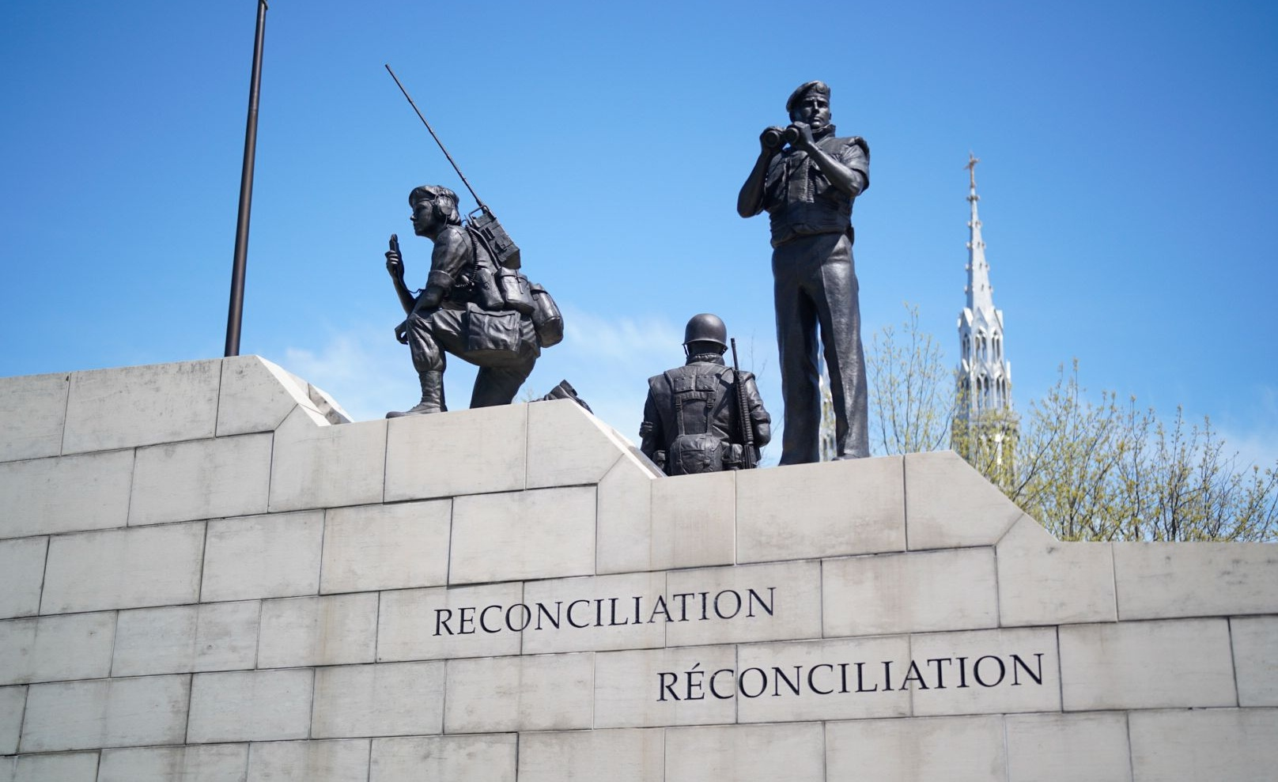
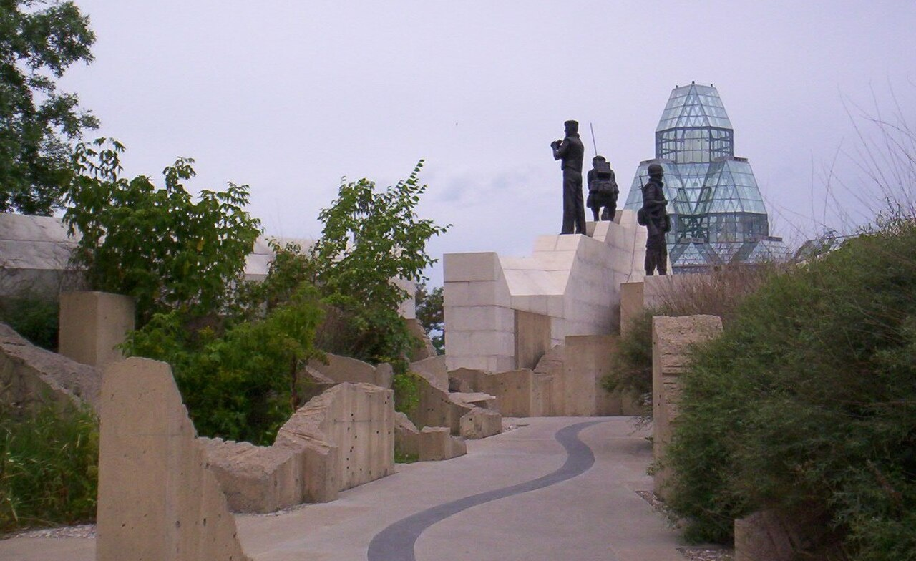
Decoding the Peacekeeping Monument
What story does this memorial tell?
Conflict
Broken concrete walls represent the damage and destruction of war
Moving forward
The path becomes smoother, showing a move toward peace
People
Three peacekeepers represent Canadians working to bring stability and help others
Unity
Twelve oak trees represent Canada’s provinces and territories at the time it was built
Reconciliation: The Peacekeeping Monument
Notes:
Teacher Notes
Emphasize the idea of a journey or transition in the design
Highlight how the structure physically shows movement from war to peace
Reinforce that memorials can represent actions and roles, not only loss
For a deeper dive, watch the Heritage Canada video Decoding Art – Reconciliation: The Peacekeeping Monument (youth version)

Slide 11
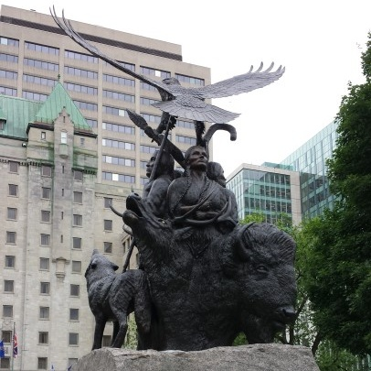
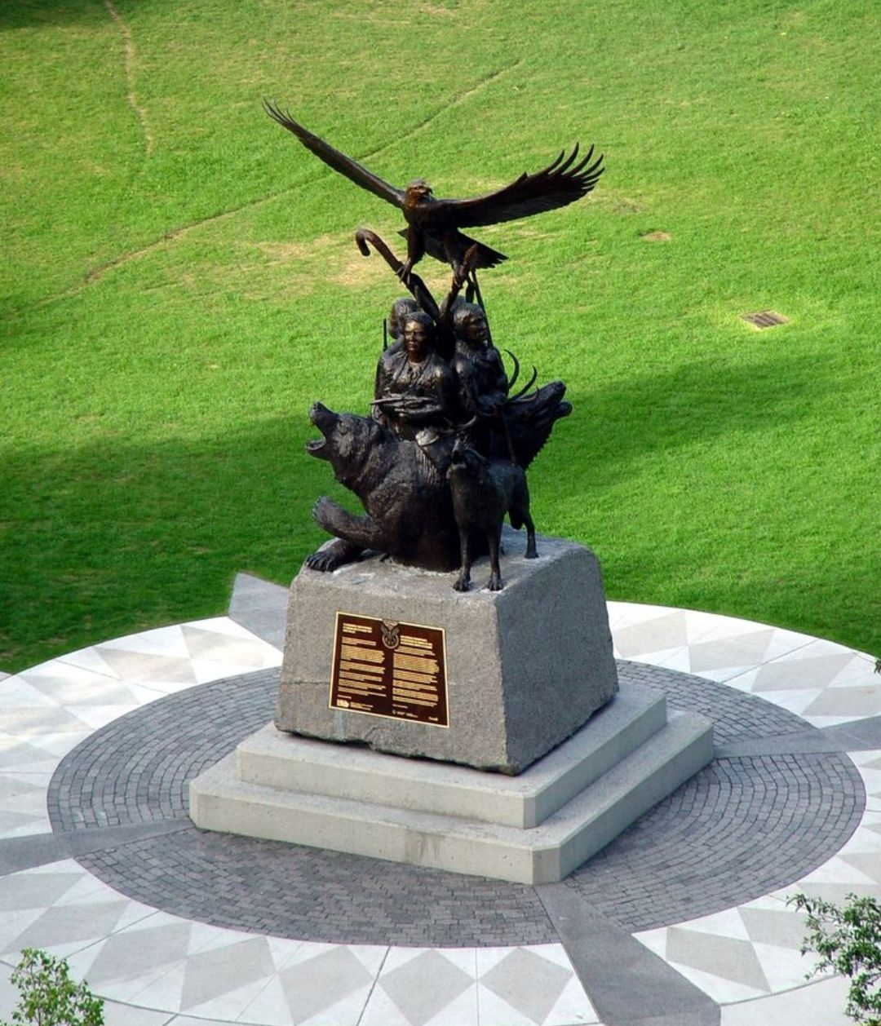
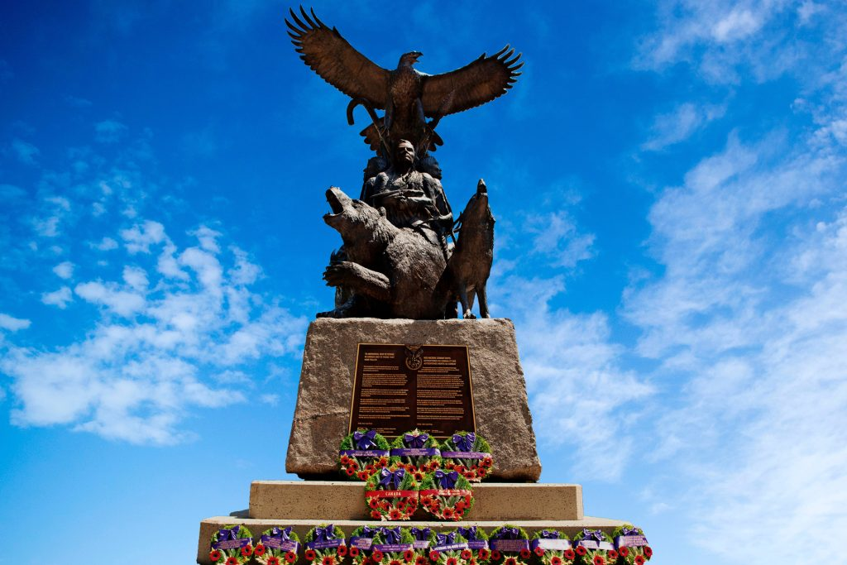
Decoding the National Aboriginal Veterans Monument
What story does this memorial tell?
Recognition
Honours First Nations, Métis, and Inuit people who served in the Canadian Armed Forces
Balance
Two figures hold weapons, and two hold spiritual objects, showing both service and cultural traditions
Guidance
An eagle sits at the top, representing vision and connection
Respect for nature
Animal figures represent strength, support, and spiritual guidance
This memorial reflects military service and cultural identity.
National Aboriginal Veterans Monument
Notes:
Teacher Notes
Highlight that this memorial includes cultural and spiritual meaning
Emphasize the importance of recognizing diverse experiences and contributions
Reinforce that memorials can reflect different perspectives and traditions
For a deeper dive, watch the Heritage Canada video Decoding Art – National Aboriginal Veterans Monument (youth version)

Slide 12
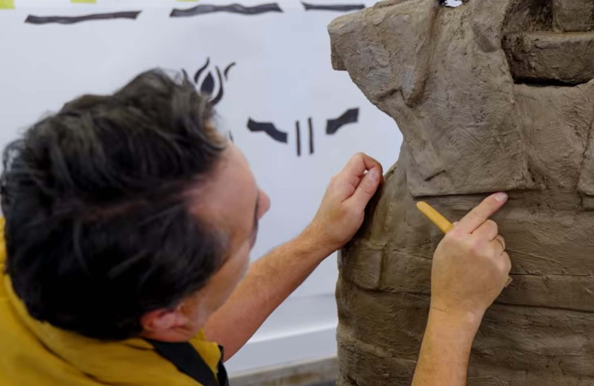
You be the designer
If you designed a monument to honour Canadians in uniform, what would it look like?
Think about:
who or what you want to remember
the story you want to tell
the message for others to understand
Let’s brainstorm topics for our memorial.
Complete these sentences before you begin:
My memorial is about ______.
It is important to remember because ______.
Designer Adrian Stimson works on a model for the
National Monument to Canada’s Mission in Afghanistan
Notes:
Teacher Notes
This is an optional activity
Frame it as applying what students have learned
Adjust the complexity of the activity according to age and ability.
Encourage students to think about how their design will be understood by others
Help students narrow their ideas by offering clear options, such as:
A new or redesigned memorial for local war dead
A memorial honouring the service and sacrifice of a group, such as
members of the army, navy or air force
Women Veterans
Veterans of a particular conflict
A new National War Memorial
A memorial to animals who served in war (this can be a good option for younger students)
For a deeper dive, show students the video

Slide 13
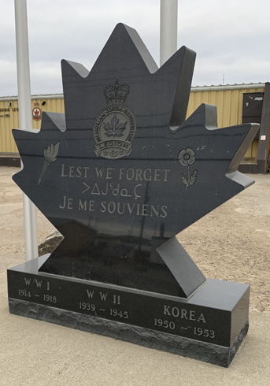
What should your memorial include?
Symbols that represent your ideas
Statues of people or animals
Names or dates to show what or who is remembered
Materials like stone, metal or glass that help show meaning
Iqaluit Veterans Memorial
Notes:
Teacher Notes (brief)
Designs can be drawn or made on the computer
Encourage students to include at least one symbol and one figure
If students are stuck…
Ask: What is the most important idea you want people to understand? What could you add so someone understands that without you explaining it?

