Slide 1

A special place to remember
Every memorial tells a story...
Notes:
Use this presentation to help your students:
Understand that war memorials help us remember people who served in times of war and peacekeeping
Learn that by visiting war memorials we are showing care about our past
Learn from the stories memorials tell

Slide 2

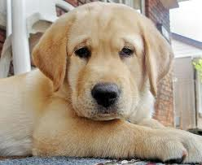
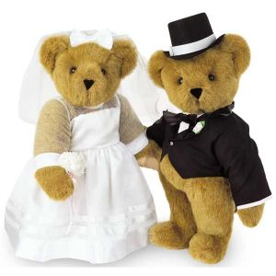
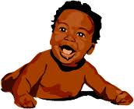
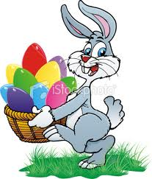
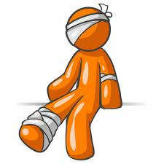
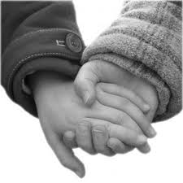
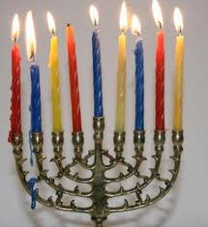
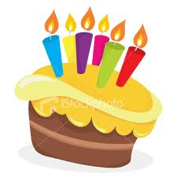
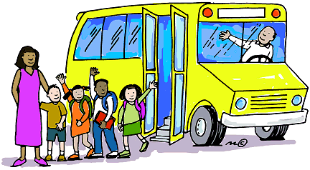



What is remembering?
We remember when we think about something important from the past.
We remember:
people we love
special days
happy moments
important events
things we learned
Notes:
Teacher Notes
Introduce the idea of remembering important moments
Ask: What kinds of things do we remember and why?
Use familiar examples to support student thinking, such as:
a fun holiday
a birthday
getting a family pet
seeing a new baby
first day of school
hurting yourself
a special birthday
holding hands with someone you love
learning to read
going to a movie
We remember vacations or holidays because they are fun times with family and friends.
We remember friends and family birthdays to make them feel special!
We remember things we do for the first time, like going to school, reading, or tying our shoelaces.

Slide 3


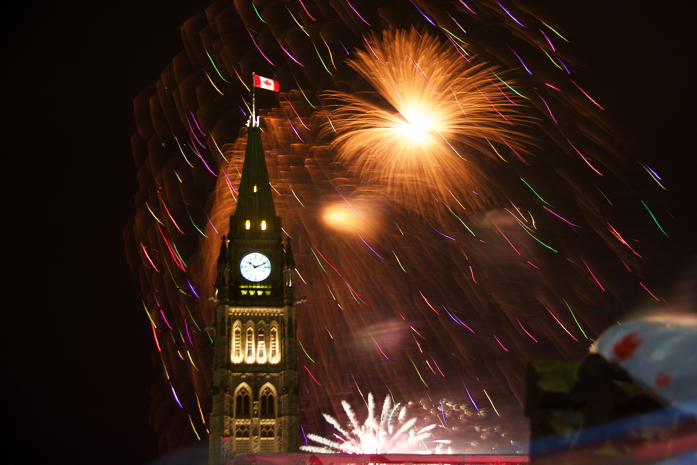
Countries remember important things too!
Canada remembers important people, events and stories from the past.
Example:
Every year on July 1 we
celebrate Canada’s birthday.
We call it Canada Day.
Notes:
Teacher Notes
Introduce that countries remember important events too
Ask: How do people celebrate Canada Day?
Connect to shared celebrations and traditions, such as:
parades
fireworks
barbecues with family
wearing or carrying Canada flags

Slide 4
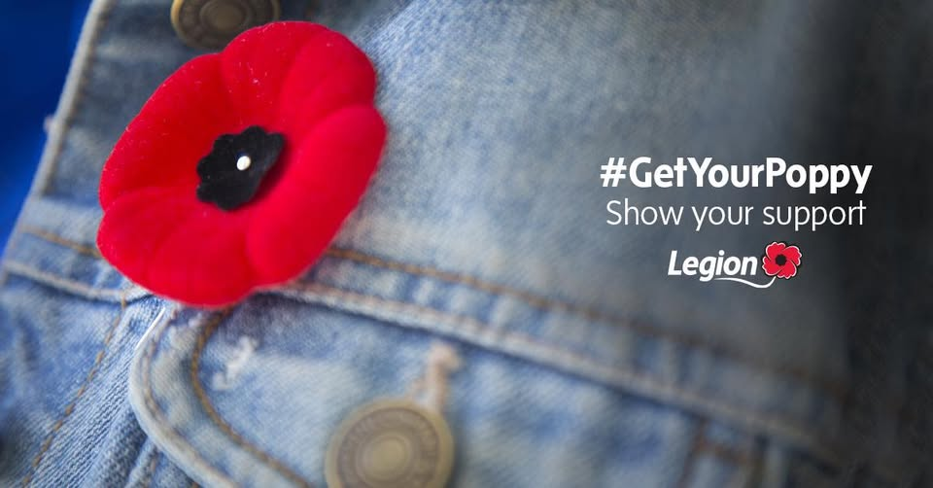
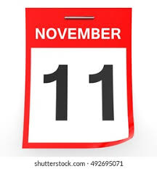
A special day to remember
Remembrance Day is a special day that helps us remember.
It happens every year on November 11.
We remember and thank the people who served in Canada’s military.
One way we remember is by wearing a poppy!
Notes:
Teacher Notes
Explain that Remembrance Day is a time to remember and give thanks
Connect to students’ prior experiences if possible
Ask: What are some ways people remember on this day?
Examples:
attend a Remembrance Day ceremony
listen to music
take a quiet moment to think
make a piece of art
write a thank you card or draw a picture

Slide 5
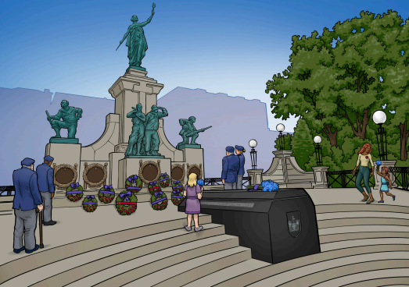
A special place for remembering
A memorial is a special place that helps us remember.
We visit memorials to remember brave people and important events.
Each memorial tells a story about who or what we are remembering.
Notes:
Teacher Notes
Define a memorial as a special place for remembering
Explain that memorials can be statues, gardens, plaques or even buildings, like a school.
Ask: What do you notice about the memorial in this photo? (i.e., how many statues, wreaths, etc.)
Reinforce respectful behaviour at memorials
Older students:
If your students are ready for it, introduce the concept of a memorial as a way to remember someone who died.
Ask if anyone in class has lost a pet or a family member, such as a grandparent. How do they remember? A headstone in a cemetery is a type of memorial.

Slide 6
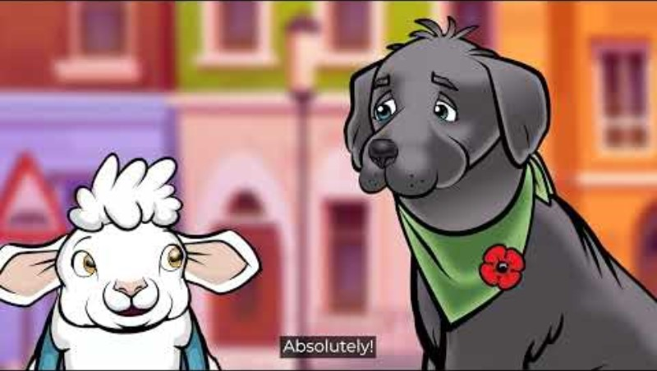
Let’s watch a video to learn more about memorials!
Notes:
Teacher Notes
Set a clear viewing purpose: Choose your favourite memorial design
Video links:
FR: https://youtu.be/vkqYmkdWlbo
EN: https://youtu.be/Jud06elFFew

Slide 7
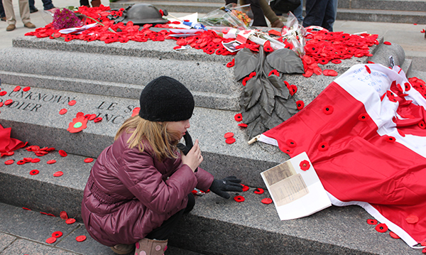
What did we learn?
Memorials help us remember important people and events.
They come in many shapes and sizes.
Each one tells a different story.
Memorials are places where we can:
say thank you
think about kindness
learn about helping others
remember the importance of peace
Notes:
Teacher Notes
Review that memorials help us remember people and events
Ask: Is there a memorial in our community?
Connect to local Remembrance Day ceremonies

