Slide 1

Symbols of remembrance
Notes:
This presentation is a broad overview of ways we can remember and recognize those who have served our country over the years. Additional details can be found in the notes section for each slide.
More information on this important subject can be found on the Veterans Affairs Canada website at www.veterans.gc.ca/en/remembrance

Slide 2
National war memorials
Notes:
Canadian National Vimy Memorial.
National War Memorial.
National Aboriginal Veterans Monument.
Artist’s rendering of new National Monument to Canada's Mission in Afghanistan.

Slide 3
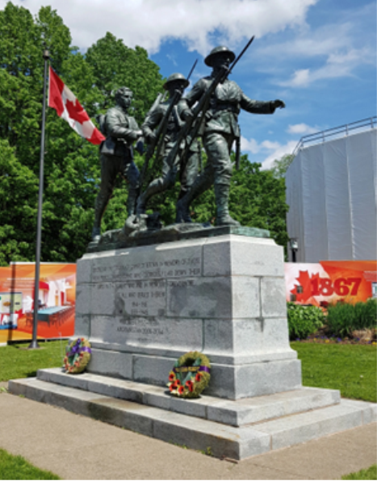
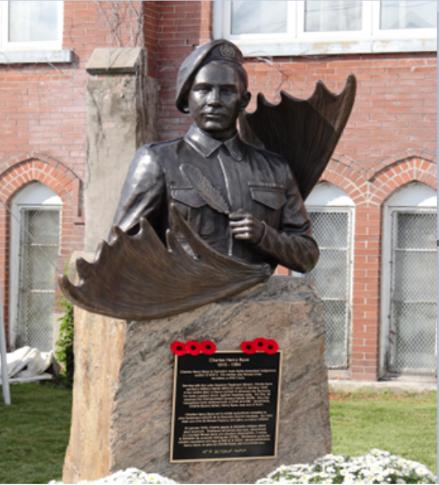
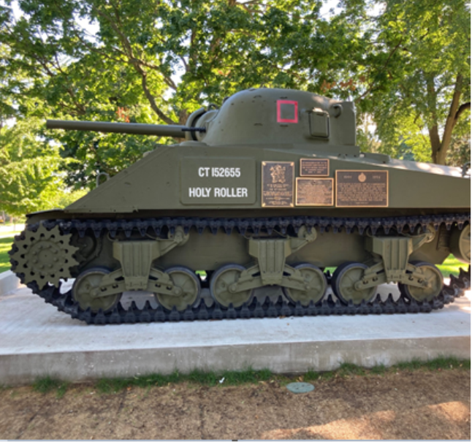
Symbols of remembrance
Notes:
Cenotaph in Charlottetown, PEI.
Monument to Cree soldier Charles Byce in Chapleau, Ontario.
Monument to 1st Hussars in London, Ontario.

Slide 4
Poppies and wreaths
Notes:
Poppies are a traditional symbol of remembrance in Canada and many other countries around the world.
Poppies incorporating Indigenous styles are a powerful spin on the classic poppy symbol.
Wreaths are often laid at memorials to recognize those who gave their lives in service.

Slide 5
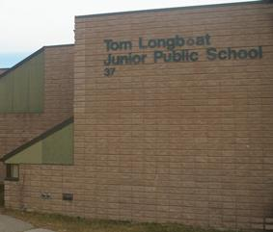
Names of communities, streets, schools and sports centres
Notes:
The Cayuga Memorial Arena in Cayuga, Ontario.
Tom Longboat Junior Public School in Toronto.

Slide 6
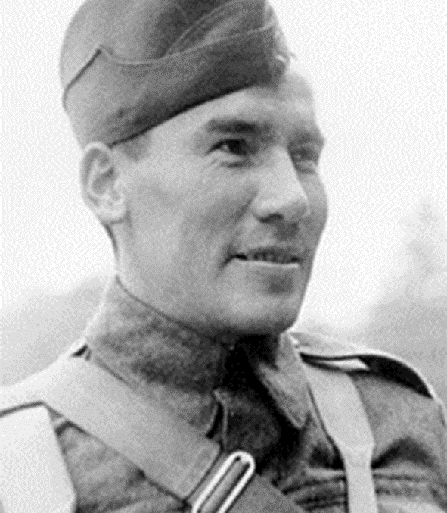
Names of lakes and mountains
Notes:
Dreaver Lake in Saskatchewan was named after Harvey Dreaver who died in the Second World War.
Mount Kerr in British Columbia is named John Kerr, a soldier from Nova Scotia who earned the Victoria Cross during the First World War.

Slide 7
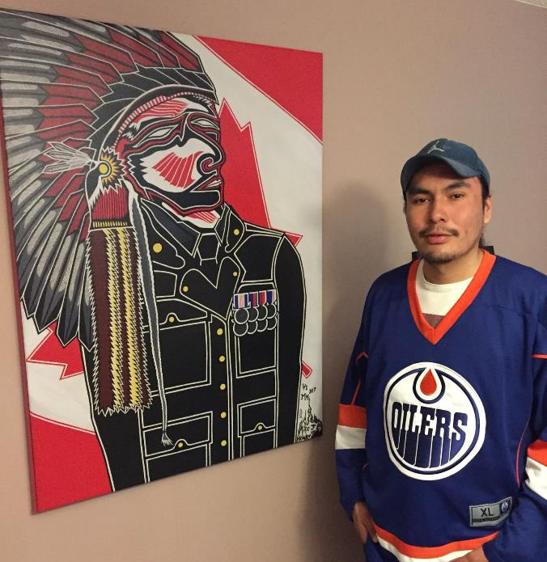
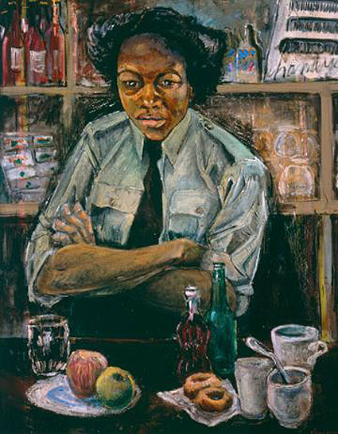
Remembrance art
Notes:
Mike Holden of Saskatchewan’s Cote First Nation is a visual artist and actor who now lives in Edmonton.
The Saulteaux Cree artist painted Dreaver in 2010. The painting is now in the collection of the Canadian War Museum.
Image:
Canadian War Museum, CWM 20180556-001
Molly (Lamb) Bobak was the first official Canadian war artist.
She painted Private Roy, Canadian Women's Army Corps in 1946.
Image:
Canadian War Museum CWM19710261-1626

Slide 8
Ceremonies and events
Notes:
Candlelight tribute ceremonies with youth.
Poster for the “Alex Decoteau remembrance run, walk or wheel” event.

Slide 9
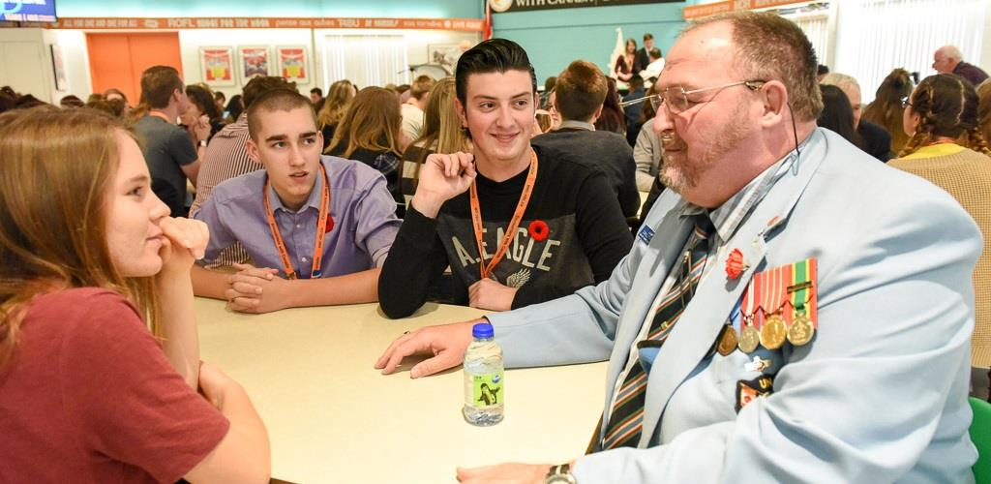
Listening to Veterans and thanking them
Notes:
Youth talking with a Veteran during a special meal in Ottawa.

Slide 10
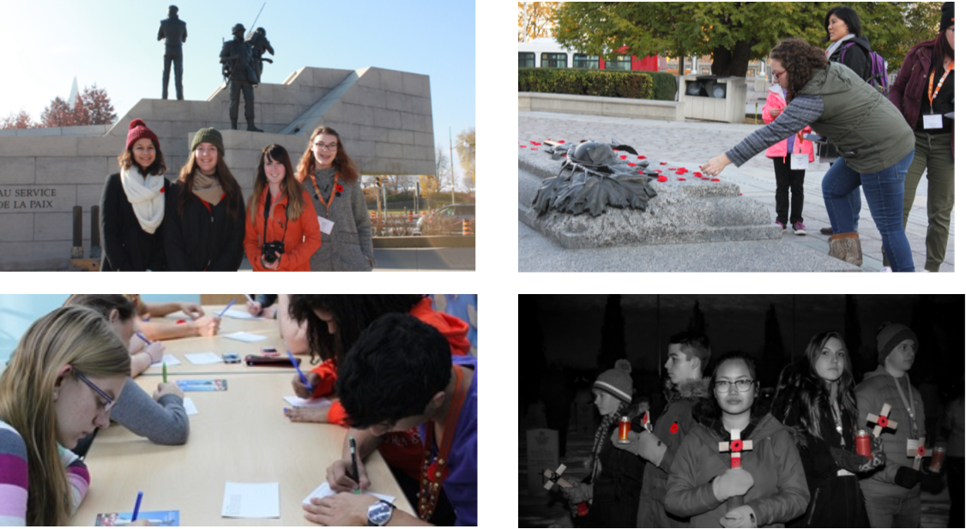
How will you remember
and recognize those who served?
Notes:
There are so many ways to honour those who have put their lives on the line to help others. What will you do to show we care?

